Slide 1

**
General English Language
Dr. Mohamed Fathi
King Faisal University
e- Learning Deanship
& Distance Education

Slide 2
Sixth Lecture
Grammar – Vocabulary – Reading
Chapter 4-5

Slide 3
Elements of the Lecture
1.. Present Progressive Tense
2. Non-Action Verbs
3. Negative Form of Present Progressive
4. Forming Questions with Present Progressive
5. Spelling of Progressive Tense
6. Comparison: Simple present vs. present progressive

Slide 4
2.The Present Progressive (page 92)
This tense is used to describe an action that is occurring right now (at this moment, today, this year). The action has begun and is still in progress.
She is typing a paper for her class.
He can’t talk. He is fixing the sink right now.

Slide 5
The Present Progressive (page 92)
The present progressive can also be used to describe an action that is occurring.
in the present, but is temporary
John is living in Modesto, but he might move soon.

Slide 6
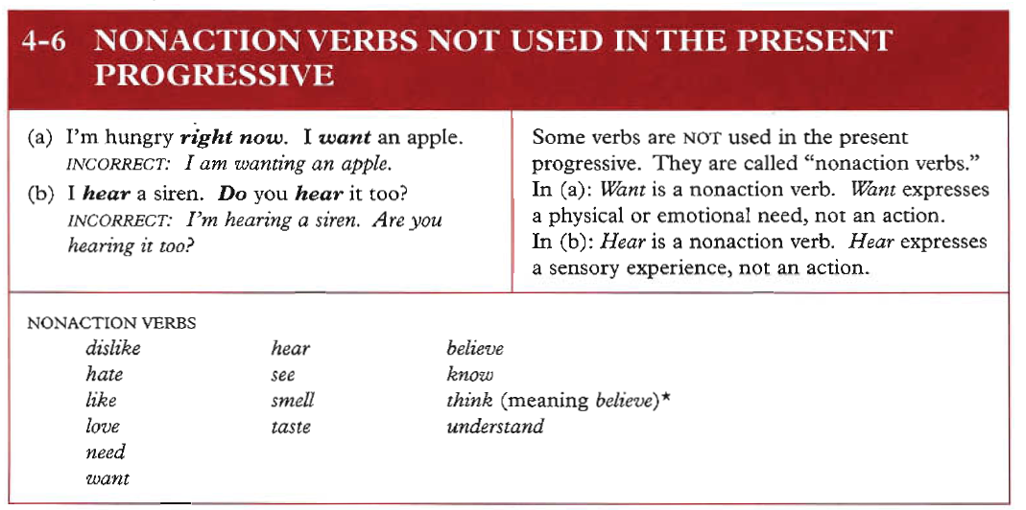
3.
Azar’s Basic Grammar Textbook: page 111
Examples:
1. I hear you now clearly.
2. They understand the lesson now.
3. Be careful! We smell dangerous chemical gas.

Slide 7
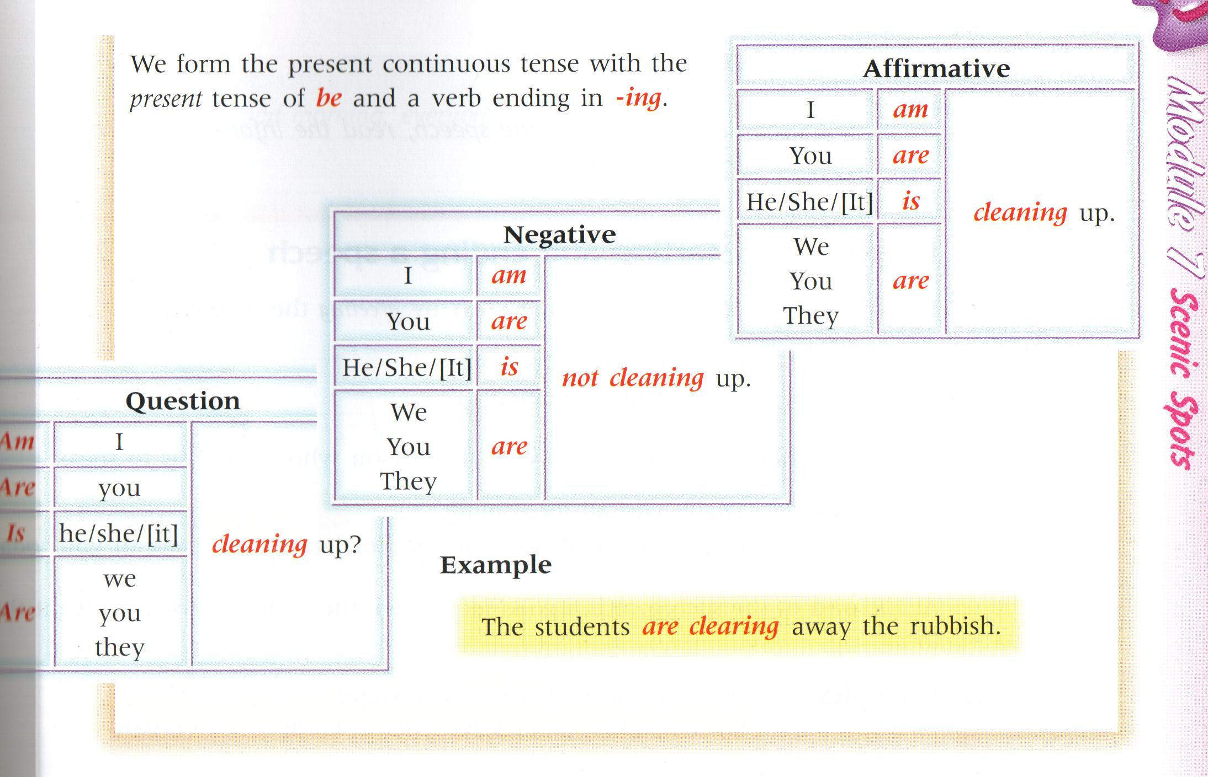
Elements : 4 + 5
We form the present continuous tense with the present tense of be and a verb ending in ing.
See Azar: Page: 99
See Azar: Page: 102

Slide 8
6.The table shows how we form the –ing form of a verb.
+ ing
Most verbs
walk
walking
Verbs ending in e
-e + ing
come
coming
Verbs ending in ie
lie
lying
-ie + y + ing
Short verbs ending in a vowel + a consonant
Double the consonant + ing
run
running

Slide 9

drive
hope
smile
dance
joke
shake
choose
come
ANow try these ones:
a Basic Grammar: Page 111
driving
hoping
Smiling
dancing
joking
shaking
choosing
coming

Slide 10
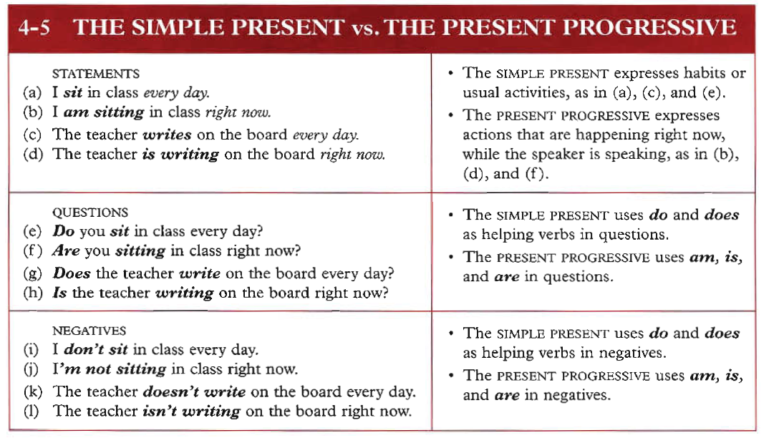
7.

Slide 11
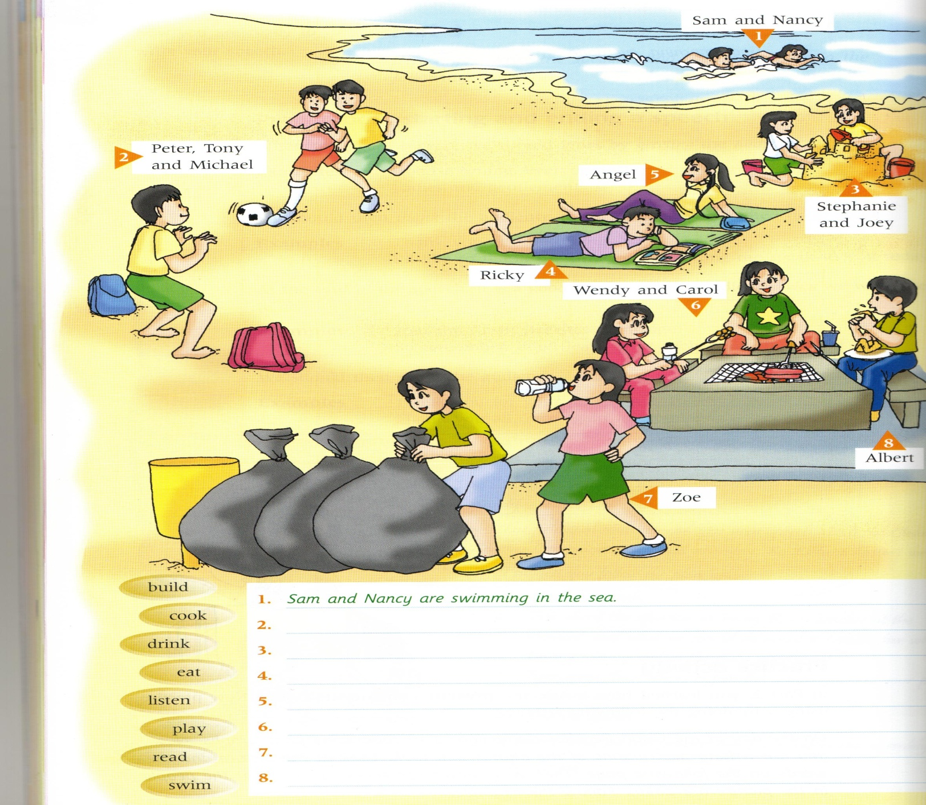
Activities

Slide 12
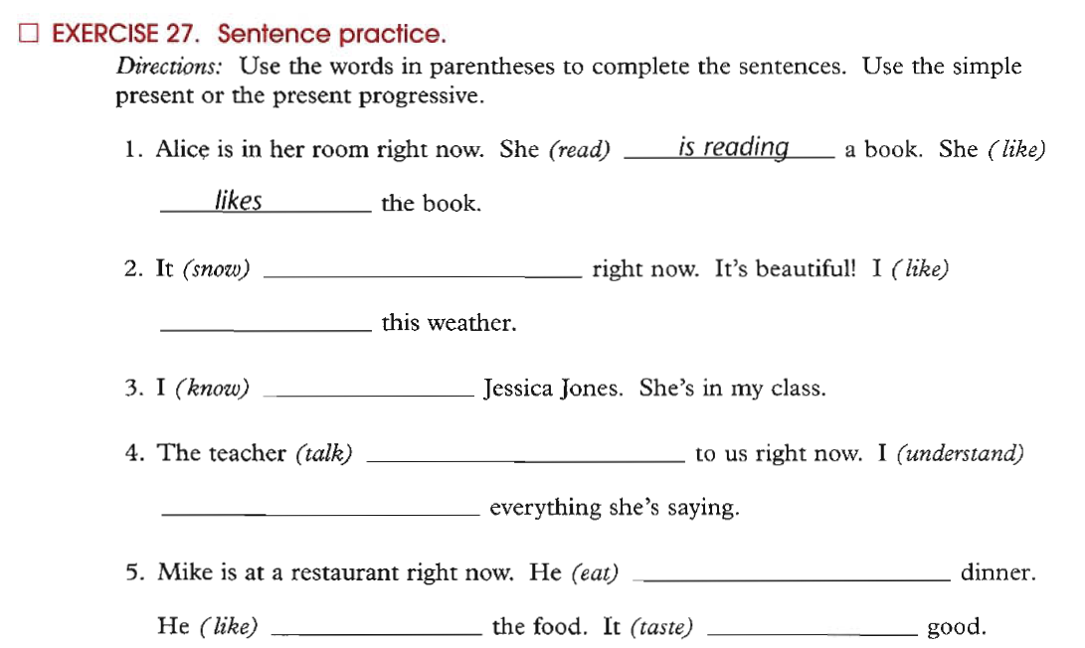

Exercise: Spelling Rules for Present Progressive (or continuous)
Pay Attention: Non-Action Verbs
begin
hop
swim
run
create
write
fill

Slide 13
Sample Questions
1. The men ____________ in the building now.
a. worked b. works c. are working d. working
2. ___________________ waiting me at the moment? – near the pharmacy.
a. Where he is b. Where does he
c. Where did he d. Where is he
3. The boys __________________________ football now .
a. are play b. play
c. is playing d. aren’t playing
4. Listen! The baby ________________ in the next room.
a. will cry b. crying
b. are crying d. is crying
5. I can’t go with you. I ______________ my homework now.
a. did b. have don c. am doing d. do

Slide 14
Sample Questions
6. She ____________ meat with rice now.
a. isn’t liking b. doesn’t like c. is liking d. like
7. She___________________ meat with rice at the moment.
a. eats b. doesn’t eats c. is eating d. eat
8. The boys __________________________ football now .
a. are play b. play
c. is playing d. aren’t playing
9. look! The car________________ coming toward us.
a. will come b. coming
b. are coming d. is coming
10. My mother is in the kitchen. She ______________ now.
a. cooked b. have cooked c. is cooking d. cook

Slide 15

بحمد الله

