Slide 1

**
General English Language
Dr. Mohamed Fathi
King Faisal University
e- Learning Deanship
& Distance Education

Slide 2
Fifth Lecture
Grammar – Vocabulary – Reading
Ch 3-4

Slide 3
Elements of Lecture 5
I- Previewing Vocabulary
2- Present Simple Tense
3- Negative Forms
4. Forming Questions
5- Spelling & Pronunciation Of Final – es
6- Scanning & Skimming

Slide 4
1. Vocabulary Previewing ( Interaction Textbook pages 45, 50, 56,57, 61)
Meaning | Word | No.
The most important things / | basics | 1
A period of time in a family history (20 years) | Generation | 2
A state of being husband and wife | marriage | 3
The normal standard | average | 4
one of two | either | 5
very / so / | too | 6
Preparing meat on fire | barbecue | 7
one of the main Parts | branch | 8
a member of your family | relative | 9
A marriage ceremony | wedding | 10

Slide 5
Vocabulary Previewing ( pages 45, 50, 56,57, 61)
Meaning | Word | No.
Do things in turn with another one | alternate | 11
Discuss angrily / debate | argue | 12
a short journey with food | picnic | 13
Made larger or longer | extended | 14
accent | dialect | 15
A website that belongs to a person | blog | 16
Rejoin | reunion | 17
A group of people/ players | team | 8
A family that follow customs | Traditional family | 9
a modern family | nuclear family | 10

Slide 6
I. Exercise
1. I speak English fluently and Reem does, ___________
a. either b. too c. so d. neither
2. My ________ in this term is 84.3 %.
a. marriage b. package c. garage d. average
3. All the members of a __________ family live in one house.
a. traditional b. nuclear c. rich d. bad
4. We went for a picnic by the sea and had a ___________. It was a very
delicious meal.
a. problem b. barbecue c. test d. camera
5. My uncle and my aunt are called my _______________.
a. relatives b. brothers c. friends d. neighbors
6. Group of people/ playing a sport is called a ________________.
a. family b. friend c. team d. match

Slide 7
2. Simple Present:
The Importance of Time
The Verb tense expresses the time of an event or action. Time and how it is expressed in writing is very important to English readers. The English language has twelve different tenses. In this lesson, we will review the simple present tense.

Slide 8
The Simple Present Tense
Expresses a habit or often repeated action. The action can be a habit, a hobby, a daily event, a scheduled event or something that often happens. It can also be something a person often forgets or usually does not do.
Adverbs of frequency such as, often, seldom, sometimes, never, etc. are used with this tense.
She goes to work everyday.
They always eat lunch together.

Slide 9
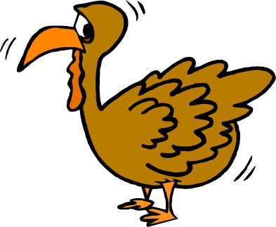
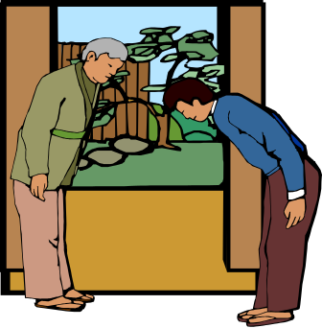
The Present Tense
Use the simple present tense to tell about things that happen again and again.
Americans eat turkey on Thanksgiving.
A Japanese always bows to others.

Slide 10
The Simple Present Tense
This tense also expresses general truths or facts that are timeless.
Snow falls in December in Minnesota.
Water boils at 100 degrees Celsius.

Slide 11


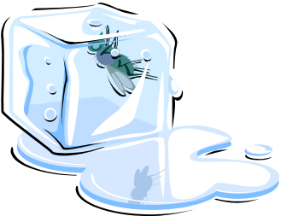
The Present Tense
Use the simple present tense to tell facts.
Water freezes at 32 degrees.
32º
Triangles have three sides.

Slide 12
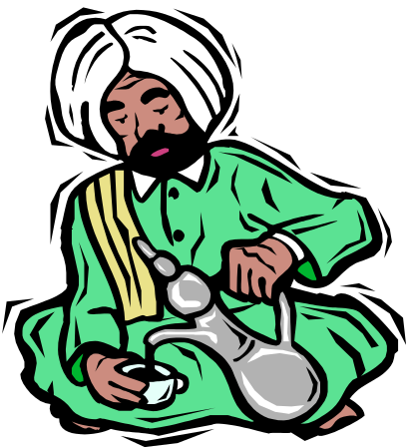
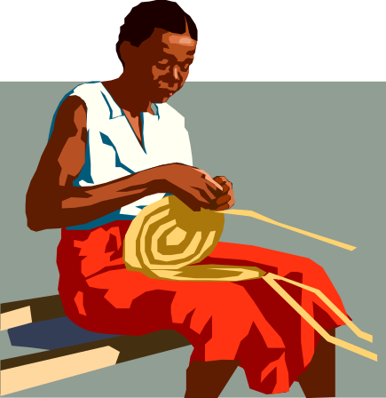
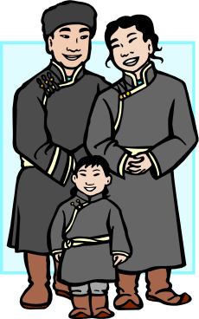
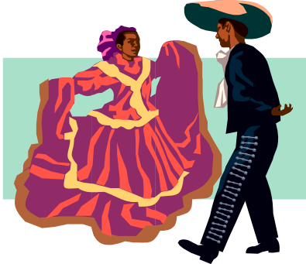
Daily Customs
She usually works on her basket after dinner.
He usually drinks tea after a meal.
They go to a dance every Sunday.
They take a walk with their son every day.

Slide 13
Exercise
1. She _______________ her mother in the house.
a. help b. doesn’t help c. don’t help d. doesn’t helps
2. Men __________ their work in the best way.
a. don’t do b. does c. doesn’t do d. don’t
3. _______________ doesn’t smoke nowadays .
a. My brothers b. You c. My father d. I
4. ____ they play football every week?
a. Do b. Does c. Are d. Done
5. Why ____ he always come late?
a. is b. do c. does d. was

Slide 14
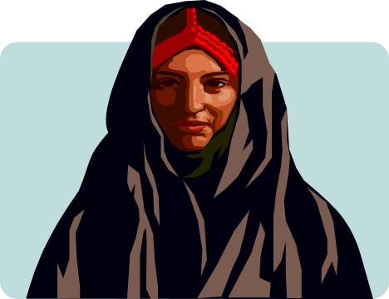

3. Negative Statements
Use contractions like don’t and doesn’t for
negative statements in speaking or in informal
writing.
Some women don’t wear a lot of makeup.
Maria doesn’t eat pizza.

Slide 15

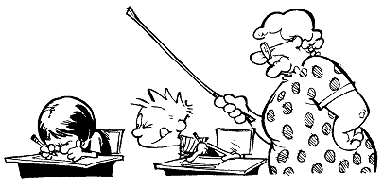
§ Negative and question forms
Use DOES (=the third person of the auxiliary'DO') + the infinitive of the verb.
He wants. Does he want? He does not want.

Slide 16
4. Simple Present –Forming Questions
We have two forms to use in questions :-
A. Does: When the verb ends with s:-
Kamal Lives in an apartment.
Does Kamal live in an apartment ?
Where does Kamal live? – In an apartment
B. Do: when the verb is infinitive
We live in an apartment
Do you live in an apartment ?
Where do you live? We live in ----
- Where/when, ..etc. + do/does + subject + main verb?
- Do/does + subject + main verb ………?

Slide 17
Present Simple, form:
Example: to think, present simple
Affirmative
Interrogative
Negative
I think
Do I think?/why do I think?
I do not think
You think
Do you think?
You don't think
he, she, it thinks
Does he, she, it think?
He, she, it doesn't think
We think
Do we think?
We don't think
You think
Do you think?
You don't think

Slide 18
. Put in : do/don't does/doesn't
1. Excuse me, _____________ you speak English?
. . Where's Ann? I _____________ know.2
George is a good tennis player but he ___________ play very often . 3

Slide 19
Write the questions for the following answers. (Present Simple)
. ?__________________________________1. A:
B : I work in a bank.
?_____________________________________2. A:
B: Yes, my brother is an engineer.
3. A: ___________________________________?
B: He lives in an apartment building.

Slide 20
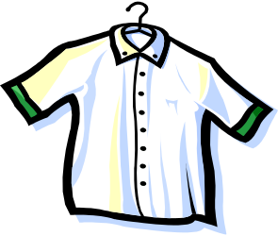
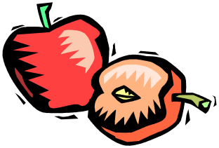
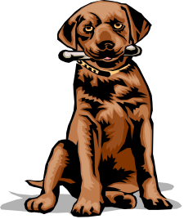
5. Third-Person Singular (Spelling and Pronunciation)
Put an –s or –es ending on third-person singular (he, she, it).
He need a shirt.
s
She want an apple.
s
It catch the stick.
es

Slide 21
Grammatical View
Present Simple, third person singular
Note:
he, she, it
s
A:
in the third person singular the verb,
always ends in :
s
s
she need
he want

Slide 22

Third-Person Singular
es
B.
To verbs ending in x, sh, or ss:
pronunciation : /z/
Add
he fix
es
it push
es
he pass
es
ch
o
she catch
es
He go
es

Slide 23
Third-Person Singular
y
y
ies
C:
Verbs ending in
;the third person changes the
to
fly
fl
cry
cr
ies
ies
Exception:
y
If there is a vowel before the :
play
play
s
s
pray
pray

Slide 24
Irregular Forms
Third-person singular forms of have, do, and go are not regular.
have
has
He has a new shirt.
do
does
She does the work.
go
goes
He goes to school.

Slide 25
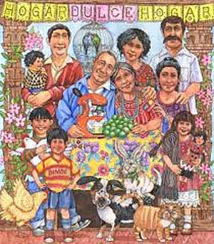
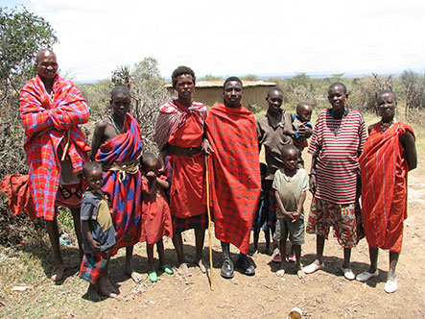
6. Scanning & Skimming Reading paragraph
( Interaction, Page 47)
Families in almost every country are changing. This is true in rich countries and poor ones. It is true in Africa, the Americas, Asia and Europe. All over the world, families are getting smaller.
In North Africa , in the past, many people lived in extended families. Fifty to one hundred people lived together in a group of houses.
These were all family members- grandparents, aunts, uncles, cousins, children, and grandchildren. But now this traditional family is breaking into smaller groups.
The traditional family in Mexico was also large. One generation ago, the average Mexican woman had seven children. Today, she has an average of only 2.5 children. Now , without so many children, families don’t need to spend so much money on basics, such as food, clothing and housing.

Slide 26
Scan and skim the previous paragraph
1. The underlined word “ ones” refers to _______________.
a. families b. countries c. children d. Americas
2. Food and clothing are __________ .
a. grandchildren b. families c. members d. basics
3. The underlined pronoun “ she” refers to_______________ .
a. a brother b. an aunt c. a Mexican women d. a family
4. How many children did a Mexican woman have ?
a. 2.5 b. 7 c. 4 d. 3
5. What happened to the traditional family?________________
a. getting larger b. breaking into smaller groups
c. became rich d. had no children

Slide 27
Activities
1. Ask your friends questions about what they do at different times. Also ask about their families.
- "What time do you get up?" - "When do your brothers go to bed?"
Write down the questions and give them to your teacher for checking.

Slide 28
Exercise
1. My uncle _________ us every week.
a. visit b. visits c. visiting d. has visited
2. Water __________ at 100 degree centigrade.
a. boiled b. boiling c. boil d. boils
3. They _______________ the work at 7 every morning.
a. begins b. have begun c. begin d. beginning
4. ____ drinks milk before sleeping.
a. The child b. The children c. The boys d. You
5. I usually ____ carefully when it rains.
a. drove b. drives c. driving d. drive
6. My mother cooks rice and meat _____________________.
a. now b. yesterday c. once a week d. last month

Slide 29
Exercise
1. The underlined letter /s/ in the word ‘ leaks” has the same
pronunciation of the letter /s/ in the word: ____________ .
a. hats b. toys c. windows d. rains
2. The underlined letter /es/ in the word ‘ fixes” has the same
pronunciation of the letter /s/ in the word: ____________ .
a. employs b. rooms c. matches d. helps
3. The underlined letter /s/ in the word ‘ goes” has the same
pronunciation of the letter /s/ in the word: ____________ .
a. heats b. repairs c. breaks d. catches

Slide 30

بحمد الله

