Slide 1

English Language
اللغة الإنجليزية
1700-101
Mohammed Al-Widyan
جامعة الملك فيصل
عمادة التعلم الإلكتروني والتعليم عن بعد
كلية التربية وكلية إدارة الاعمال
1

Slide 2
Word Study
Unit Four

Slide 3
Forming Questions in the Past Tense

Slide 4
In Unit Two: Making questions in the simple present tense
1. Action Verbs:
They exercise every day. Do they exercise every day?
She studies hard. Does she study hard?
2. Verb BE:
The test is difficult Is the test difficult?
I am late Am I late?
The mountains are wonderful Are the mountains wonderful?

Slide 5
Forming Questions: Past Tense
Verb BE:
Tom was home last night.
Three students were late this morning.
Was Tom home last night?
Were the students late this morning?
RULE
Sentence: Subject + BE
Question: BE + Subject ….?

Slide 6
Change the following sentences into questions:
The book was heavy.
Ahmad and Abdullah were the best in the class.
Maram was on holiday.
Was the book heavy?
Were Ahmad and Abdullah the best in the class?
Was Maram on holiday?

Slide 7
2. Action Verbs
Mohammad watched a movie last night.
Hala played video games.
Alaa taught her son English.
Did Ahmad watch a movie last night?
Did Hala play video games?
Did Alaa teach her son English?
Rule:
Sentence: S + V – ed (or irregular form)
Question: Did + S + V (simple form)

Slide 8
Change the sentences to past tense questions
1- The dancers listened to the music.
2. The orchestra ate dinner after the performance.
3. The meat was in the oven for two hours.
4. The cowboys raised the cattle in the country.
Did the dancers listen to the music?
Did the orchestra eat dinner after the performance?
Was the meat in the oven for two hours?
Did the cowboys raise the cattle in the country?

Slide 9
5. The cook fried some thin pieces of meat.
6. The band sold compact discs to fans at the nightclub.
7. The blues singers were asleep on the bus.
8. Our neighbor went to San Francisco to hear Wynton Marsalis
Did the cook fry some thin pieces of meat?
Did the band sell compact discs to fans at the nightclub?
Were the blues singers asleep on the bus?
Did our neighbor go to San Francisco to hear Wynton Marsalis?

Slide 10
Irregular Verbs
Simple Verb | Past Tense | Simple Verb | Past Tense
do | did | go | went
get | got | give | gave
see | saw | sell | sold

Slide 11
Exercise page 134:
1-Carlos ____________ his homework early yesterday. (do)
2-Did you ____________ a good grade on your test? (get)
3-Helen ____________ her friends at the Student Union this morning at breakfast time. (see)
4-They ___________ to the football game last Saturday. (go)
5-We ___________ our mother a birthday present every year. (give)
6-Did the Browns _________ their house? (sell)
7-Paul and Robert _________ at home last night. (BE)
8-Coffee __________ in Brazil. (grow)
9-I ___________ of the answer after the teacher asked someone else. (think)
10- We ____________ pizza for lunch yesterday. (eat)
11-All the students ______________ to the class party last night. (come)
did
get
saw
went
give
sell
were
grows
thought
ate
came

Slide 12
Adverbs
Adverbs are words that describe verbs
He runs quickly.
She speaks softly.
He laughs loudly.
Many adverbs end in –ly
We can make adverbs by adding –ly to adjectives
Spelling: (1) if the adjective ends in y, change the –y to i
easy + -ly = easily
happy + -ly = happily
(2) If the adjective ends in –ble, drop the -le
Possible + -ly = possibly
Probable + -ly = probably

Slide 13
Add –ly to each adjective. Then use the correct adverb in each blank. Underline the verb.
differently
cheaply
 | busy |  | cheap |  | different |  | easy
 | warm |  | possible |  | loud |  | happy
easily
busily
happily
loudly
possibly
warmly

Slide 14
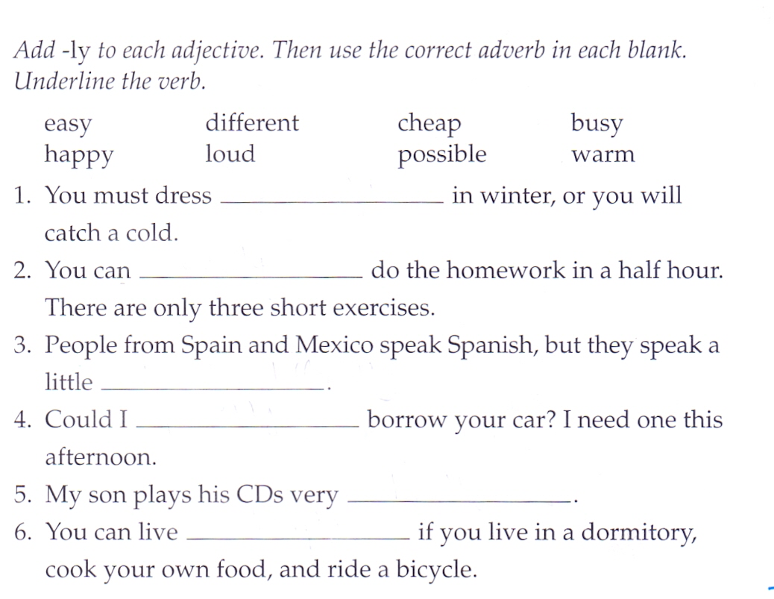
warmly
easily
differently
possibly
loudly
cheaply

Slide 15
Word Forms: Noun and Verb the Same
Some nouns and verbs have the same form
work (n.) vs. work (v.)
Work (n): I have so much work to do.
Work (v.): He works at the hospital
Contexts for nouns and verbs
Subject (n.) __________
of ________
adjective __________
a/an/the __________
Verb
Noun
Noun
Noun

Slide 16
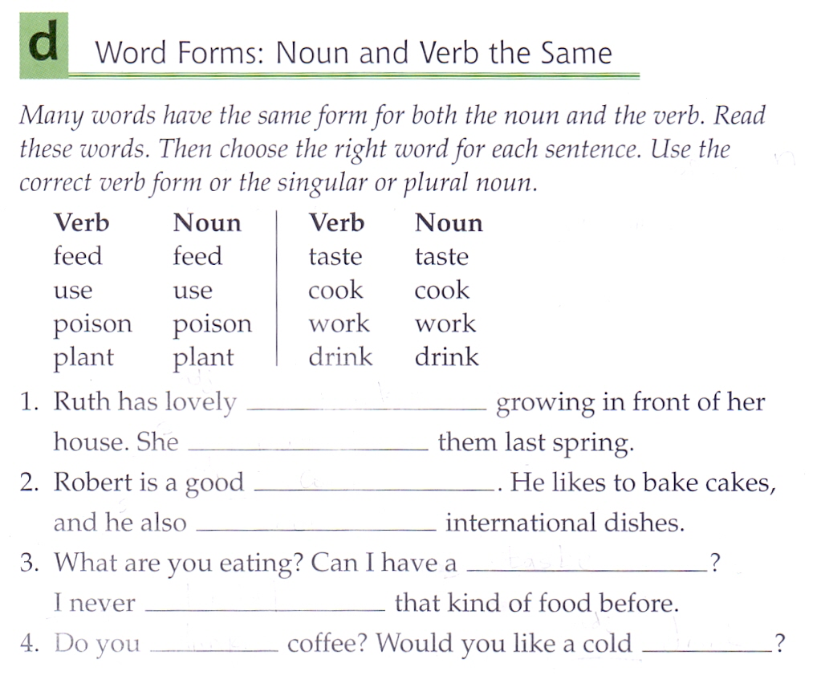
plants
planted
cook
cooks
taste
tasted
drink
drink

Slide 17
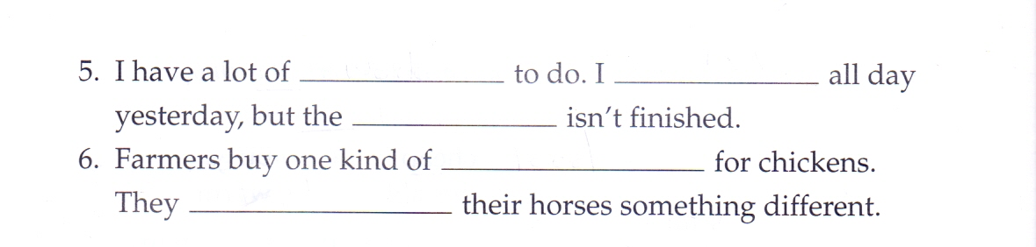
work
worked
work
feed
feed

Slide 18
Collocations
Collocations are words that are often used together
do homework
make coffee
go swimming

Slide 19
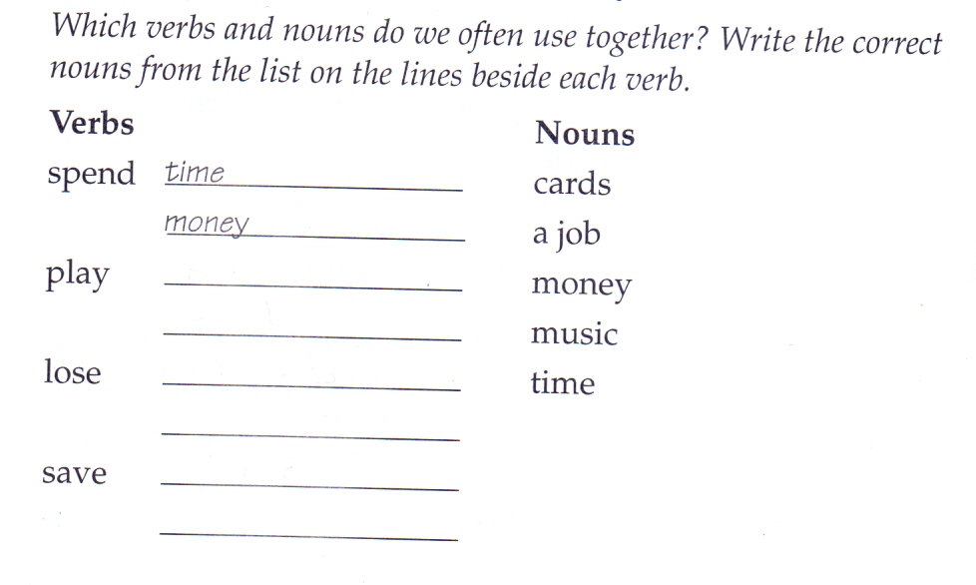
Which word makes a collocation with the word “lose”
Cards
Music
A job
cards
music
money
a job
money
time

Slide 20

بحمد الله

