Slide 1

**
English Language
Instructor: Ammar Sultan Almaani
King Faisal University
e- Learning Deanship
& Distance Education

Slide 2
^{9th} Class

Slide 3
Contents of Lecture 9
Frequency Adverbs
Scanning & Skimming A reading Text
Past Progressive Tense
Previewing Vocabulary

Slide 4
Vocabulary Previewing ( pages 127 / 132 / 139 )
meanings | New words | No.
The condition we live in/ everything around | environment N | 1
Problems in life/ pains | hardships N | 2
a person’s age between 13 and 19 | teenager N | 3
A big or strong difference | contrast N | 4
illegal behavior like killing or stealing | Crime N | 5
Love, anxiety, joy / feelings | Emotions N | 6
A picture | Vision N | 7
Work for free | Volunteer V | 8
To let things/ persons free | Release V | 9
To get ready | Prepare V | 10
Take things to destination / hand on | Deliver V | 11

Slide 5
Vocabulary Previewing ( pages 127 / 132 / 139 )
Meanings | New words | No.
Well-known | Famous Adj | 12
Being without any people around | Lonely Adj | 13
Very hard / strong | Tough Adj | 14
Happiness or enjoyment | Fun Adj | 15
quickly | Fast Adj | 16
Look after | Take care of PV | 17

Slide 6
Exercise
I. The word “ __________” means work for free.
A. employ B. volunteer
C. prepare D. watch
2. The phrase “ a big or strong difference” means ______________.
A. contract B. difficulty
B. contrast D. similarity
3. You are________________ because every body knows about you.
A. sick B. a driver
C. a player D. famous
4. A person between 13 and 19 years old is a _____________________
A. teenager B. worker
C. volunteer D. pilot

Slide 7
Exercise
5. In our society, a mother usually____________ her children and prepares food.
A. kills B. goes for
C. Takes care of D. sets out
6. The word “ ________________” is closest in meaning to the word “ a picture”.
A. mission B. vision
B. revision D. television
7. The box is ________________ . It is not easy to break it.
A. heavy B. rough
C. tough D. red
8. Some examples of ____________ are love, feelings and joy.
A. invitation B. emotions
C. tourism D. sickness

Slide 8
Adverbs of
Frequency

Slide 9
Always 100%
Usually 80%
Often 65%
Sometimes 50%
Seldom 30%
Rarely 15%
Never 0%
Adverbs of Frequency
frequency
frequency

Slide 10
Location or position of Frequency Adverbs in sentences.
1. If there is only a main verb in a sentence we put the frequency
adverb immediately before it
e.g.,- Sami______________ his friends.
A. respects always B. respects never
C. always respects D. respects sometimes
2. If there is only one of the verbs to Be ( is, am, are, was, were ),
we put the frequency adverb immediately after that verb to Be.
e.g.,- The students ________________ afraid of the final tests.
A. usually are B. are usually
C. is usually D. usually is

Slide 11
Location or position of Frequency Adverbs in sentences.
3. If there is a helping verb and a main verb in a sentence we put the
frequency adverb between the helping verb and the main verb
e.g.- Our doctor ______________ his mobile.
A. has switched off rarely B. has rarely switched off
C. rarely has switched off D. never has switched off
4. In case of a question , we just replace the subject with the helping verb
e.g. – The doctor has never disappointed any student.
Has the doctor ever disappointed any student?
Note: Be careful! In questioning, we change never to ever

Slide 12
Exercise
1. My friend is very clever. He _________ passes the tests.
A. sometimes B. always
C. never D. seldom
2. My friend is very clever. He _________ fails the tests.
A. always B. sometimes
C. never D. seldom
3. ______________ a snake? – No, I haven’t.
A. Have you seen ever B. Have you ever seen
C. Have you seen never D. Have you never seen

Slide 13

FORM
The position of these adverbs is:
before the main verb
 |  | Adverbs of frequency | verb
I |  | always | get up | at 6.45.
Ali | can | usually | play | football.
Mandy | has | sometimes | got | some homework.
after a form of to be am, are, is (was, were)
 | verb | Adverbs of frequency
Laila | is | never | late.

Slide 14

Examples
Ali always plays the tennis.
She usually eats some chocolate.
She often goes shopping.
He is sometimes late for work.
Ali hardly ever travels by cars.
He never smokes a cigarette.

Slide 15
Reading Section

Slide 16
II. Read the following essay ,then answer the questions that follow
page 128
Some people go to work each day and then come home. They spend time with their family and friends. Maybe they watch TV or go to a movie. Sometimes they exercise or read. This is their life. But for other people, this is not enough. They look around their neighborhoods and see people with terrible hardships: sickness, loneness, and homelessness. Other people see problems with the environment. Many people want to help. They volunteer. They give some of their time to help others.
Volunteers help in many ways. Some visit sick and lonely people. Some give their friendship to children without parents. Some build houses for homeless people .

Slide 17
Exercise
1.The most suitable Topic for the passage is ____________
A. Homelessness B. Volunteering
C. Hardships D. Sickness
2. The underlined word “ exercise ” means: ___________
A. building houses B. question
B. Practice sports D. test
3. ________________ is an example of hardships.
A. Volunteering B. environment
C. neighborhood D. homelessness
3

Slide 18
Exercise
4. Why do some people give some of their time to others?
A. To earn much money B. To help them
C. To know the time D. To watch TV
5. The underlined pronoun “ their ” Line 9 refers to___________
A. all people B. friendships
B. some volunteers D. all volunteers
6. ________________ is closest in meaning to the phrase “work for free “.
A. Volunteer B. build houses
C. give some time D. look around
3

Slide 19
Past Progressive VS. Past Progressive

Slide 20
The Simple Past
We use the simple past to indicate exactly when an action or event took place in the past.
I visited my sister yesterday.
We went out to dinner last night.

Slide 21
The Past Progressive
The past progressive is used to talk about an activity that was in progress at a specific point of time in the past. The emphasis is on the duration of the activity in the past.
I was studying for an exam while my mother was cooking dinner.
We were walking in the park around 7 p.m. last night.

Slide 22
The Past Progressive
The past progressive is often used with the simple past to show that one action was in progress when another action occurred.
I was taking a bath when the doorbell rang.
They were eating dinner when the neighbors stopped by for a visit.

Slide 23
Activities

Slide 24
Exercise : Past Progressive
I. We saw an accident while we ____________ to university.
A. go B. have gone
C. were going D. was going
2. When he ________, it was raining heavily.
A. was arriving B. arrived
B. arrives D. is arriving
3. As the children ________________ in the park, someone fell down.
A. were playing B. played
C. play D. are playing
3

Slide 25
Exercise : Adverbs of Frequency
1. Hind is very punctual. She _________ comes late to her work.
A. always B. never
C. sometimes D. often
2. Rami plays football three times a week. He ______ plays football.
A. always B. sometimes
C. never D. seldom
3. ______________ the homework alone?
A. Do you do usually B. Do you never do
C. Do usually you do D. Do you usually do

Slide 26
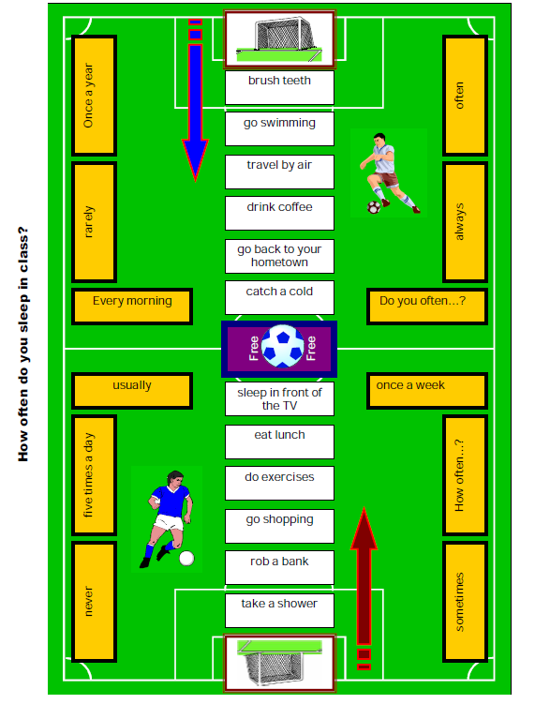

Slide 27

بحمد الله

