Slide 1

**
English Language
Instructor: Ammar Sultan Almaani
King Faisal University
e- Learning Deanship
& Distance Education

Slide 2
^{10th} Class

Slide 3
Elements of Class
Vocabulary
Parts of Speech

Slide 4
Vocabulary Previewing ( pages 147/ 50/ 152 /160) )
meanings | New words | No.
Very beautiful | Attractive ( Adj ) | 1
Special food for sick or for slimming | Diet ( N ) | 2
Not cooked | Raw (Adj ) | 3
thin in an attractive way | Slim ( Adj ) | 4
Win or get something | Gain ( V) | 5
Meet or unite | join ( V ) | 6
Fat – the opposite of slim or thin | Overweight ( Adj) | 7
during | While ( conj) | 8
Do / succeed/ have a job | Work ( V) | 9
a small or light meal between main meals | Snack ( N) | 10

Slide 5
Vocabulary Previewing ( pages 147/ 50/ 152 /160) )
meanings | New words | No.
Heat with fire | Bake ( V) | 11
Heat in water | Boil ( V) | 12
Heat in oil | Fry ( V) | 13
Old, smelly and bad | Disgusting ( adj) | 14
Very pleasant taste | Delicious ( adj) | 15
Apart from | Except ( Conj) | 16

Slide 6
Previewing Vocabulary
1. The word” _____________” is closest in meaning to the phrase “ not cooked”.
A. boiled B. raw
C. fried D. ugly
2. Some people lose weight fast, but they usually _____________ it back again.
A. gain B. eat
C. help D. give
3. The word “ ___________” is closest in meaning to the phrase “ very beautiful”.
A. interesting B. attractive
C. difficult D. thin
4. She looks very ______________ because of the diet she follows.
A. slim B. ugly
C. dangerous tall

Slide 7
Previewing Vocabulary
5. I remembered the meanings of all words ____________the word” except”.
A. expect B. accept
C. except D. receipt
6. My friend suffers from being _____________. He is now too fat.
A. thin B. overweight
C. light D. happy
7. “ _________” is closest in meaning to the phrase “ old, smelly and very bad”.
A. interesting B. attractive
C. disgusting D. delicious
8. Dieting often doesn’t work. People usually gain back the weight.
The word “Work” means:___________________
A. have a job B. succeed
C. fail D. be active and try

Slide 8
English Grammar
Parts of Speech

Slide 9
Eight Parts of Speech
Nouns
Verbs
Interjections
Pronouns
Adjectives
Adverbs
Prepositions
Conjunctions

Slide 10

Noun :
Word that names
A Person
A Place
A Thing
An Idea

Slide 11

Kinds of Nouns

Slide 12
The Verb
A word that expresses action or otherwise helps to make a statement
Action
Subject
“be” verbs
&
taste
feel
sound
look
appear
become
seem
grow
remain
stay
Linking
predicate

Slide 13
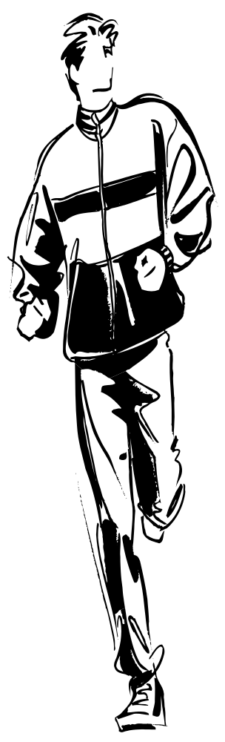
Every sentence must have
VERB
a

Slide 14

Kinds of Verbs
Action verbs express mental or physical action.
Linking verbs make a statement by connecting the subject with a word that describes or explains it.
He rode the horse to victory.
He has been sick.

Slide 15
The Pronoun
The pronoun is a word used in place of one or more nouns.
It may stand for a person, place, thing, or idea.
Indefinite Pronouns
anybody
each
either
none
someone, one, etc.
Demonstrative Pronouns
this
that
these
those
Personal Pronouns
I, me, mine
you, your, yours
she, her, hers,
it, its
we,us, our, ours
they, them, their,
theirs
myself
yourself
Interrogative Pronouns
who
whom
what
which
whose

Slide 16

The Adjective
Modifies or describes a
noun or pronoun.
Answers these questions:
Did you lose your address
book?
Which?
Is that a wool sweater?
What kind?
Just give me five minutes.
How many?

Slide 17
The Adverb
Modifies or describes
a verb, an adjective,
or another adverb.
Answers the questions:
How?
He ran quickly.
When?
She left yesterday.
We went there.
Where?
It was too hot!
To what degree or how much?

Slide 18
Kinds of Adverbs
Interrogative
Adverbs
introduce questions
How did you break your leg?
When does your plane leave?
How?
When?
How often do you run?
How often?
Where?
Where did you put the mouse trap?

Slide 19
The Preposition
A preposition introduces a noun or pronoun
or a phrase or clause functioning in the sentence
as a noun. The word or word group that the
preposition introduces is its object.
They received a postcard from Bobby telling
about his trip to Canada.

Slide 20
Some Common Prepositions
aboard
about
above
across
after
against
along
among
around
at
before
behind
below
beneath
beside
between
beyond
by
down
during
except
for
from
in
into
like
of
off
on
over
past
since
through
throughout
to
toward
under
underneath
until
up
upon
with
within
without

Slide 21
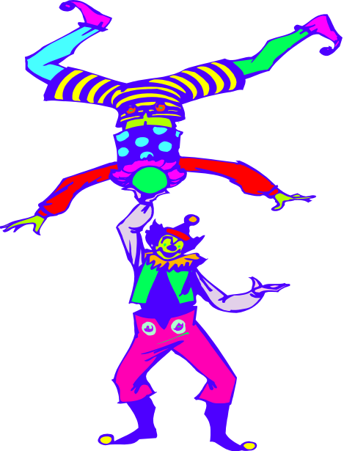
The conjunction
A conjunction is a word that joins words
or groups of words.
or
and
neither/nor
either/or
but

Slide 22
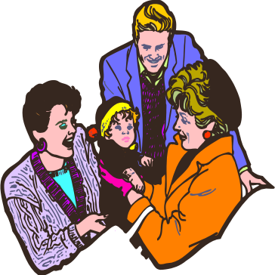
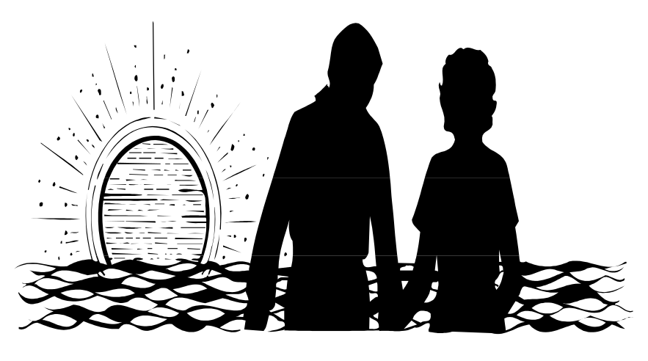

The interjection
is an exclamatory word that expresses
emotion
Goodness! What a cute baby!
Wow! Look at that
sunset!

Slide 23
Exercise
Circle the most suitable answer a, b, c or d for each of the following
- The final test will be similar to the questions in the lectures exercises.
1. The part speech of “ final” is __________________________________
A. a verb B. an adverb
C. a noun D. an adjective
2. The part speech of “ questions ” is _____________________________
A. a verb B. an adverb
C. a noun D. an adjective
3. The part speech of “ will” is __________________________________
A. a main verb B. a verb to be
C. a modal D. a preposition
4. The part speech of “ in” is ___________________________________
A. a verb B. a preposition
C. a noun D. an adjective

Slide 24
Exercise
Circle the most suitable answer a, b, c or d for each of the following
The doctor gave us the first homework last week.
5. The part speech of “ us” is _________________________pronoun
A. a possessive B. an object
C. a subject D. a reflexive
6. The part speech of “ gave ” is ______________________________
A. a present verb B. an auxiliary
C. a future verb D. a past verb
7. The part speech of “ last” is ________________________________
A. an adjective B. a verb to be
C. an article D. a preposition
8. The part speech of “ doctor” is _________________________________
A. a verb B. a subject noun
C. an object noun D. an adjective

Slide 25

بحمد الله

