Slide 1

Course Title:
Children’s Literature
Instructor:
Dr Abdulgawad Elnady
Associate Professor of Literature, Department of English,
King Faisal University.
King Faisal University
Deanship of E-Learning
1

Slide 2
Third Lecture

Slide 3
Characteristics of Children’s literature
Just a quick reminder: Children’s literature is Both fictional and non-fictional books, written especially for children 0-18 years old. It is a genre that began very early in history and that was initiated officially, so to speak, in the year 1865 with the publication of Alice in the Wonderland by Lewis Carroll as the first novel to have been written for the pure pleasure and enjoyment of children.

Slide 4
Question
What is the first novel to have been written for the pure pleasure and enjoyment of children?
Alice in the Wonderland
Robinson Crusoe
Gulliver’s Travels
Animal Farm

Slide 5
Characteristics of Children’s literature
Alice in the Wonderland by Lewis Carroll tells of a girl named Alice who falls down a rabbit hole into a fantasy world (Wonderland) populated by peculiar, mythological creatures. The tale plays with logic, giving the story lasting popularity with adults as well as children.
Adults and children alike can read and enjoy children’s literature.

Slide 6
Question
Children’s literature can be read and enjoyed by:
children only
Adults only
Both adults and children

Slide 7
Characteristics of Children’s literature
Let us try something new today. I will not directly tell you of those characteristics you find in the title. I will show you a picture and a movie and then we can come up, ourselves, with some very nice feature. Ready?
Move to the next slide please.

Slide 8
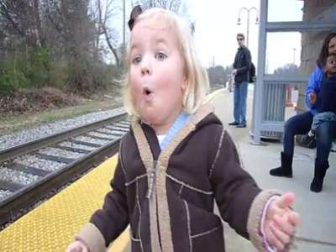
First, the Picture
What is a work of art for children expected to be like?

Slide 9
Then the Movie
What is a work of art for children expected to be like?

Slide 10
Characteristics of Children’s literature
Initial ideas from the picture and the movie:
Children’s literature has to….be easy & simple.
Children’s literature has to….contain a message.
Children’s literature has to….have a moral lesson.
Children’s literature has to….attractive, surprising , and exciting
Children’s literature has to provide adventures
Children’s literature has to provide suspense

Slide 11
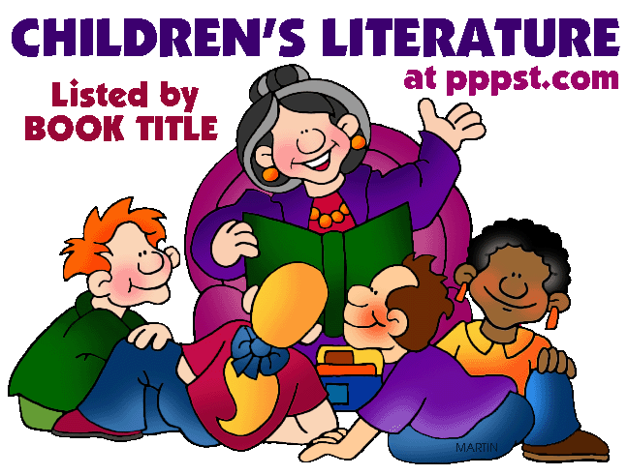
Funny. Uses stories. Interesting.

Slide 12
Telling stories
The art of telling a story is very important in writing for children. It helps the writer to capture the interest and imagination of the child. Without possessing this art everything might turn dull and children will easily lose concentration. As the writer tells the story he or she has to be exciting, funny, interesting, and challenging. How so?

Slide 13
The art of Telling stories
Using an unfamiliar way of starting or ending a sentence.
Using negation
Using questions
Allowing for some time of silence so the kids would think or even have a break
Changing different tones, not just maintaining one monotonous voice from start to finish
Marinating a cozy smile all the way through
To understand all this I want you to imagine yourself as a father or mother telling your child a bedtime story.

Slide 14
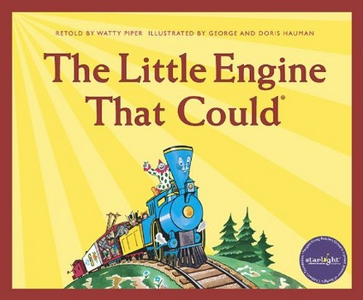
Uses technology and modifies it to suit the understanding of the children. Depends on nature.

Slide 15
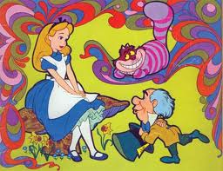
fantasy

Slide 16
Fantasy
Children’s literature depends greatly on fantasy, but we have to remember that some logic is also needed, otherwise we are not doing justice to the children. We will talk about this later.

Slide 17
Question
Literature for children
must use fantasy only.
Must mix fantasy and realism
Must never use logic or realism

Slide 18
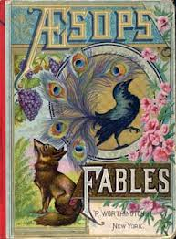
The fable is: A story in which all characters are animals

Slide 19
Fables
Fables are fine with children, but it has been noticed that allegory as in Animal Farm works miracles with the children, much more than fables. Why? Because it mixes fantasy with logic.

Slide 20
Question
Which is more preferable for children, fables or allegories?
Fables
Allegories
None of the above

Slide 21

بحمد الله

