Slide 1

Course Title:
Children’s Literature
Instructor:
Dr Abdulgawad Elnady
Associate Professor of Literature, Department of English,
King Faisal University.
King Faisal University
Deanship of E-Learning
1

Slide 2
Fourth Lecture

Slide 3
Further characteristics of
children’s literature

Slide 4
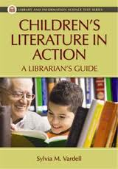
There must be some kind of action

Slide 5
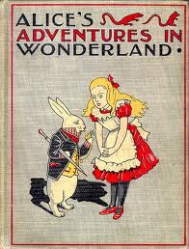
A novel written in 1865. the first real novel for children

Slide 6
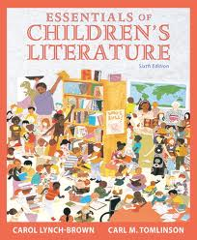
Has to be about the world of children

Slide 7
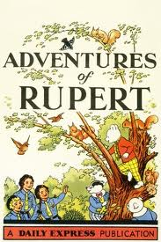

Slide 8
Harry potter
Harry Potter is a series of seven fantasy novels written by the British author J. K. Rowling. The books chronicle the adventures of a wizard, Harry Potter, and his friends Ronald Weasley and Hermione Granger, all of whom are students at Hogwarts School of Witchcraft and Wizardry. The main story concerns Harry's quest to overcome the Dark wizard Lord Voldemort, whose aims are to become immortal, conquer the wizarding world, subjugate non-magical people, and destroy all those who stand in his way, especially Harry Potter.

Slide 9
Harry Potter
Since the release of the first novel Harry Potter and the Philosopher's Stone on 30 June 1997, the books have gained immense popularity, critical acclaim and commercial success worldwide. The series has also had some share of criticism, including concern for the increasingly dark tone. As of June 2011, the book series has sold about 450 million copies, making it the best-selling book series in history, and has been translated into 67 languages. The last four books consecutively set records as the fastest-selling books in history.

Slide 10
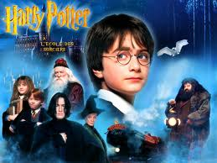
A child character at the forefront and somoe adults are there as a backdrop, in the background

Slide 11
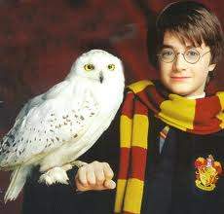
Uses animals and birds as characters as in a fable

Slide 12
Questions
Whose point of view should be dominant in a book for children?
That of children
The point of view of grown ups
The author’s point of view.

Slide 13

Characteristics of Children’s Literature

Slide 14
Characteristics of Children’s Literature
Simple and straightforward.
You cannot use complex language or difficult issues in talking to kids.
This does not mean that vocabulary needs to be overly simplistic or that style should be choppy or flat (as too many books for children are).

Slide 15
Characteristics of Children’s Literature
Children’s Literature:
must always be simplistic
Should be easy and acceptable
Must be difficult to understand

Slide 16
Characteristics of Children’s Literature
Focuses on action.
Subtle psychological events are often implied through narration and comment on actions.
Thoughts and ideas will make children absent minded or they would lose interest easily. So it is better to keep them focussed on action.

Slide 17
Characteristics of Children’s Literature
Children’s Literature Focuses on action:
it should never deal with ideas
It has to have action all the time
It does provide action which helps to understand ideas.

Slide 18
Characteristics of Children’s Literature
Is about childhood.
Naturally. It cannot talk about adults. Or wars or marriage or higher studies or the UN. Only the concerns of childhood.

Slide 19
Characteristics of Children’s Literature
Expresses a child’s point of view.
Same as above
Child ideas and topics mean the point of view to be expressed.
Can it present the point of view of elders?
Can children be just followers of the views of adults?
Can they have their own p o view?

Slide 20
Characteristics of Children’s Literature
Is optimistic.
“Hope is a vital dimension of a children’s book”. (Sarah Smedman)
Pessimism does not fit the world of children. It just puts them off and creates a wall between them and the novel. Of course we are talking here about children readers and characters.

Slide 21
Characteristics of Children’s Literature
Tends toward fantasy.
Fantasy often implies a symbolic defiance of our knowledge of reality.
Lots of imagination with some logic of course. But fantasy should be the ruling principle.

Slide 22
Characteristics of Children’s Literature
Is a form of pastoral idyll.
The pastoral idyll celebrates the joys and innocence of rural life, close to nature and in the company of friends.
Greenery, shrubs, trees, flowers, water, rivers, roses, nature in general. All these are so dear to the hearts of kids.
Pasture

Slide 23
Characteristics of Children’s Literature
Views an un-idyllic world from the viewpoint of innocence.
More complex and interesting books reflect ambivalence about desire to have the comforts of home and the exciting dangers of adventure, desire to be innocent and experienced, desire to grow up but not grow up, etc.
being not able to grasp the evil there is in the whole world, thinking that all is well while in fact it is not. Cf optimistic.

Slide 24

بحمد الله

