Slide 1
Lecture 8 vocabulary unit 2
(B) interests

Slide 2
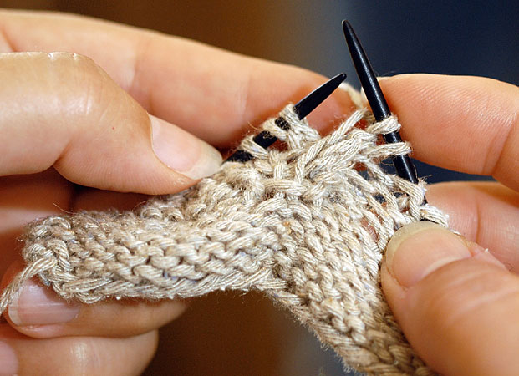
Definition:
means to make a fabric or garment by intertwining yarn or thread in a series of connected loops by using knitting needles or on a machine, while a nit is the egg or young of aparasitic insect
Synonyms:
Drew:
join , link
Word:
knit
Antonyms:
نسج
Un knit
Sentence:
Knit sweater, yet i was helpless to change it
Knit for 6 rows

Slide 3
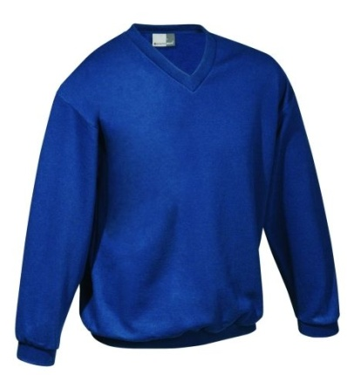
Definition:
a piece of clothing made from wool which covers the upper part of the body and the arms and which dose not open at the front .
Synonyms:
Drew:
jumper
Word:
Antonyms:
Sweater
سترة
_______
Sentence:
Sweater for the evenings.
I love your sweater it’s nice

Slide 4
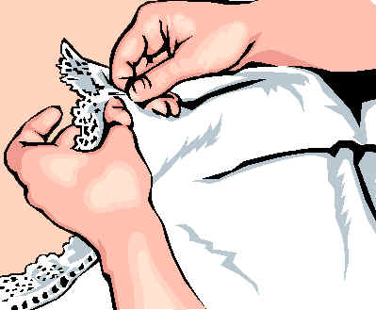
prepare fabric for clothing, covering
Definition:
Synonyms:
Drew:
baste, bind
Word:
Sew
خيآطة
Antonyms:
rip, tear
Sentence:
Sewn in groundsheet.
She has sew a perfect sweater

Slide 5
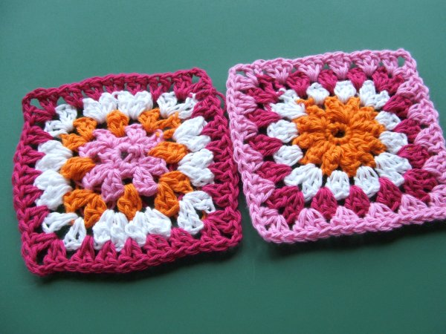
Definition:
To make clothes and other things using wool and special needle with a hook curve at one end
Synonyms:
Drew:
knit
Word:
نسيج محبوكـ
crochet
Antonyms:
Sentence:
Crochet stitch.
Crocheted shawl

Slide 6
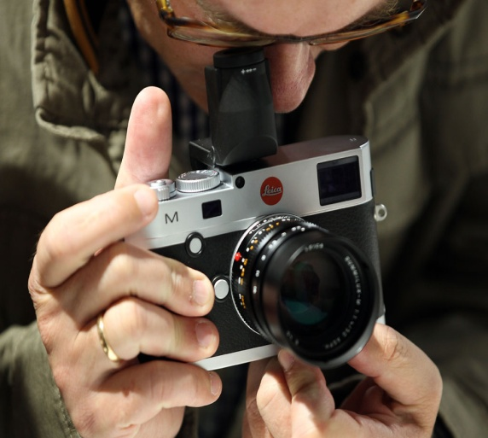
Definition:
The activity or job of taking photographs or films
Synonyms:
Drew:
fine arts
Word:
Photography
تصوير
Antonyms:
Sentence:
One of my hobby is photography
I love photography

Slide 7
Lecture 7
(A) unit 2 interests

Slide 8

Definition:
pleasurable pastime
Synonyms:
Drew:
interest,
Word:
Hobby
هوآية
Antonyms:
vocation
Sentence:
Hobby of mine to crack these puzzles
My hobby is sew clothes!

Slide 9
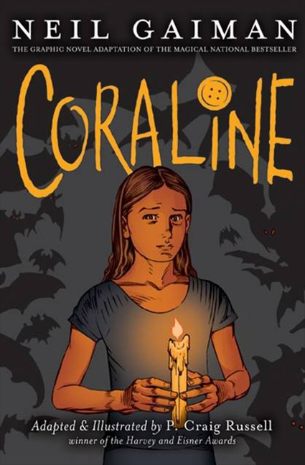
Definition:
new, original
Synonyms:
Drew:
fresh, funky*
Word:
روآية
novel
Antonyms:
common, customary
Sentence:
    My favourite novel is romance
    I enjoy reading science fiction and fantasy novels
    I love reading novels

Slide 10
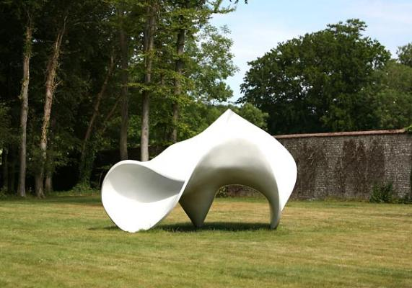
Definition:
form a three-dimensional art object
Synonyms:
Drew:
sculpt, shape
Word:
Sculpture
فن النحت
Antonyms:
Sentence:
Sculpture park
. Sculpture carved from an existing tree.

Slide 11

Definition:
sketch, draft
Synonyms:
Drew:
drawing, idea,
Word:
Design
تصميمـ
Antonyms:
Sentence:
Designed by architect james mckissack.
Designed to protect consumers.

Slide 12
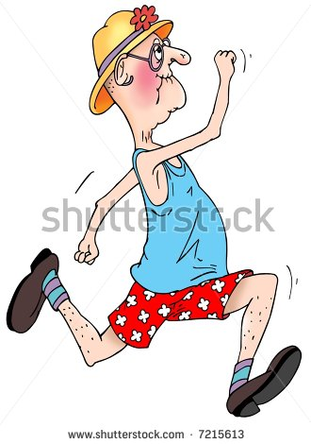
Definition:
activate, push
Synonyms:
Drew:
hurry, run
Word:
هرولة
jog
Antonyms:
repress
Sentence:
Jog along
. Jog back recovery

Slide 13

Definition:
offense against the law
Synonyms:
Drew:
wrong
Word:
Crime
جريمة
Antonyms:
kindness, good
Sentence:
Crime reduction is not just the job of the police
I love to read crime story .

Slide 14
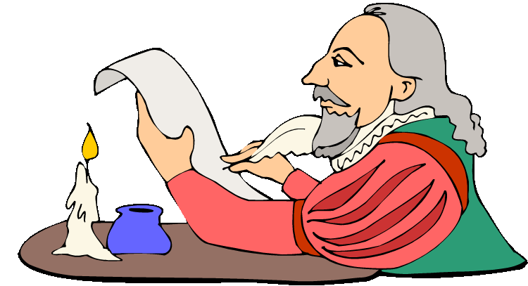
Definition:
expressive, rhythmic literary work
Synonyms:
Drew:
song,
Word:
شعر
poetry
Antonyms:
prose
Sentence:
I love poetry
Life is a poetry

Slide 15
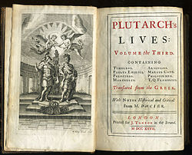
account of person's life
Definition:
Synonyms:
Drew:
profile, résumé,
Word:
Biography
سيرة
Antonyms:
Sentence:
Biography of the poet for each student.
This biography about abraham lincoln life

Slide 16

Definition:
puzzle, secret
Synonyms:
Drew:
problem, puzzlement,
Word:
غموض
mystery
Antonyms:
known, understanding
Sentence:
Mystery thriller set in hollywood
I love mystery things

Slide 17
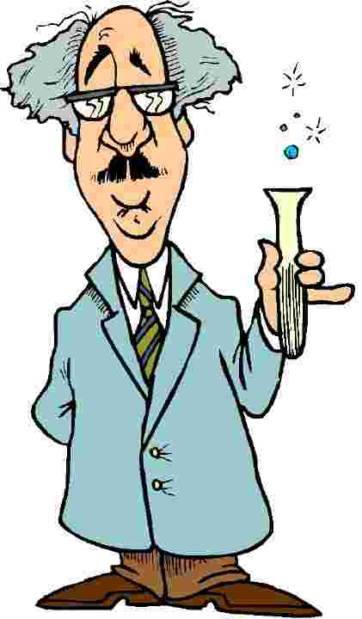
Definition:
methodical study of part of material world
Synonyms:
Drew:
information, learning
Word:
Science
علم
Antonyms:
art
Sentence:
Other teams in social sciences are also working on aging.
Science teachers is current spending.

Slide 18
آختكمـ
سآرو 7
آدعولي و لوآلدي
آنتظرو كلمآت المحآضرة 5و12
قريبآآ

