Slide 1
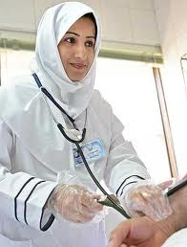
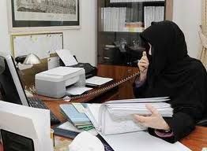
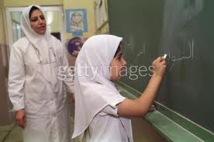

Unit 1
Finding the Ideal Job
Writing: The Sentence

Slide 2
Unit 1: Finding the Ideal Job
Part 5: Writing
The Sentence
Sentences & Fragments
Parts of the Sentence: Subjects & Verbs
Exercises

Slide 3
Unit 1: Finding the Ideal Job
Part 5: Writing
1.The Sentence√
2. Sentences & Fragments √
3.Parts of the Sentence: Subjects & Verbs
4.Exercises

Slide 4
Part 5: Writing
1.The Sentence
Book P. 13
A sentence is a group of words that tells a complete thought.
She works hard. (A complete thought)
A sentence must contain a subject and a verb and convey
a complete thought.
Ahmad worked from 8 to 5.
Is there a subject (Who?) - Yes, Ahmad is the subject.
Is there a verb (Did What?) - Yes, worked is the verb.

Slide 5
Part 5: Writing
2. Sentences & Fragments
An Incomplete sentence which does not express a complete thought is called a fragment.
A fragment tries its best to be a sentence, but it just cannot make it. It's missing something. Usually, the verb is missing.
Ahmad in the office
S (the verb is missing) C
Is there a subject (Who?) Yes, Ahmad is the subject.
Is there a verb (Did What?) No, we don't know what Ahmad did.

Slide 6
Part 5: Writing
2. Sentences & Fragments
Book P. 13
Which of the following lines are sentences and which aren’t. Put ✓ next to the sentences and × next to fragments.
Marika worked for a big camera company for six years. ✓
My friend in Boston. ×
He’s tired. ✓
Teaches mathematics to students at a good college in Massachusetts. ×

Slide 7
Unit 1: Finding the Ideal Job
Part 5: Writing
1.The Sentence
2. Sentences & Fragments
3.Parts of the Sentence: Subjects & Verbs √
4.Exercises

Slide 8
Part 5: Writing
3.Parts of the Sentence
Subject & Verb
Book P. 13
Every sentence in English must have a subject and a verb.
She works.
A sentence can have just a subject and a verb. But, usually, sentences have other words too.
She works for an employment agency.
2. Subject pronouns (I, YOU, SHE, HE, IT) can act as subjects.
She speaks English well.
I live in Dammam.

Slide 9
Part 5: Writing
3.Parts of the Sentence
Subject & Verb
Book P. 13
3. In commands, the subject is not mentioned. But, the subject of commands is always understood as "you".
Answer the phone. = (you) answer the phone.
4. Subjects come before the verb and often come at the beginning of the sentence.
  She is a beautiful girl.
  He is a hardworking employee.
  Connie told me it was a great job.

Slide 10
Part 5: Writing
3.Parts of the Sentence
Subject & Verb
Book P. 13
5. Subjects can be one word or many words.
  They told me it was a great job.
  S
Ahmad and Ali told me it was a great job.
S
6. Subjects cannot be repeated.
They, Ahmad and Ali told me it was a good job. × wrong
S1 S2

Slide 11
Part 5: Writing
3.Parts of the Sentence
Subject & Verb
Book P. 13
7. Verbs are usually the second word in the sentence, immediately following the subject.
Huda speaks English.
8. The first letter of the first word of a sentence must be capitalized. A sentence must end with a period, question mark, or exclamation point.
There was one problem.
I was bored.

Slide 12
Unit 1: Finding the Ideal Job
Part 5: Writing
1.The Sentence
2. Sentences & Fragments
3.Parts of the Sentence: Subjects & Verbs
4.Exercises √

Slide 13
Part 5: Writing
4. Exercises
Book P. 14
Q1: Each sentence has one mistake. Correct the mistakes.
The camera company it paid Marika a lot of money.
She happy with her job at the camera company.
Decided to change her job anyway.
Her didn’t understand her question.
Why did she change her job?
Marika she just wanted her dream job.
Started Marika her own restaurant.
Marika happier now than ever before!

Slide 14
Part 5: Writing
4. Exercises
Answers
The camera company it paid Marika a lot of money.
She ↑^{is} happy with her job at the camera company.
↑She Decided ^{decided} to change her job anyway.
Her ^{She} didn’t understand her question.
Why did she change her job? ✓
Marika she just wanted her dream job.
Started Marika ^{Marika started} her own restaurant.
Marika ↑^{is} happier now than ever before!

