Slide 1
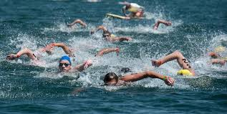
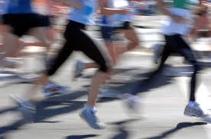
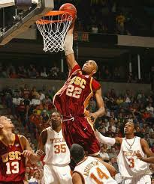
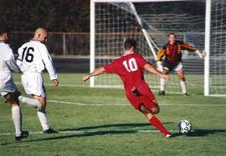

Unit 3
Swimming across Borders Introduction

Slide 2
Unit 3: Swimming across Borders
Introduction

Slide 3
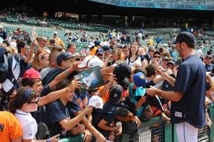
Unit 3: Swimming across Borders
Introduction
Look at the picture. Answer the questions.

Slide 4
Unit 3: Swimming across Borders
Introduction
Who is the person in the uniform?
- He is a an athlete.
- He is a player.
Who are the people around him?
- They are the fans.
What are they doing? Why?
- They are signing photographs by their idol athlete because they admire him.

Slide 5
Unit 3: Swimming across Borders
Introduction
Athletes are heroes to us. We admire them, even love them. Why? There are many answers to this question. Read about four major league baseball players in you book page 38.
List other athletes that you admire and say why you admire them.
Cristiano Ronaldo is an international football player. He is one of the most expensive footballers in history. He is one of the best footballers in the world. He has many scoring records.
Mohammad Ali is a boxer. He is one of the greatest in the sports history. He is a heavyweight world champion. He became a Muslim.

Slide 6
Unit 3: Swimming across Borders
Introduction
In most sports, athletes can do better if they have certain physical characteristics. For example, tennis player Bjorn Borg has a low heart rate. This helped him to stay strong in long tennis matches.
Can you guess which physical characteristic each athlete has? Why do you think so? Write each letter on a line.
____ 1. Bjorn Borg, tennis player a. has an extra layer of fat around heart and other organs
____ 2. Carl Lewis, long jumper b. weighs 284 pounds ( 127 kg)
____3. Wakanohana Kanzi, sumo wrestler c. is 7’1” tall (216 cm)
____ 4. Wilt Chamberlain, basketball player d. has a low heart rate
____ 5. Lynne Cox, cold-water swimmer e. has extremely long legs
Answers: d, e, b, c, a

