Slide 1
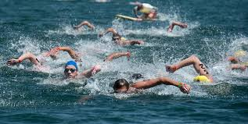
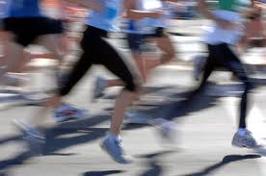
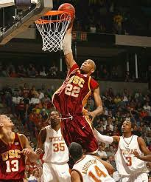
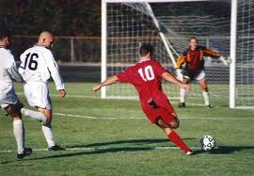

Unit 3
Swimming across Borders Vocabulary

Slide 2
Unit 3: Swimming across Borders
Vocabulary
Definitions
Vocabulary for Comprehension
Focus on Vocabulary
Exercises

Slide 3
Definitions
not have problems with example: Some people can tolerate hot water. They can play sports outside on a very hot day and feel fine. | tolerate
be naturally good at something example: In order to be a great athlete, a person needs to both work hard and have talent. Hard work or talent alone is not enough. | have talent
be better than the best ever example: The runner did more than just win. His time broke the record for the 200-meter race. | break the record
better than excellent example: Most athletes are very good at what they do. But, every once in a while, an athlete who is truly outstanding comes along and captures the world’s attention. | outstanding

Slide 4
Definitions
line separating two countries example: The border between the United States and Canada stretches from the Atlantic to the Pacific and is the longest border in the world. | border
things that you do successfully example: We admire some athletes not only for their achievements as athletes, | achievements
something that is interesting because it is difficult example: She liked the challenge of playing against athletes who were better than she was. | challenge
to give somebody courage and hope example: She lost the race and wanted to quit, but her friends encouraged her to try again. | encourage

Slide 5
Definitions
shared by a whole nation example: First, she ran in small local races; then, when she was good enough, she ran in national races. | national
a part of the body like the heart, the brain .. example: Athletes’ hearts, lungs, and other major organs are in excellent condition. | organs
someone who has sports abilities like running and jumping example: She is a natural athlete. | athlete
to respect and like someone because you think he/she has done something good example: I really admire your enthusiasm. | admire
a book in which someone writes about his/her own life | autobiography

Slide 6
Definitions
a book that tells what has happened in someone’s life written by someone else | biography
a long running race of about 42.2 km or 26 miles | marathon
a list with the most important events in someone’s life with the dates of these events | vita/vitae
from one part of a country to the other especially not using roads | cross-country
a competition to find the best player or team in a particular sport example: He won a silver medal at the championship. | championship
representative of one’s country | ambassador

Slide 7
Definitions
a man/ woman who is admired for doing something extremely brave Example: The Olympic team were given a hero’s welcome when they returned home. | hero/heroine

Slide 8
Unit 3: Swimming across Borders
Vocabulary
Exercises

Slide 9
Unit 3: Swimming across Borders
Vocabulary
Answers
Book exercise – vocabulary for comprehension- page 39-40
1-a 2-a 3-c 4-c 5-b 6-b 7-a
Focus on Vocabulary 1 –page 48
1-b 2-e 3-a 4-c 5-d 6- f
Focus on Vocabulary 2- page 48
Across
3- organs 4- tolerate 5- borders 6- national
Down
1-waves 2- encouraged 3- outstanding 5- broke

