Slide 1
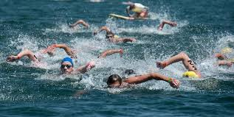
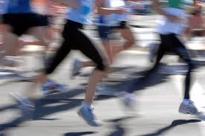
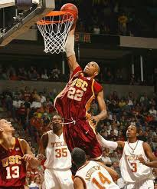
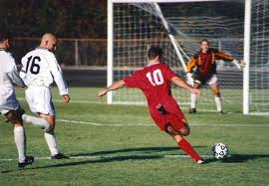

Unit 3
Swimming across Borders
Reading 1: Swimming to Open Up Borders

Slide 2
Unit 3: Swimming across Borders
Reading 1: Swimming to Open Up Borders
Reading 1: Swimming to Open Up Borders

Slide 3
Unit 3: Swimming across Borders
Reading 1: Swimming to Open Up Borders
This unit explores the characteristics, abilities, and achievements of athletes.
Reading One is the story of Lynne Cox ,a long-distance swimmer , who has not only broken records, but also has swum to Lessen political tension among countries.
Reading two presents the professional achievement of three known athletes, Pele, Grete Waitz, & George Foreman, in Vitae form.

Slide 4
Unit 3: Swimming across Borders
Reading 1: Swimming to Open Up Borders
This unit explores the characteristics, abilities, and achievements of athletes.
Reading One is the story of Lynne Cox ,a long-distance , cold-water very special swimmer , who has not only broken records, but who has also swum to Lesson political tension among countries.
Now, I will read “Swimming to Open Up Borders”; listen carefully then answer the following questions.

Slide 5
Unit 3: Swimming across Borders
Reading 1: Swimming to Open Up Borders
Answers
Reading for main ideas:
1-b 2-c 3-a
Reading for details – 1 :
2
1
4
5
3

Slide 6
Unit 3: Swimming across Borders
Reading 1: Swimming to Open Up Borders
Answers
Reading for details -2:
1-5 2-2.7 3- 38 4- 10 5- 12 6- 3 7-30
Reacting to the reading
oral discussion by instructor – available in corresponding recorded lecture in Tegrity Classes

