Slide 1
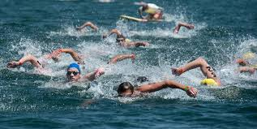
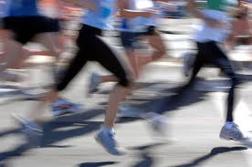
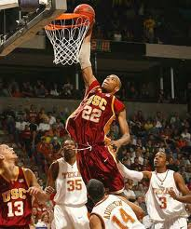
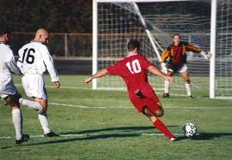

Unit 3
Swimming across Borders
Focus on Writing
Transition Words of Time

Slide 2
Unit 3: Swimming across Borders
Focus on Writing
Transition Words of Time
Style: Transition Words of Time

Slide 3
Unit 3: Swimming across Borders
Focus on Writing
Transition Words of Time
Transition words show the relationship between sentences in a piece of writing. Transition words of time, show time relationships. They help the reader understand which event happened first, which happened second and so on.
Transition words of time include first, then, next and later, which have similar meanings, and finally.
A transition word at the beginning of a sentence is followed by a comma.
Then, she swam in the cold waters of the Pacific Ocean.

Slide 4
Unit 3: Swimming across Borders
Focus on Writing
Transition Words of Time
Exercise 2- page 51 : Answers
1-First 2- Then /Next 3- Next/Then 4- Finally

Slide 5
Unit 3: Swimming across Borders
Focus on Writing
Transition Words of Time
Exercise 3- page 51 : Answer
Kip Keino was born in Kenya in 1940. She has a long history of an outstanding athlete. First, Kip Keino started running when he was in elementary school. Then, he studied at a school for police and ran while he was there. Next, he raced in national races. Later, In 1962 he began to race internationally. Then, he went to the Tokyo Olympics, in 1964, but won nothing. He went to the Mexico City Olympics four years later and won a gold medal in the 1.500-meter race. Finally, at the Munich Olympics, in 1972, he won a gold medal in the 3.000-meter steeplechase.

Slide 6
Unit 3: Swimming across Borders
Focus on Writing
Transition Words of Time
Exercise 4- page 51 : Answer
Grete Waitz was born in Oslo, Norway in 1953. She has a long history of an outstanding athlete. First, Grete Waitz won Norway’s national 800m and 1.500m in 1971. Then, in 1975-1976 she set world records for 3.000m. Next, she was world cross-country champion. Later, In 1983 she was world marathon champion. Then, in 1988 she won the New York City marathon for the ninth time. Finally, she retired from competition with 13 wins in the nineteen marathons she ran.

