Slide 1
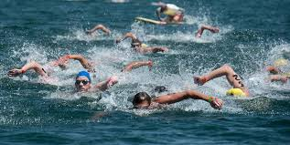
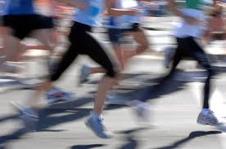
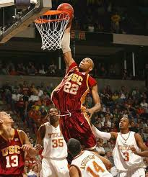
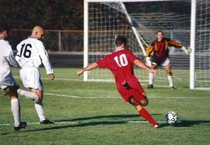

Unit 3
Swimming across Borders
Grammar: Present Progressive
Affirmative and Negative Statements & Writing

Slide 2
Unit 3: Swimming across Borders
Grammar: Present Progressive
Affirmative and Negative Statements & Writing
Exercise 1 : Page 52
Answers
Verbs in the present progressive
They all end with “ing”
Actions that are happening now

Slide 3
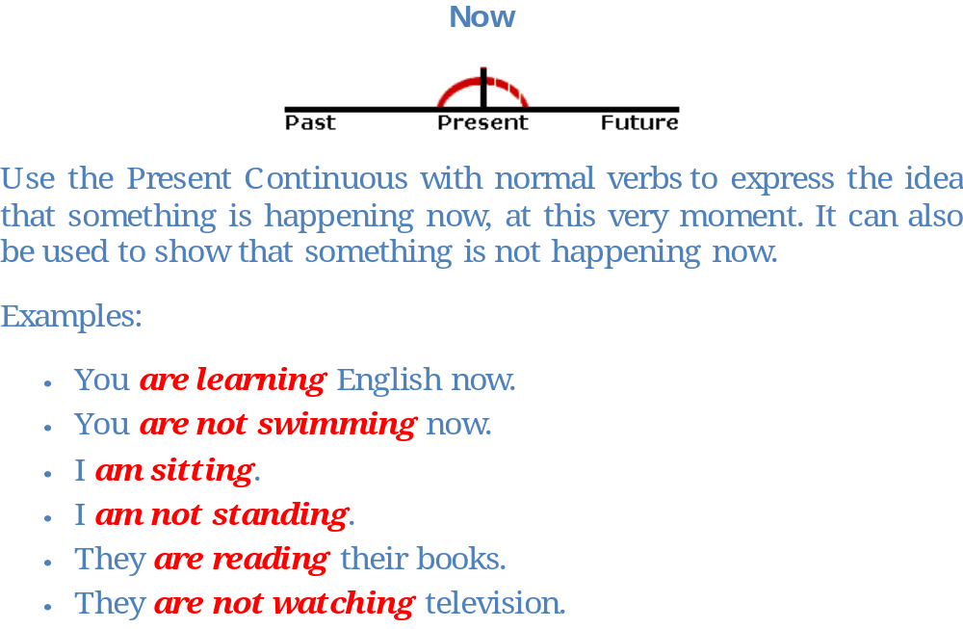
Unit 3: Swimming across Borders
Grammar: Present Progressive
Affirmative and Negative Statements & Writing

Slide 4

Unit 3: Swimming across Borders
Grammar: Present Progressive
Affirmative and Negative Statements & Writing

Slide 5
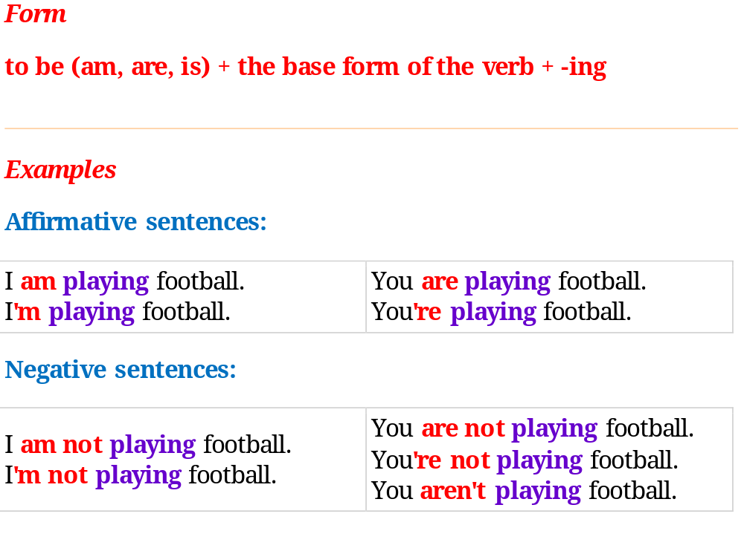
Unit 3: Swimming across Borders
Grammar: Present Progressive
Affirmative and Negative Statements & Writing

Slide 6
Unit 3: Swimming across Borders
Grammar: Present Progressive
Affirmative and Negative Statements & Writing
Use contractions when using I’m learning to speed skate
the present progressive
in speech or informal writing

Slide 7
Unit 3: Swimming across Borders
Grammar: Present Progressive
Affirmative and Negative Statements & Writing
When adding “ing” to the base form, remember:
When a verb ends in a silent e, drop the e before adding the -ing | skate | skating
When a one-syllable verb ends in a consonant, a vowel, and a consonant (CVC), double the last consonant before adding the –ing | run swim | running swimming
Exception: the last consonant is w,x,or y | play | playing

Slide 8
Unit 3: Swimming across Borders
Grammar: Present Progressive
Affirmative and Negative Statements & Writing
Answers
Exercise 2: page 54
Robin is not (isn’t)biking across America.
They are not (aren’t)playing soccer in the park.
We are (We’re) trying to win this game.
Exercise 3: page 54
3: I’m not watching 4: ‘s throwing 5: ‘s running 6: ‘re trying
7: aren’t running 8: ‘s jumping 9: ‘s making 10: what’s happening
11: I’m not sitting

Slide 9
Unit 3: Swimming across Borders
Grammar: Present Progressive
Affirmative and Negative Statements & Writing
Answers
Exercise 3: page 55
Three people are running a race. The tall man is winning. The other two aren’t winning. Two fans are clapping for the winner. One of the runners is falling down. Two people are helping him. A bird is flying in the sky and the sun is shining. The winner is smiling.

Slide 10
Unit 3: Swimming across Borders
Grammar: Present Progressive
Affirmative and Negative Statements & Writing
Answers
C: Writing Topics: 1: page 55
The Red team is winning. A tall basketball player is
scoring. Four other players are watching what is happening.
One player from the other team is trying to hold the tall
Player. The player is jumping very high to reach the net.

