Slide 1
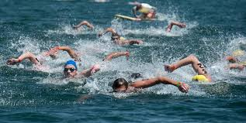
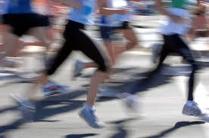
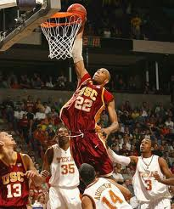
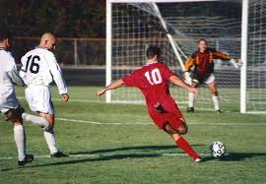

Unit 3
Swimming across Borders
Reading 2: The Athlete’s Life

Slide 2
Unit 3: Swimming across Borders
Reading 2: The Athlete’s Life
Reading 2: The Athlete’s Life

Slide 3
Unit 3: Swimming across Borders
Reading 1: Swimming to Open Up Borders
A vita is a list of the most important events in a person’s life with the dates of these events. We will read three different vitae for three different athletes.
Listen to the reading, then answer the following questions.

Slide 4
Unit 3: Swimming across Borders
Reading 2: The Athlete’s Life
Answers
Linking readings 1 & 2
Vita of Lynne Cox

Slide 5
Vita of Lynne Cox
Born in New Hampshire, USA | 1957
Started swimming | 1962
Moved to Southern California and started swimming in the ocean | 1969
Swam 27 miles to Catalina, of the coast of California | 1971
Broke the English Channel record – less than 10 hours | 1974
Swam beside dolphins across Cook Strait, New Zealand | 1975
Swam between Norway and Sweden, and between Sweden and Denmark | 1977
Swam around Africa’s Cape of Good Hope | 1978
Swam across the Bering Strait to support peace between USA & Russia | 1987
Swam between Argentina and Chile | 1990

Slide 6
Unit 3: Swimming across Borders
Reading 2: The Athlete’s Life
Answers
Linking readings 1 & 2
2 ( oral discussion by instructor- available in the corresponding recorded lecture in Tegrity Classes)

