Slide 1
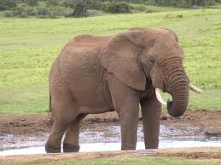
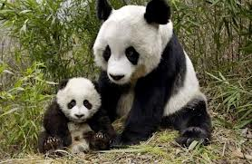
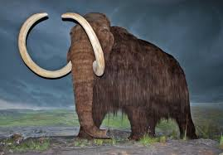
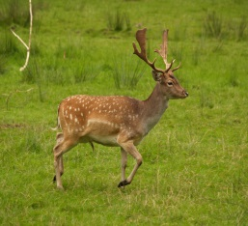
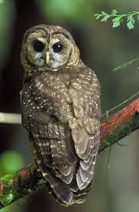
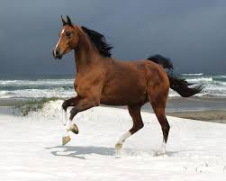
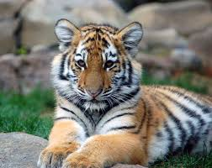
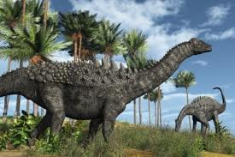

Unit 4
Save the Elephants
Introduction

Slide 2
Unit 4: Save the Elephants
Introduction
Introduction

Slide 3
Unit 4: Save the Elephants
Introduction
Look at the Pictures and answer the following.
Which animals do you know?
Which of these animals have you seen only in pictures?
Which of these animals have you actually seen? Where did you see them?

Slide 4
Unit 4: Save the Elephants
Introduction
Page 58
Not in Danger | Endangered | Extinct
Horse | Owl | Mammoth
Crow | Panda | Dinosaur
Deer | Tiger | Pterodactyl
 | Elephant

Slide 5
Unit 4: Save the Elephants
Introduction
Page 58-59
Read Friends of the Tiger and Save the Northern Spotted Owl ,then answer the following questions.
Why are these animals endangered?
They are endangered because people kill them to sell their parts, cut down their forests and destroy where they live.
What are Friends of the Tiger and Save the Northern Spotted Owl trying to do?
They are trying to protect the forests and stop people from killing the tiger and stop logging companies from cutting the trees where the owl lives.
Do you think it is important to save endangered animals ? Why or why not?
Yes, it is important to save endangered animals otherwise they will be extinct and disappear forever.

