Slide 1
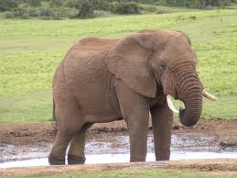
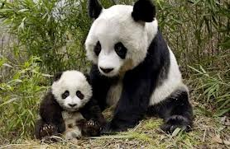
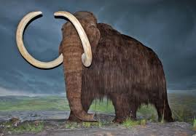
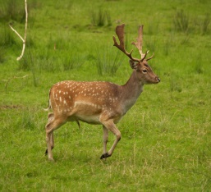
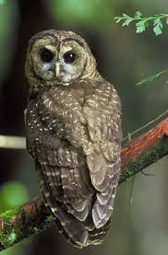
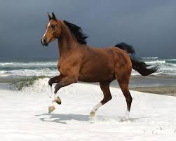
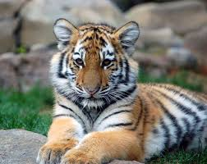
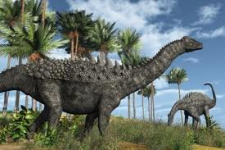

Unit 4
Save the Elephants
Vocabulary

Slide 2
Unit 4: Save the Elephants
Vocabulary
Vocabulary for Comprehension
Focus on Vocabulary

Slide 3
Unit 4: Save the Elephants
Vocabulary
Definitions
To keep someone or something safe | protect
No later than that time | by 1907 ( or any date)
a gift, normally money, to an organization | donation
Someone who kills animals, usually for food | hunter
bone-like material that comes from elephant tusks; in the past was often used to make jewelry | ivory
people who cut down trees to use the wood | loggers
in nature; not in a house or a zoo | wild

Slide 4
Unit 4: Save the Elephants
Vocabulary
Definitions
Born in a certain place | native
against the law | illegal
to change someone’s opinion about something | Convince

Slide 5
Unit 4: Save the Elephants
Vocabulary
Focus on Vocabulary
Answers
Page 66- Exercise 1:
1: protect : fix 2: wild: wales 3: donation: animal 4: ivory: bird
5: hunter: plants 6: native: brought into the place
7: by the year 2010 : in 2010 8: convince: get angry
9: illegal: saving 10: logger: animals

Slide 6
Unit 4: Save the Elephants
Vocabulary
Focus on Vocabulary
Answers
Page 67- Exercise 2:
1: native 2: protect 3: by the year 4: convince
5: illegal 6: wild 7:donation

Slide 7
Unit 4: Save the Elephants
Vocabulary
Focus on Vocabulary
Answers
Page 68- Exercise 3:
Dear Grandma,
The wedding gift you sent is really beautiful. You are very kind, but I cannot accept the gift. I wanted to write this letter to tell you why. I hope that you understand.
The knifes and forks have handles made of ivory. Merchants are killing elephants to use their tusks in making ornaments. I cannot accept that. If we allow this killing of elephants to go on, elephants will be extinct soon.
Let’s work together to save the elephants and stop merchants from killing them. I hope I made myself clear.
I love you,
Sarah

