Slide 1
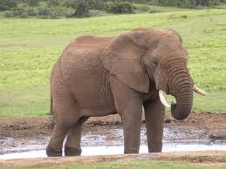
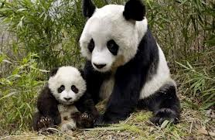
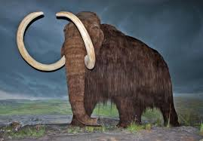
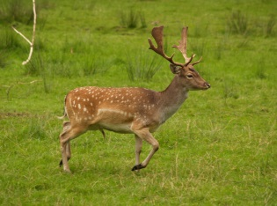
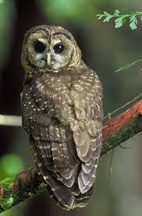
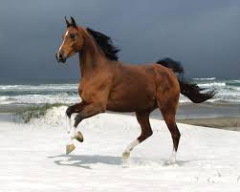
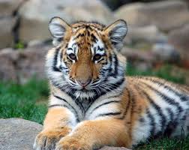
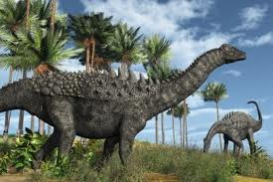

Unit 4
Save the Elephants
Reading One: Save the Elephants

Slide 2
Unit 4: Save the Elephants
Reading 1: Save the Elephants
Reading for Main Ideas
Reading for Details
Reacting to the Reading

Slide 3
Unit 4: Save the Elephants
Reading One: Save the Elephants
Reading One is a letter asking readers for donations for Save the Elephant Fund. The donations will be used to help save the endangered elephant in Thailand.
Who is the letter to? Who is the letter from?
It is to the friends of Save the Elephant Fund. It is from Mark Gow the Executive Director of the fund.
What do you think the writer of the letter wants?
He wants donations or money.
Now listen to the reading then answer the following questions.

Slide 4
Unit 4: Save the Elephants
Reading One: Save the Elephants
Answers
Reading for main ideas ( Page 63)
What is the general purpose of Save the Elephants Fund?
It’s general purpose is to raise money to help save the elephants around the world.
Why are elephants in Thailand endangered?
They are endangered because they don’t have enough food to eat because paper companies cut down banana trees and also because hunters kill them to use their tusks in ornaments.
What can Save the Elephants Fund do to help protect elephants in Thailand?
It can convince people not to buy things made of ivory and also it can help hunters find other ways to make money.
Reading for details ( Page 63)
1-T 2- F 3- F 4-T 5- F 6- T

Slide 5
Unit 4: Save the Elephants
Reading One: Save the Elephants
Answers
Reacting to the Reading ( Page 63 64)
1. Dose the writer of the letter know the reader? How do you Know?
No. He doesn`t . He doesn't use the reader`s name.
2. The letter says, “we need your help.” What kind of help dose Save the Elephants Fund want?
It wants money to help protect elephants.
3. Why dose Save the Elephants Fund tell the reader how many elephants there are Thailand?
It wants to show readers the elephants are endangered animals.

Slide 6
Unit 4: Save the Elephants
Reading One: Save the Elephants
Answers
Reacting to the Reading ( Page 63 64)
4. Save the Elephants Fund says it wants to convince people not buy ivory. How dose this help save elephants?
If people don`t buy ivory, then hunters won`t kill elephants for their tusks.
5. Save the Elephants Fund says it will “help hunters find other ways to make money.” How dose this help save elephants?”
If hunters make money from other jobs, they won`t kill elephants to make money.

