Slide 1
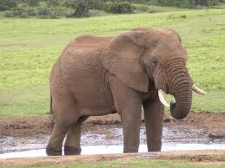
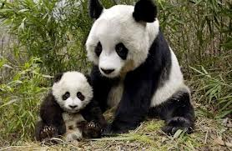
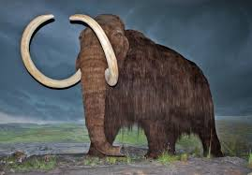
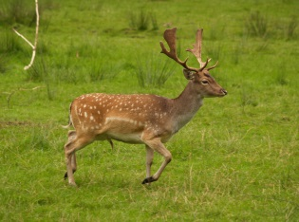
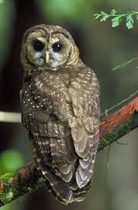
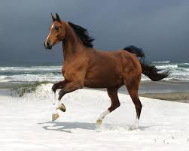
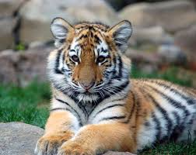
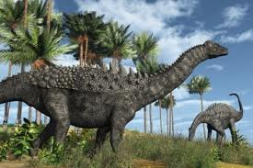

Unit 4
Save the Elephants
Reading Two: Save a Logger – Eat an Owl

Slide 2
Unit 4: Save the Elephants
Reading Two: Save a Logger – Eat an Owl
Reading Two is a letter to the editor of a newspaper. It is a response to an article about the Northern spotted owl.
Listen to the reading, then answer the following questions.

Slide 3
Unit 4: Save the Elephants
Reading Two: Save a Logger – Eat an Owl
1. Why is Ken Waxter angry?
He`s angry because the newspaper didn`t talk about loggers and talked only about saving the owl.
2. Why did the logging companies in Kin`s town stop cutting down so many trees?
The local government told the logging companies to stop cutting down the trees in order to save the owl.
3. How does saving the northern spotted owl hurt Ken Waxter and other people in his town?
When there was less logging, the loggers didn’t have as much work. So, Many loggers became out of work, and many moved to other places looking for jobs.

Slide 4
Unit 4: Save the Elephants
Reading Two: Save a Logger – Eat an Owl
Linking Readings 1 & 2
Page 66
Northern Spotted Owls | Asian Elephants
Their homes are being destroyed by loggers | a. Paper companies are cutting down the trees they eat. b. They`re hunted for the ivory in their tusks. | 1. Why are the animals endangered?
Stop or slow down logging in owl areas | a. Plant other trees that elephants can eat b. Pay for game wardens to protect elephants from hunters c. Find other work for hunters d. Convince people to stop buying ivory | 2. What can people do to help save these animals?
Logging companies &loggers | Papers companies; hunters; workers | 3. Who might be hurt when people try to save the animals ? why ?

