Slide 1
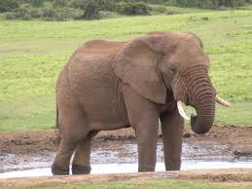
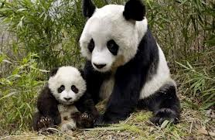
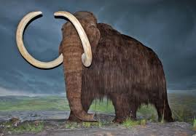

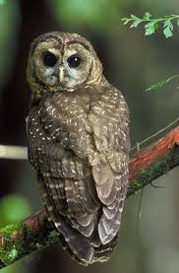
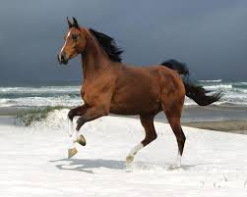
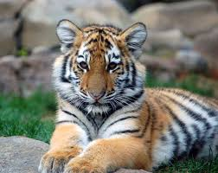
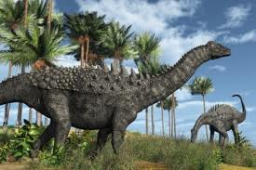

Unit 4
Save the Elephants
Focus on Writing

Slide 2
Unit 4: Save the Elephants
Focus on Writing
Letter Writing

Slide 3
Unit 4: Save the Elephants
Letter Writing
Letters have 5 parts: date, opening, body, closing and signature.
September 30,204 [date]
Dear Julie,
Hi! Thanks for your letter. Your vacation plans sound like so much fun!
What interests you about Kenya? I am interested in going to Africa too! I hear that the animals in Kenya are amazing. I’d like to know more about your trip and the tour group. Who leads the tours? Where do the guests sleep? If you sleep in tents, I think I will find another tour group! I would be too scared of having an elephant walk over me while I sleep.
What do you need to bring? I have an old suitcase, but maybe I should buy a backpack. How much does the trip cost? When do you need to pay? I don’t have much money in the bank right now, but I guess I could use a credit card. Who do I call if I am interested in going?
By the way, why do you want to go in December? Isn’t it really hot there at that time of year?
I’ll call you soon to talk more about the trip. Maybe we can go together.
All the best,
Christine

Slide 4
Unit 4: Save the Elephants
Personal Letter
The letter from Christine is a personal letter.
Personal Letters has five parts:
1. Date: usually in the top right corner of the paper
2. Opening: a greeting to the person you are writing to – “Dear, the person`s name , and a comma
3. Body: your message- one or more paragraphs.
4. Closing: a word or phrase(like “All the best”, “Best wishes”, “Yours truly”) followed by a comma
5. Signature: your first name only for people you know: your full name for other people

Slide 5
Unit 4: Save the Elephants
Business Letter
The letter on pages 64-62 from Save the Elephants Fund is a business letter. A business letter has the same five parts as the personal letter, but there are a few differences.
Name & address: come after the date (The name & address of Save the Elephants Fund comes at the top of the page because it is already printed on the paper. This kind of printed name & address is called letterhead. Most businesses use letterheads on their letters.)
Name, title & address of a specific person: come before the opening.
To Whom It May Concern (for the opening) : if you don`t know who will read your letter.
Closing : use “Sincerely ,”
Signature: your name (printed if you are not typing) and job title (if you have one) go under your signature.

