Slide 1
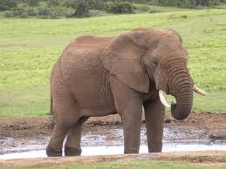
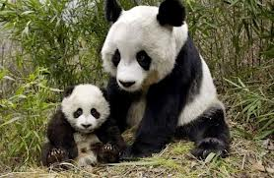
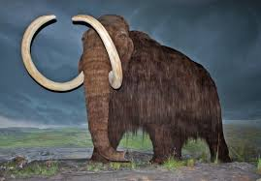
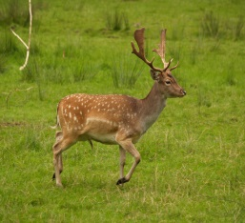
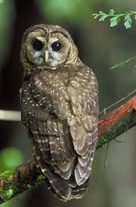
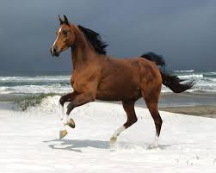
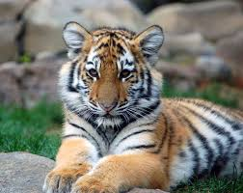
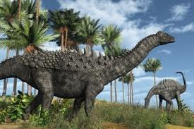

Unit 4
Save the Elephants
Grammar: Wh-Questions in the Simple Present Tense (Part 1)

Slide 2
Wh- Questions in the Simple Present Tense
WH- Questions & Answers
Forming Yes/No Questions in the present tense.

Slide 3
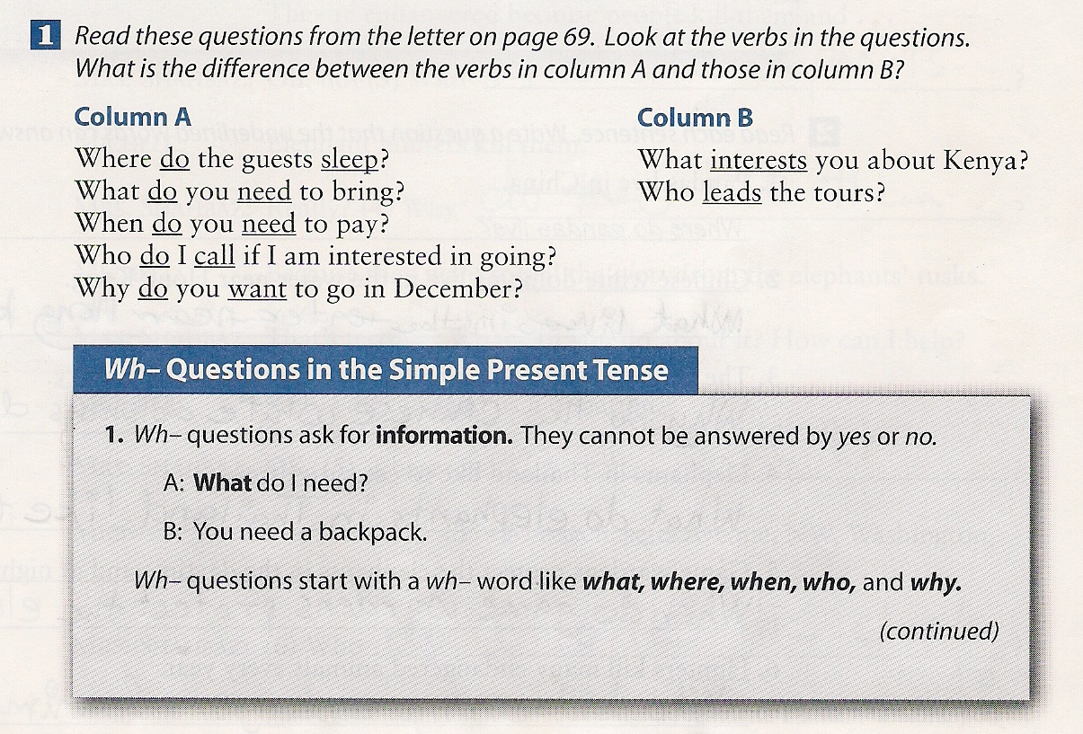
GRAMMAR: Wh-Questions in the Simple Tense Page 71

Slide 4
GRAMMAR: Wh-Questions in the Simple Tense Page 71
Column A uses the WH-word + do + the base form of the verb.
Column B uses the WH word + simple present tense form of the verb.

Slide 5
GRAMMAR: Wh-Questions in the Simple Tense Page 72
Answers:
Where do pandas live?
What lives in the water near Hong Kong?
Why do the Chinese white dolphins die?
What do elephants in Thailand like to eat?
When do game Wardens protect the elephants?
Who kills many endangered animals every year?
.

Slide 6
GRAMMAR: Wh-Questions in the Simple Tense Page 72
Answers:
(1)Who Do you work for ?
(2) Why do you need to save the elephants there?
(3) Who kills the elephants?
(4) Why do they kill them?
(5) Where can I send it?
(6) Who do I write the check to?
.

