Slide 1
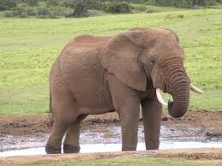
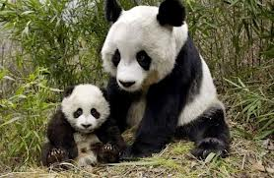
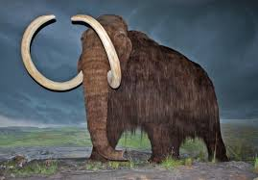
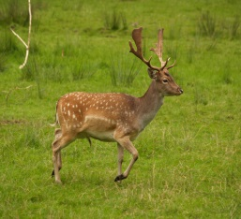
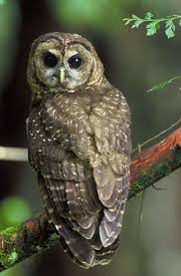
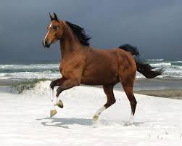
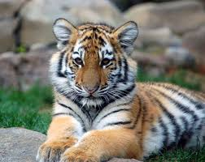
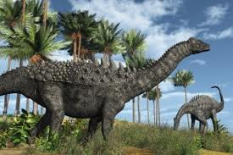

Unit 4
Save the Elephants
Grammar: Wh-Questions in the Simple Present Tense (Part 2)

Slide 2
Wh- Questions in the Simple Present Tense
WH- Questions & Answers
Forming Yes/No Questions in the present tense.

Slide 3
Forming a Yes/No Question
Wh- Questions in the Simple Present Tense
Yes/no questions are created using the auxiliary do . The auxiliary is placed before the subject.

Slide 4
Forming a Yes/No Question in the Simple Present
Wh- Questions in the Simple Present Tense
Example | Subject | Auxiliary
Do I sing? | I | Do
Do you sing? | you | Do
Does he sing? | he | Does
Does she sing? | she | Does
Does it sing? | It | Does
Do we sing? | we | Do
Do they sing? | they | Do

Slide 5
Forming aWH- Question
Wh- Questions in the Simple Present Tense
WH- questions (using words such as “what”, “when”, and “where”) are also created by putting the auxiliary do before the subject. Then, you add the WH- word at the beginning. Here are some examples:

Slide 6
Forming a WH- Question
Wh- Questions in the Simple Present Tense
WH- question | Statement
What do I sing? | I sing.
Why do you travel? | You travel because you have time.
Where does he live? | He lives in Dammam.
When do they wake up? | They wake up at 6:00 am.
What does Ahmad like? | Ahmad likes chocolate.
What am I? | I am a teacher.

Slide 7
Wh- Questions in the Simple Present Tense
Forming a WH- Question
Complete Answers | Wh - Questions
My family celebrates my birthday with me. | Who celebrates your birthday with you?
My favorite holiday is Eid Al-Fitir. | What is your favorite holiday?
My birthday is on June 28. | When is your birthday?
I am from Saudi Arabia. | Where are you from?
I like it because all Muslims break their fast at the same time. | Why do you like Eid Al- Fitir?
I visit family and friends. | How do you celebrate Eid Al- Fitir?

Slide 8
Forming a WH- Question
Wh- Questions in the Simple Present Tense
Tick the correct Wh-word.
1. Who / Why / Where are the kids? | They are outside now.
2.How / Who / Why is the baby in bed ? | Because he is very tired.
3.What / When / How old is the test? | On Friday
4. How much / When / How are the oranges? | Two dollars a kilo
5. How much / How old / When is your sister? | She is 17 years old today.

Slide 9
Forming a WH- Question
Wh- Questions in the Simple Present Tense
6.What / Where / Who color is the dress? | It is green.
7.How / How many / Why do you go to work every morning? | I go to work by car.
8.Where / What / When are my shoes? | They are under the chair.
9. Why / What / When are you home every day? | At about 17:00 p.m.
10.How / Where / What is on the shelf? | The radio …..

Slide 10
Forming a WH- Question
Wh- Questions in the Simple Present Tense
Complete the sentences with the correct Wh-word.
1. …… are you excited? Because I have a birthday party today.
2. ……. are you today ? I’m fine ,thank you.
3. …… is your coat ? It is In the bedroom
4. …….. is she at the moment? She is at home.
5. ………is your birthday ? It is in September

