Slide 1
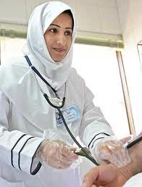
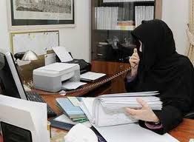
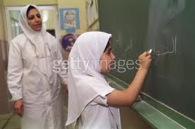

Unit 1
Finding the Ideal Job
Assignments
Lectures (1,2,3)

Slide 2
Unit 1: Finding the Ideal Job
LECTURE 1
Assignment

Slide 3
Lecture 1
Assignment
Q1: Choose the correct answer :
1- She is a great doctor. She has a distinguished …………………. in medicine.
a) satisfaction b) ads c) career d) review
2- The government is trying to encourage ………………..in the private sector.
a) employment b) resume c) want ads d) percent
3- When you apply for a job, you should send your ………… before the interview.
a) career b) job c) resume d) employment
4- The ………………job for me is to become a teacher.
a) wanted b) ideal c) satisfied d) interested
5- I cannot afford to buy a new car now because I am ………………….
a) ideal b) rewarded c) out of work d) out of order

Slide 4
Unit 1: Finding the Ideal Job
Lecture 2- part 1
Assignment

Slide 5
Lecture 2 – part 1
Assignment
  Q1: Read the book review on pages 5-6 then answer the following questions.
  What kind of book is What Color is Your Parachute?
  Does What Color is Your Parachute? help people find new jobs? how?

Slide 6
Unit 1: Finding the Ideal Job
Lecture 2 – part 2
Assignment

Slide 7
Lecture 2 – part 2
Assignment
Q1: Answer the following questions in full sentences.
Is Betsy happy in her new job? What does she do?
What is Amanda's job? Is she satisfied with it? why?
What is Danna's job? Does she make a lot of money?

Slide 8
Unit 1: Finding the Ideal Job
Lecture 3
Assignment

Slide 9
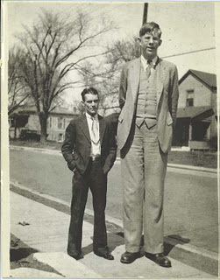
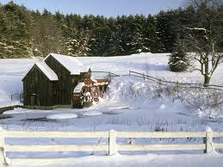
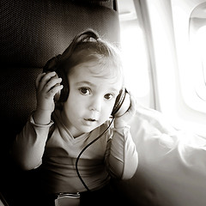
Lecture 3
Assignment
Q1: Describe the pictures. For each picture, write at least two sentences. You can use the adjectives listed below.
Big- short- tall- old – white- green- huge- small

Slide 10
Lecture 3
Assignment
Q1: Choose the correct answer:
1. Her dress is long and simple.
(The possessive adjective is ………..)
a) dress b) Her c) long d) simple
2. She left for university at 8. ( What is the underlined word ? )
a) subject b) object c) verb d) preposition
3. My job is ideal.
(Which is the descriptive adjective)
a) job b) my c) is d) ideal
4. She is a smart student.
(the underlined word is a ….)
a) verb b) subject c) possessive adjective d) descriptive adjective

Slide 11
Lecture 3
Assignment
Their house is fabulous.
(the underlined word is …)
a) verb b) subject c) possessive adjective d) descriptive adjective
6. Which of the following statements is correct ?
a) She is a clever student. b) They are a hardworking doctors.
c) He is skillful engineer. d) We are a smart students.
7. Choose the sentence which has a descriptive adjective followed by a noun.
a) I am interested in my job. b) They are clever.
c) She is an important writer. d) Amal is my friend.

Slide 12
Lecture 3
Assignment
8. ________ pencil is broken. Can I borrow ________?
a ) Mine, yours b) Your, mine c) My, yours d) Yours, mine
9. Hala has lost ________ book.
a) mine b) her c) hers d) theirs
10. Huda has eaten her lunch already, but I'm saving ________ until later.
a) hers b) her c) my d) mine

