Slide 1
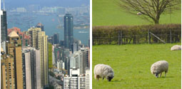
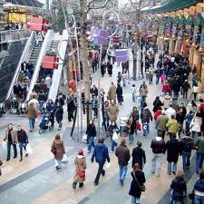

Unit 2
Country Life vs. City Life
Lecture 1 (Part 1)

Slide 2
Unit 2: Country Life vs. City Life
Part 1: Introduction
Part 2:Vocabulary
Definitions
Exercises

Slide 3
Unit 2: Country Life vs. City Life
Part 1: Introduction

Slide 4
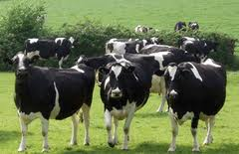
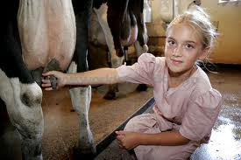
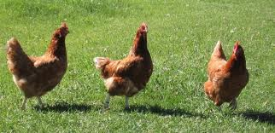
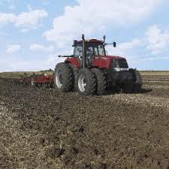
Part1: Introduction

Slide 5
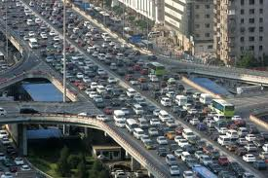
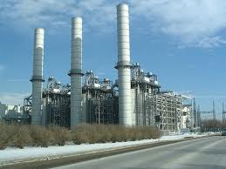
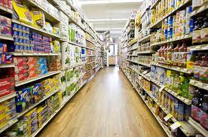
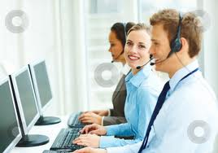
Part1: Introduction

Slide 6
Part1: Introduction
Look at the pictures, then answer these questions.
Where would you see the scenes in the two slides?
What are the people in the pictures doing? Where do they live?
How do people in the city spend their time?

Slide 7
Part1: Introduction
How do people in the country spend their time?
Where do you live?
Where did you grow up?
Where did your parents grow up?
Where did your grandparents grow up?

Slide 8
Part1: Introduction
Answers
The scenes in the first slide can be seen in the country. The scenes in the
second slide can be seen in the city.
The little girl is milking the cow. She lives in the country. The two men and
the woman in the second slide are working in an office . They live in the city.
People in the city spend their time working in offices.

Slide 9
Part1: Introduction
Answers
People in the country spend their time working on the farm; milking the cows, ploughing the land , growing crops and feeding the animals .
I live in ( a city- a small town – the country).
I grew up in ( a city- a small town – the country).
They grew up ( a city- a small town – the country).
They grew up ( a city- a small town – the country).

Slide 10
Part1: Introduction
Book P20
Read the statements and answer the following questions.
In 1900, 50 percent of all Americans worked or lived on farms. In 2000, less than 1 percent of all Americans lived or worked on farms.
In the late 1990s, agritourism ( vacationing on small family farms) made up 5 to 10 percent of the tourism trade in Europe. Experts think this number will increase in the next 20 years.
Where are people living now if they are not living on farms?
They are living in the city.
Why do you think tourists want to visit farms for their vacations
Tourists want to visit farms for their vacations because they are quite and relaxing and also because the air there is fresh and the food is healthy.

Slide 11
Unit 2: Country Life vs. City Life
Part 2: Vocabulary
Definitions
Exercises

Slide 12
Definitions
LAND - An area of land used for growing crops A field of corn | fields
PLANTS - A plant such as a grain, fruit, or vegetable that is grown in large amounts by farmers. | crops
animals/crops- to make an animal or crop grow to raise chickens/sheep | raise
PLANTS AND ANIMALS - All the plants, creatures, substances, and forces that exist in the universe, which are not made by people and which are created by God. I like to get out and enjoy nature. | nature

Slide 13
Definitions
Something that it is your job or duty to deal with The manager has a lot of responsibilities. [+ to do sth] It is your responsibility to make sure that your homework is done on time. | responsibility
AREA (also woods) - A large area of trees growing near each other. We went for a walk in the woods. | wood
PURPOSE If you use something, you do something with it for a particular purpose. Can I use your pen? She uses her car for work. Nick used the money to buy a CD player. | use

Slide 14
Definitions
used to do/be something- If something used to happen or a situation used to exist, it happened regularly or existed in the past ,but it does not happen or exist now. I used to go out every night when I was a student. Monica used to live in Glasgow. He used to be a lot fatter. | used to
When the sun appears in the morning and the sky becomes bright. | sunrise
Needing the help of someone or something in order to exist or continue as before. She's completely dependent on her parents for money. | dependent on

Slide 15
Definitions
NOT WORK - to leave your job or school permanently. She recently quit her job to spend more time with her family. | quit
The ability to deal with dangerous or difficult situations without being frightened The soldiers fought with great courage. She didn't have the courage to tell him the truth. | courage
BECOME ADULT to become older or an adult She grew up in New York. | grow up

Slide 16
Definitions
money that you earn by working, investing, or producing goods families on low incomes | income
PLEASED- feeling very pleased about something you have done, something you own, or someone you know. She was so proud of her son. [+ to do sth] I'm very proud to be in this project. | proud of
give birth- When a woman or an animal gives birth, she produces a baby from her body. She gave birth to twins. | birth

Slide 17
Part 2: Vocabulary
Exercises
Vocabulary For Comprehension - Book P21-22
Read each statement. Then circle the correct definition of the underlined words.
There is a beautiful view from this window. I can watch the farmers at work in the fields. In winter; the fields are brown; in spring, they are green; in summer and fall I can see the tomatoes and pumpkins planted there.
  a) pieces of land covered with trees
  b) pieces of land for planting ✓
We planted the crops really early this year, we got the corn, wheat, and tomatoes in the ground by the end of April.
  a) plants that a farmer grow ✓
  b) pieces of land

Slide 18
Part 2: Vocabulary
Exercises
Vocabulary For Comprehension - Book P21-22
She raises sheep on her farm. She is with them from the time they are born until she sells them.
  a) takes care of ✓
  b) brings farm animals to market to sell
He used to be a farmer when he was young. After 20 years of farming, he decided to change careers now he is a teacher.
  a) wanted to
  b) was before but isn’t now ✓

Slide 19
Part 2: Vocabulary
Exercises
Vocabulary For Comprehension - Book P21-22
Most people who live in the city find ways to enjoy nature. They visit the city parks, keep flowers in their windows, and go away for weekend visits to the country, to the beach, or to the mountains.
    a) activities in the city
    b) the world and everything in it which people have not made ✓
Unlike most of her friends, 12- year- old Sally has a great sense of responsibility. She has to take care of her baby sister every day after school, and she always does it very well.
    a) something that you have to do ✓
    b) something that you want to do

Slide 20
Part 2: Vocabulary
Exercises
Vocabulary For Comprehension - Book P21-22
A lot of children from New York City have never been in a wood. They don’t know what it’s like to walk in the cool dark space where lots of plants and animals live under lots and lots of trees.
    a) park
    b) area with a large number of trees ✓
They had stayed up all night. Just when they were ready to go to sleep, they saw a pink light in the sky. They decided to stay up just a little longer to watch the sunrise.
    a) city lights
    b) sun coming up in the morning ✓

Slide 21
Part 2: Vocabulary
Exercises
Vocabulary For Comprehension - Book P21-22
Eli’s dog, Spot, is dependent on him. Spot needs Eli to give her food and water.
    a) needing someone or something to help or support you ✓
    b) loving someone or something.
Julia was at the birth of her first pony. She has taken care of this pony ever since the first day he came into the world.
    a) when a baby is born ✓
    b) when someone gives something to another person

Slide 22
Part 2: Vocabulary
Exercises
Vocabulary For Comprehension - Book P21-22
Mr. Gow was very proud of his daughter. She worked very hard for many years to start her own restaurant. Last week the newspaper said it was the best restaurant in town.
    a) happy that someone is making a lot of money
    b) happy about someone’s good actions ✓

