Slide 1
University of Dammam
Course: General English
Book: North Star
Basic / Low Intermediate
By
Natasha Haugnes & Beth Maher

Slide 2
Unit 5
Netiquette

Slide 3
Lecture 7

Slide 4
Netiquette
Scope of unit 5:
Theme: “Netiquette” or the network etiquette.
      (the basic rules of e-mail use)
Introduction to main theme
Reading skills : Reading two passages for main ideas, scanning for details.
    - “Netiquette” do’s and don’t:
    An Article about the basic rules of email use
    - Dear Debbie:
    A newspaper advice column called “Dear Debbie”
Vocabulary : Introducing “Prefix”
Writing skills: Punctuation
Grammar: Verbs plus gerunds and infinitives

Slide 5
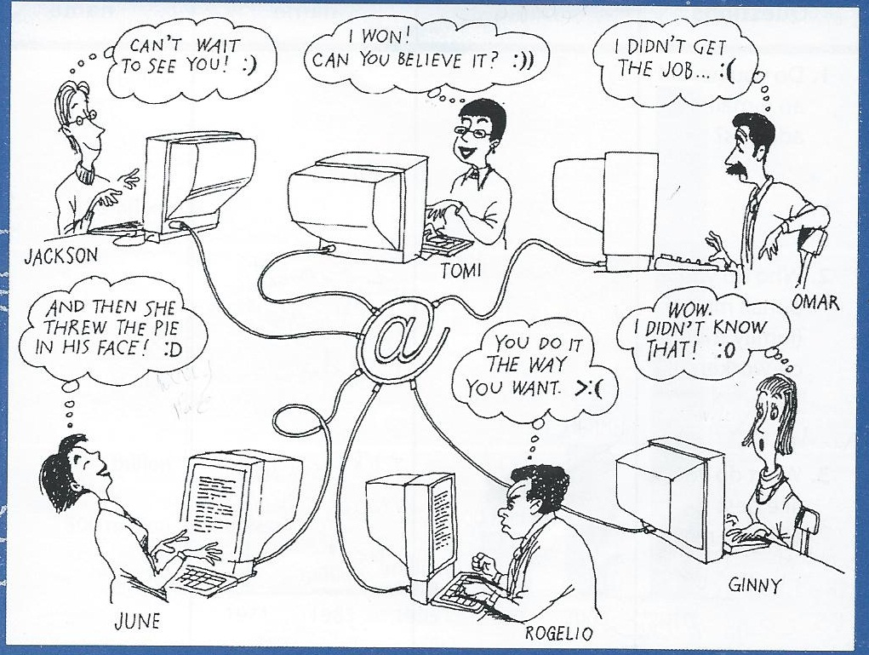
FOCUS ON THE TOPIC
A- Prediction
What are these people doing?
They are writing messages and
sending e-mails.
Can you tell how each person
feels?
Some are happy and some are not.
When are these symbols [:) , :)), :D, :O, >:( , :( ] used in an email? What do they communicate?
They communicate different feelings.

Slide 6
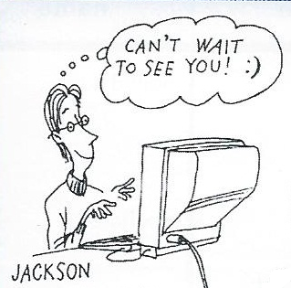
Picture 1
What is Jackson doing?
He is sending an e-mail saying
“can’t wait to see you !:)”.
What do you think he feels?
He is happy and smiling.
What does the symbol :) he uses communicates?
It communicates his feeling of happiness.

Slide 7
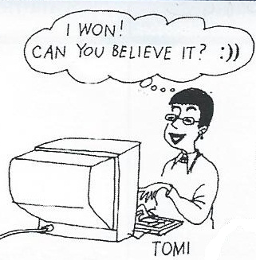
Picture 2
What is Tomi doing?
She is sending an e-mail saying
“I won! Can you believe it?:))”.
What do you think she feels?
She is very happy.
What does the symbol :)) she uses communicates?
It communicates her extreme feeling of happiness.

Slide 8
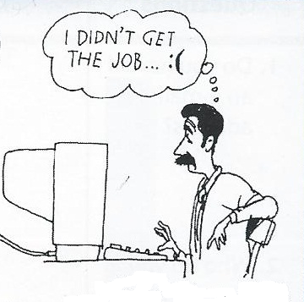
Picture 3
What is Omar doing?
He is sending an e-mail saying
“I didn’t get the job..:(”.
What do you think he feels?
He is sad.
What does the symbol :( he uses communicates?
It communicates his feeling of sadness.

Slide 9
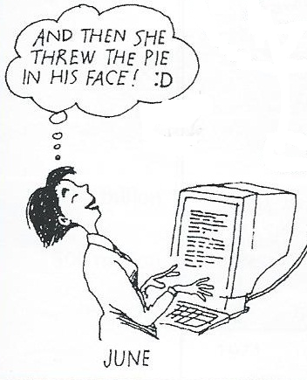
Picture 4
What is June doing?
She is sending an e-mail saying
“and then she threw the pie in
his face!:D”.
What do you think she feels?
She is satisfied.
What does the symbol :D she uses communicates?
It communicates her feeling of satisfaction.

Slide 10
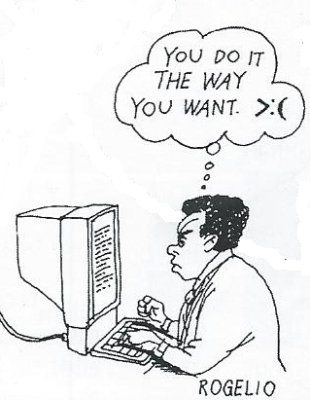
Picture 5
What is Rogelio doing?
He is sending an e-mail saying
“you do it the way you want >:(”.
What do you think he feels?
He is furious.
What does the symbol >:( he uses communicates?
It communicates his madness at someone.

Slide 11
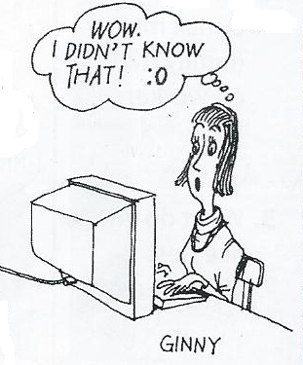
Picture 6
What is Ginny doing?
She is sending an e-mail saying
“Wow. I didn’t know that!:O”.
What do you think she feels?
She is surprised.
What does the symbol :O she uses communicates?
It communicates her feeling of surprise.

Slide 12
Conclusion
People send different e-mails to communicate different feelings. They use symbols in their e-mails to communicate their feelings.
Examples:
:) :)) :D
:O >:( :(

Slide 13
B- Sharing Information
Answer the following questions:
1- Do you have an e-mail address?.
2- Who do you e-mail most?(family, friends, co-workers).
3- What do you like best about email?.
4- What are some problems with e-mail?.
5- How often do you write letters using “snail mail” or the regular postal system?

Slide 14
C- Preparing to read
Background
On page 79 you have a graph showing the number of Email addresses worldwide.
Look at the graph then answer the questions that follow.

Slide 15
Vocabulary for comprehension
Calm: quiet
Upset: Sad
Rude: not polite
Polite: nice
Reply: answer
Organize: arrange
Subject: theme
Receive: get
Communicate: interact
Private: personal

Slide 16
II. FOCUS ON READING
Reading One: “Netiquette” do’s and don’t
this is an article taken from an online news letter for banking employees.
Main idea of the text:
What is “netiquette”?
Sarah Byrne writes a list of what people must do and another list of what people must not do when they use e-mail
After reading the text answer exercises on P.82-83.

Slide 17
II. FOCUS ON READING
B. Reading Two: Dear Debbie
This is an excerpt from a newspaper advice column called “Dear Debbie”.
Let us find out what each e-mail is about.

Slide 18
II. FOCUS ON READING
C. Linking readings one and Two:
Choose one of the three e-mail bloopers and fill the following letter outline with the appropriate information.

