Slide 1

University of Dammam
Course: General English
Instructor: Dr. Naglaa El-Hehyawi
Associate Professor
Text Book: North Star
Basic / Low Intermediate
By
Natasha Haugnes & Beth Maher

Slide 2
Unit 1
Finding the ideal job (the best kind of work)
The theme: Work

Slide 3
Lecture 1

Slide 4
Finding the Ideal Job
Scope of unit 1:
Theme: How to find your ideal job (job hunting)
Introduction to main theme
Reading skills - Reading two passages for main ideas, scanning for details
    A review of job hunter's manual
    A newspaper report
Vocabulary - Introducing new vocabulary related to job hunting
Writing skills
    Learning the difference between a sentence and a fragment
    Learning parts of the sentence
    Constructing complete sentences
Grammar: Descriptive and possessive adjectives

Slide 5
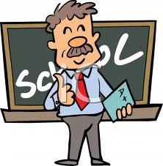
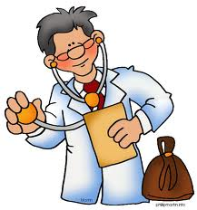
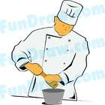
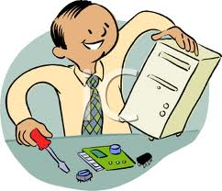
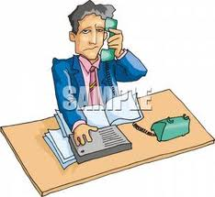
FOCUS ON THE TOPIC
What do you think the man in picture 2 works as?
Is the man in picture 3 an engineer or a chef?
What is the man in picture 4 doing?
Is the man in picture 5 a teacher or a manager?
What is the job of the man in picture 1?

Slide 6
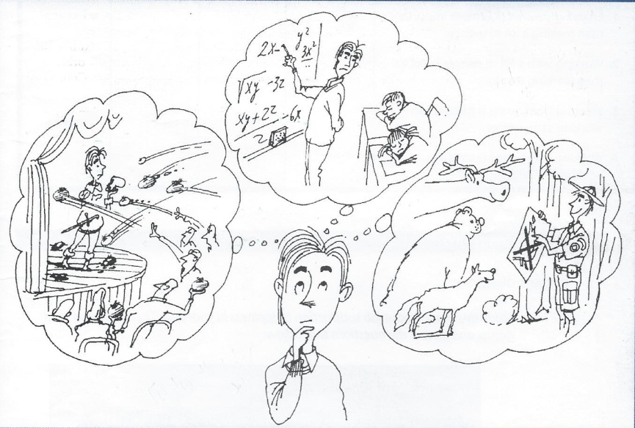
A- Prediction
What is the young man in the picture doing?
He is thinking of different works.

Slide 7
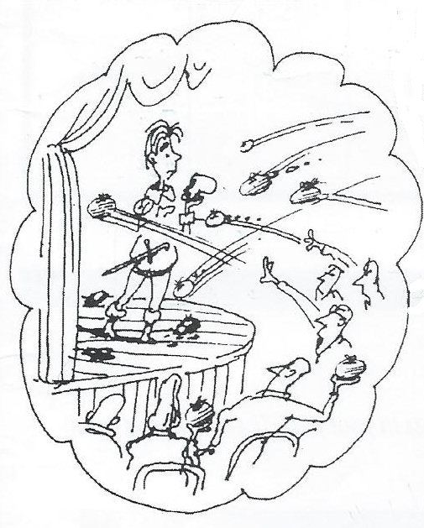
Picture 1
what kind of work is he thinking of?
He is thinking of becoming a singer.
You can see him standing on the
theatre and holding a microphone
in his hand.
You can also see the audience
reaction to what he is doing.
What does this mean?
It means that the people do not like him. They are not satisfied with what he is doing.

Slide 8
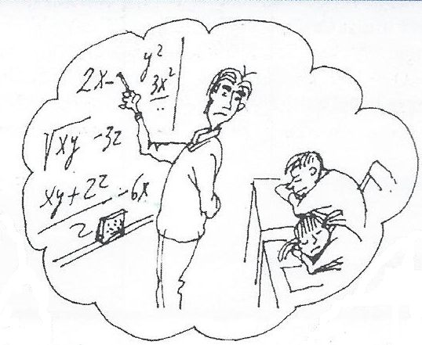
Picture 2
what kind of work is he thinking of?
He is thinking of becoming
a teacher.
You can see him writing on the
blackboard some math problems.
What are the students doing?
They are sleeping.
What does this mean?
It means that he is boring.

Slide 9
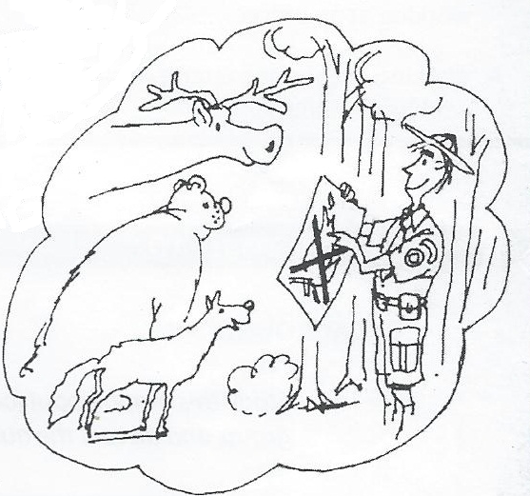
Picture 3
what kind of work is he thinking of?
He is thinking of becoming
a forest guard.
You can see him standing
with a happy smile on his face
and trees and animals
around him.
What does this mean?
It means that he likes his work.

Slide 10
Conclusion
What do you think is the ideal or best job for this young man?
Which picture shows his success in his job?
In picture 1 people are not satisfied with his singing. So he is not successful and it is not the suitable job for him.
In picture 2 the students are bored and sleeping. So he is not successful and it is not the suitable job for him.
In picture 3 he looks happy and the animals are also happy to have him around. So he is successful and it is the suitable job for him.

Slide 11
B- Sharing Information
What criteria do you consider important in trying to find the ideal job?
On page 2 you have 4 statements
Read the statements and mark your answer (How far do you agree).
1- Enjoying your work is more important than making a lot of money.
2- Working with a lot of people is better than working alone.
3- Working from home is better than working at an office.
4- Working indoors is better than working outdoors.

Slide 12
C- Preparing to read
On page 2 you have some statistics about job satisfaction in the United States.
You have a table showing the percentage of American workers who are satisfied or dissatisfied with their jobs. Look at the graph then answer the questions that follow.

Slide 13
Vocabulary for comprehension
Career: The job that someone does for a long period
  She has a career in advertising.
Employment: The work that you do to get money
  It is difficult to find employment nowadays.
Hire: If you hire someone, you give them a job
  The manager hired a new secretary.
Ideal: Perfect
  She is the ideal person for the job.

Slide 14
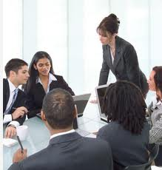
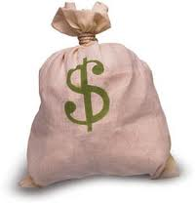
Manager: A person who is in charge of a group of workers.
She is a hotel manager.
Out of work: Without a job
Many young people are out of work.
Resume: A piece of paper with your work and education history. It is also called a CV.
You should send your resume with your job application.
Rewards : Good things that you get because you have done something good or because you have worked hard, e.g. money or health insurance.
The manager rewarded good employees for their hard work.

Slide 15
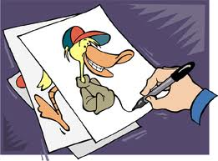
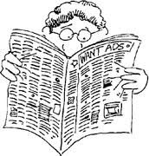
Satisfied : If you are satisfied with something, you are happy because you have got what you wanted.
I am satisfied with my marks.
Skill: A skill is something that you can do well.
She has good computer skills.
He has good drawing skills.
Want ads: Want ads are advertisements for jobs, usually in a newspaper.
She found her new job in the want ads.

