Slide 1

General English Language
Eng 121
Instructor: Ammar Sultan Al-Maani
King Faisal University
e- Learning Deanship
& Distance Education
1

Slide 2

First Class
English Language
Basic English Grammar

Slide 3
In this lesson
let’s make sentences with verb “be” (am, are, is).
Sentences = SUBJECT + VERB.
Subjects = nouns and pronouns (I, you, he, she, it , we, they ,this, these.
Subject + form of verb “be”

Slide 4
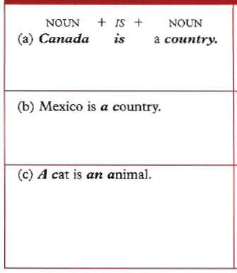
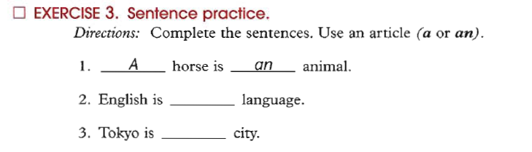
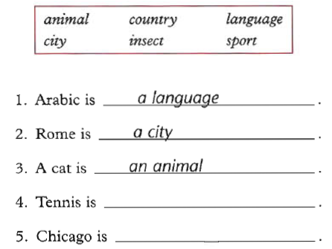

Slide 5

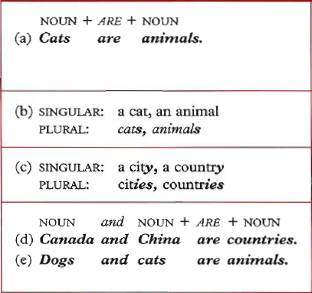
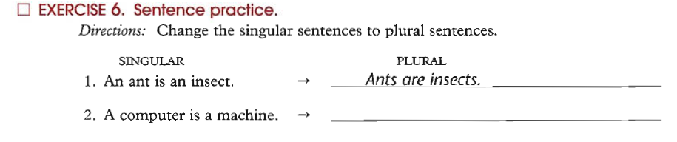

Slide 6

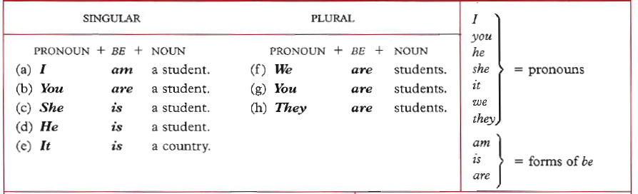
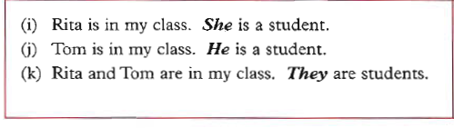

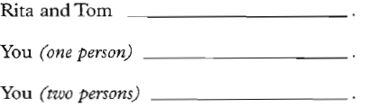

Slide 7

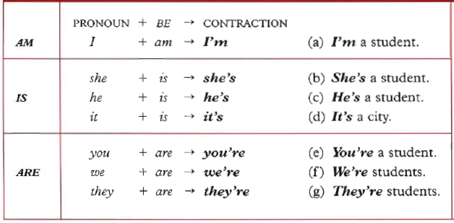
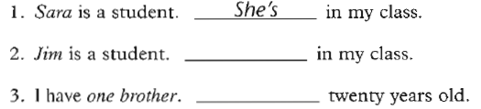

Slide 8

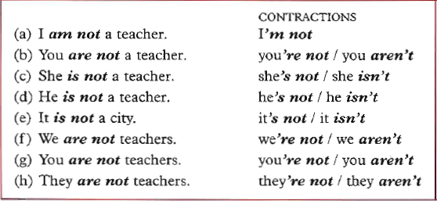
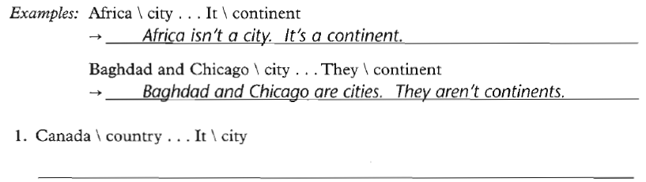

Slide 9

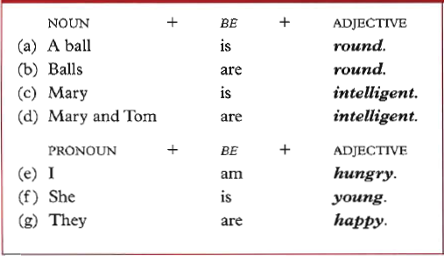
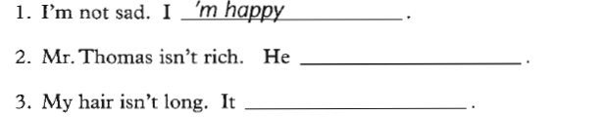

Slide 10

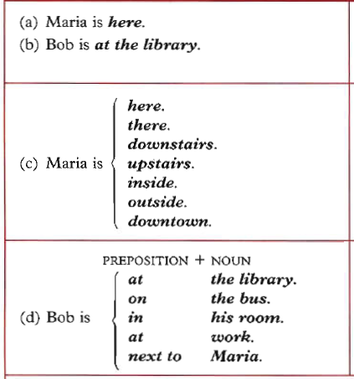

Slide 11
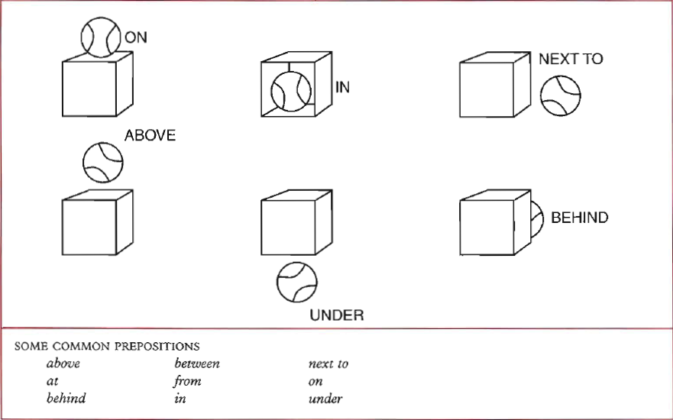

Slide 12
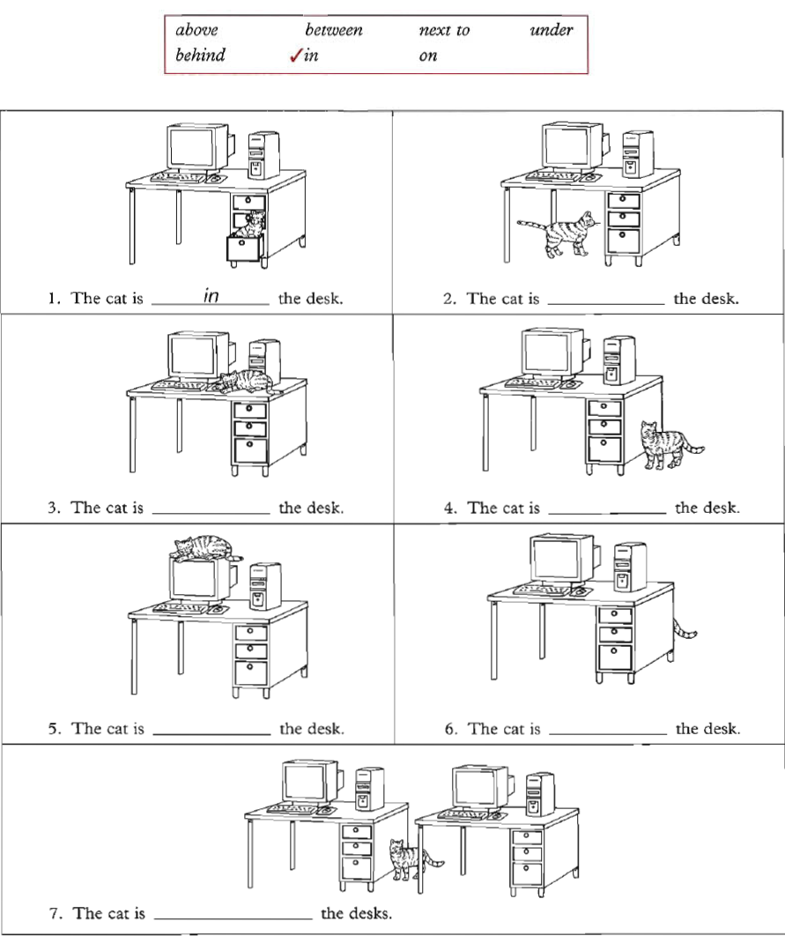

Slide 13

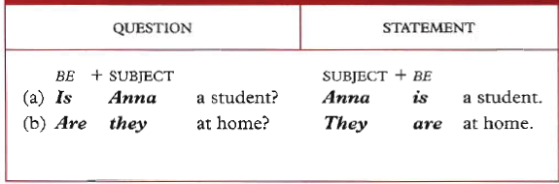
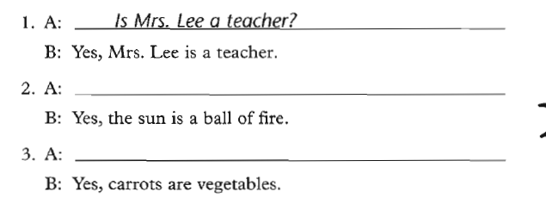

Slide 14
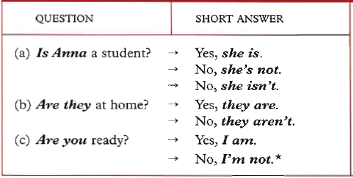
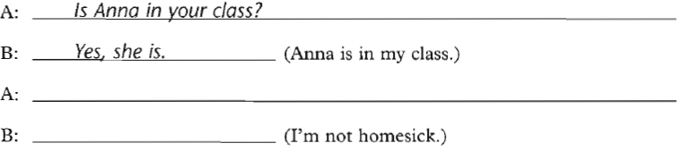

Slide 15
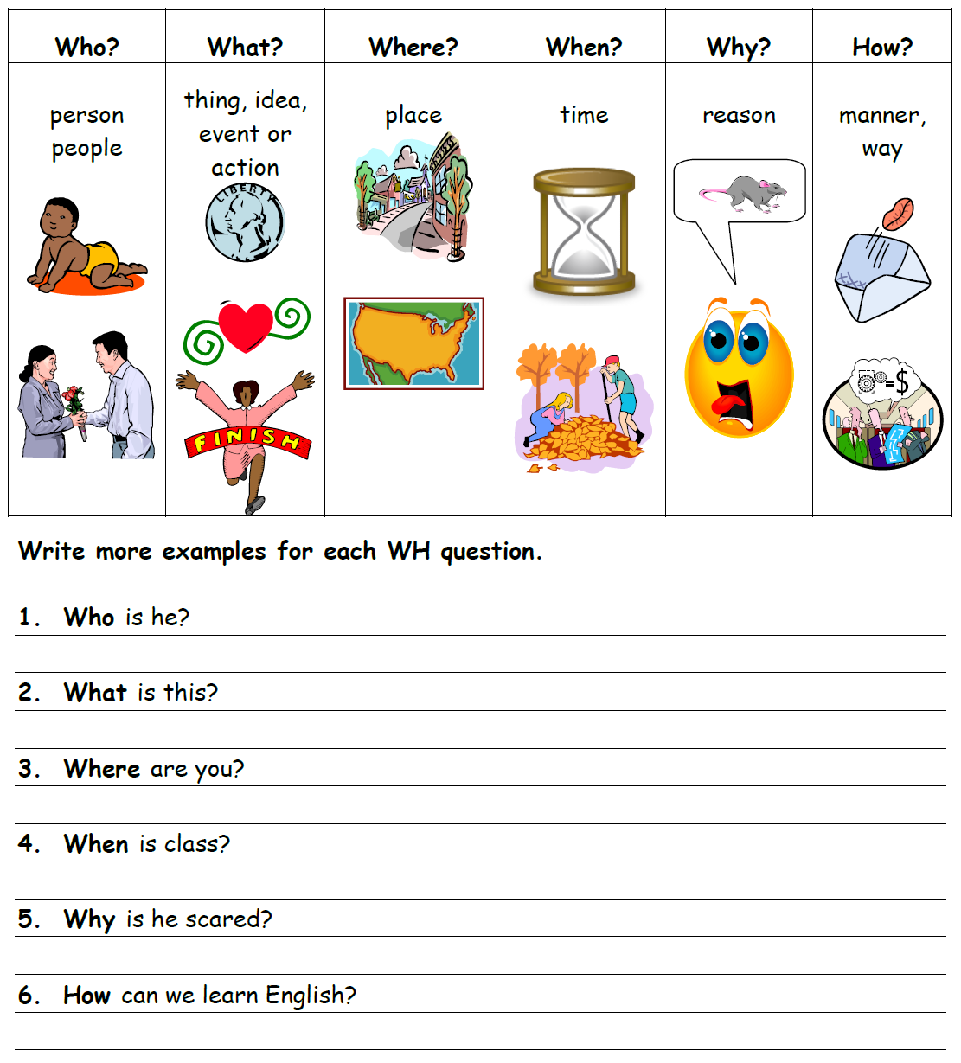
WH Questions Chart

Slide 16

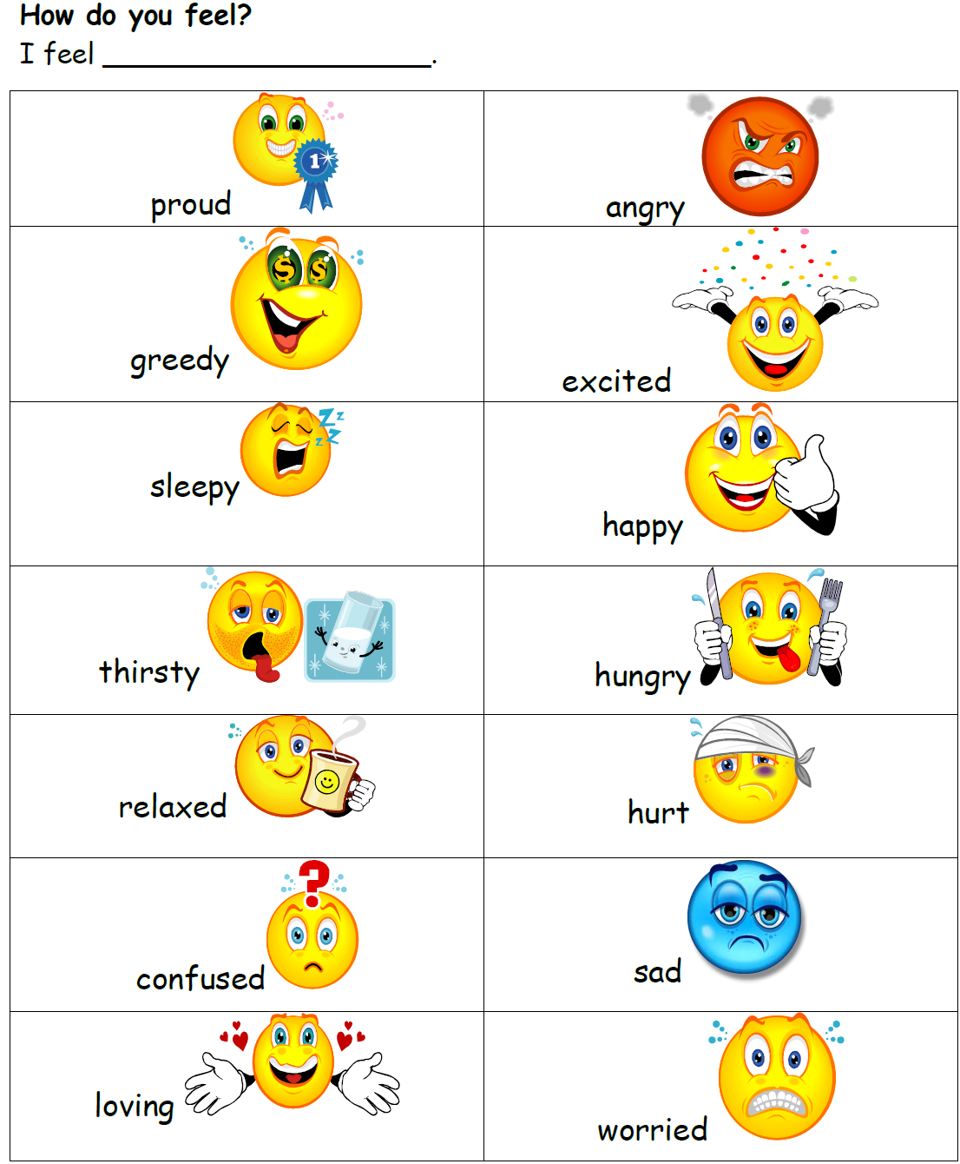

Slide 17
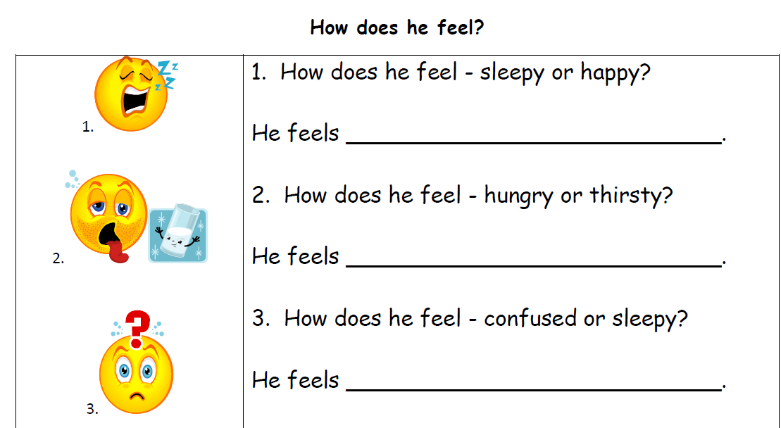

Slide 18
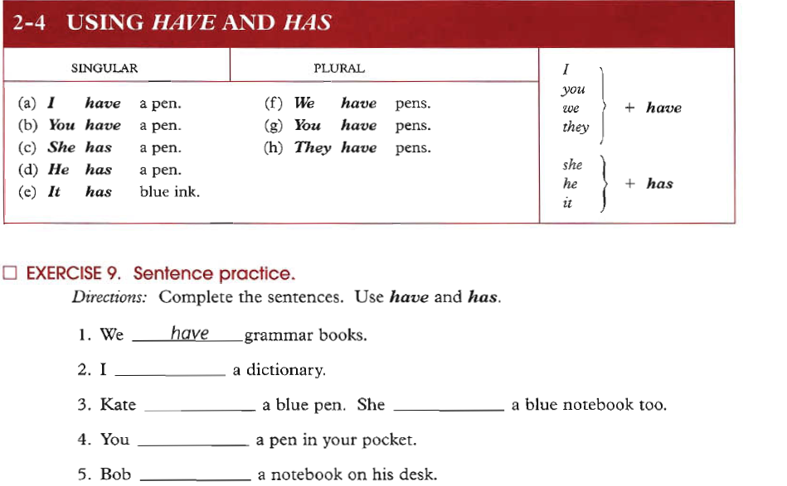
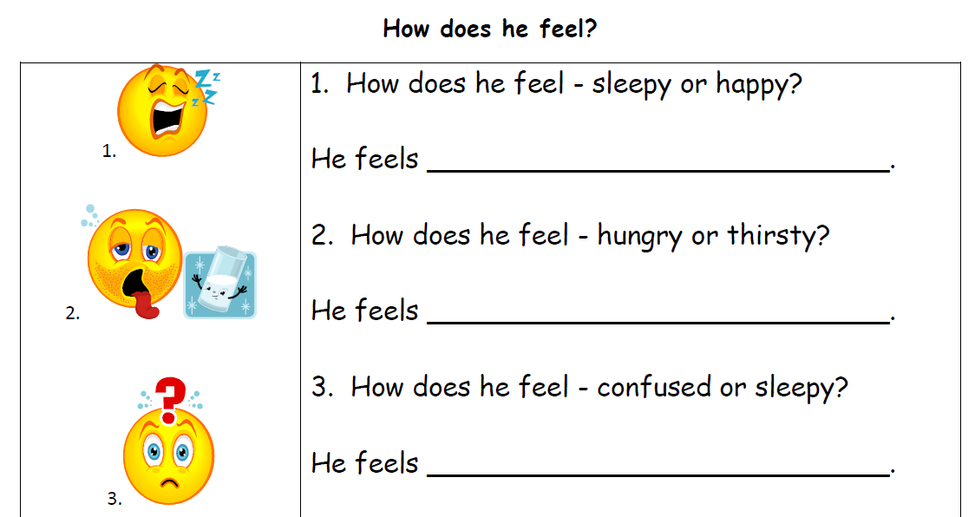

Slide 19

Do your Homework on→
- Chapter 1: Exercise 3. page 2
Ch. 1: Ex 4. page 3
Ch. 1: Ex 6. page 4
Ch. 1: Ex 10. page 7
Ch. 1: Ex 12. page 8
Ch 1: Ex 15. page 10
Ch 1: Ex17. page 12
Ch 1: Ex 25. page 19
Ch2: Ex 2. page 25 + 26
Ch 2: Ex 3. page 25 + 26
Ch 2: Ex 9. page 30

Slide 20
Contact → If there is “a relevant question”.
Instructor : Ammar Sultan Al-Ma’ani
Lecturer
English & American Literature
University of North Florida – USA
*****************************************************************************************************
Office Hours: 11:30 – 12:30 ( Mon, Tue )
3:00 - 4:00 (Sun)
Mobile :
Office Tel.
Email: aalmaani@kfu.edu.sa

Slide 21

بحمد الله

