Slide 1

General English Language
اللغة الانجليزية العامة
Eng 121
Instructor: Ahmed H. Alhuwayshil
E-mail: aalhuwayshil@kfu.edu.sa
جامعة الملك فيصل
عمادة التعلم الإلكتروني والتعليم عن بعد
كلية الآداب
1

Slide 2

First Class
English Language
Basic English Grammar

Slide 3
In this lesson
let’s make sentences with verb “be” (am, are, is).
Sentences = SUBJECT + VERB.
Subjects = nouns and pronouns (I, you, he, she, it , we, they ,this, these.
Subject + form of verb “be”

Slide 4
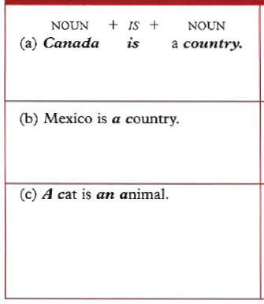
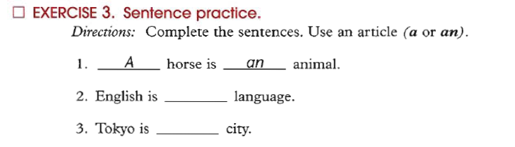
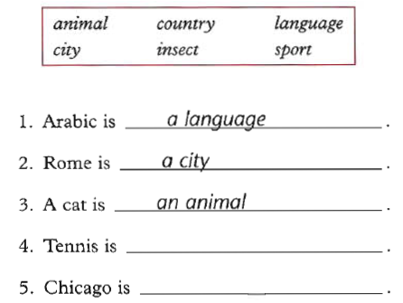

Slide 5

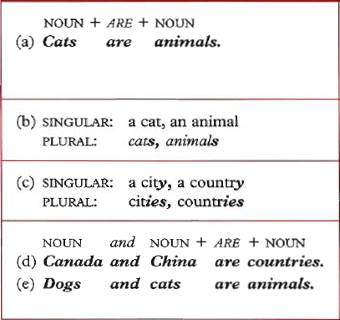
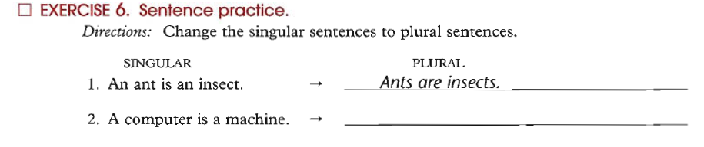

Slide 6

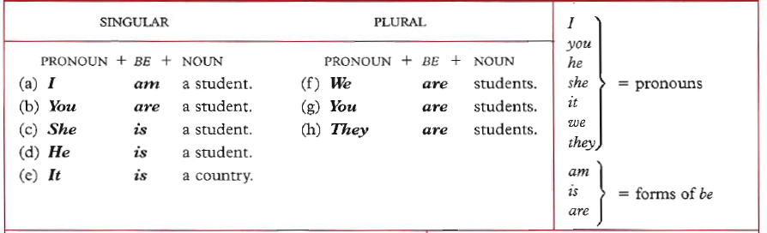
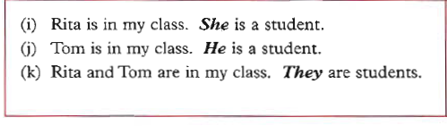

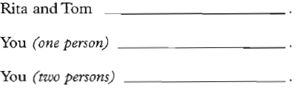

Slide 7

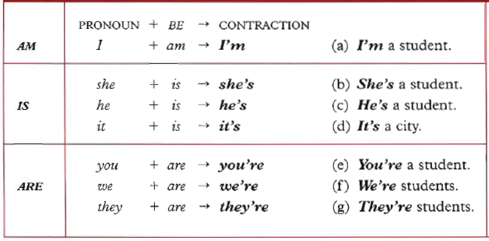
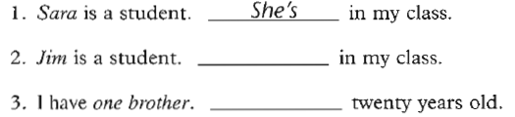

Slide 8

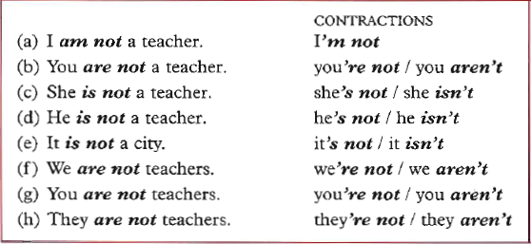
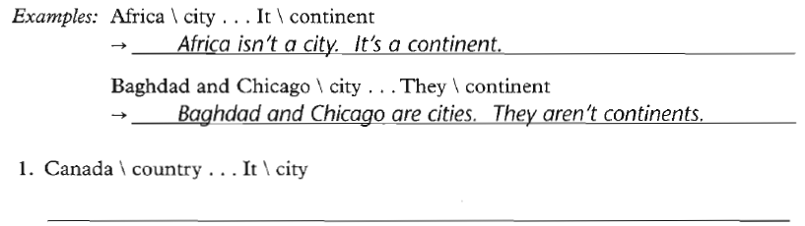

Slide 9

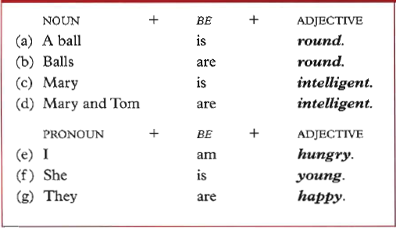
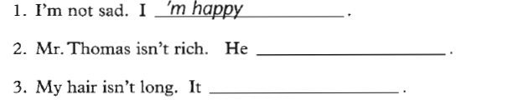

Slide 10

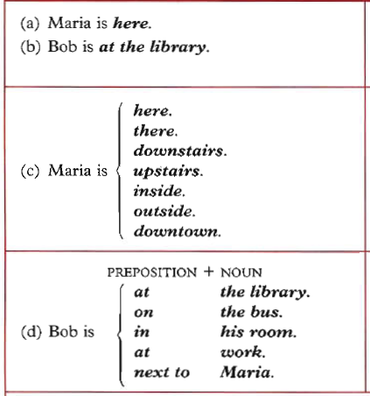

Slide 11

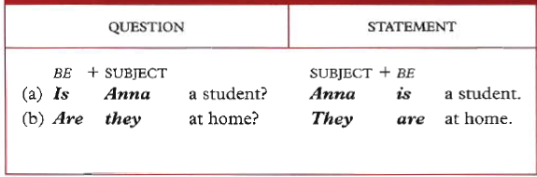
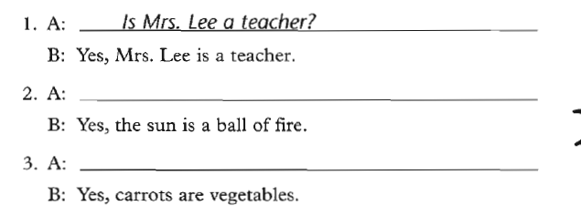

Slide 12
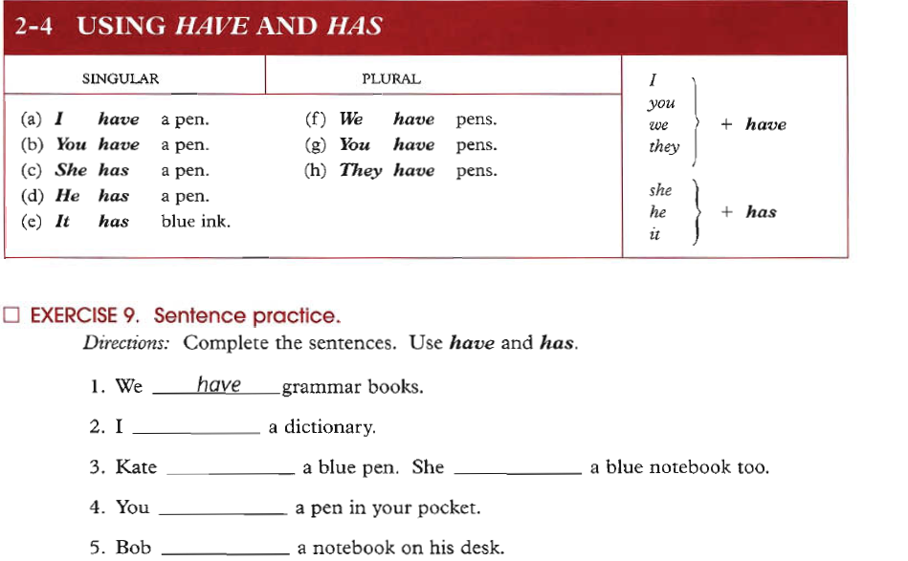
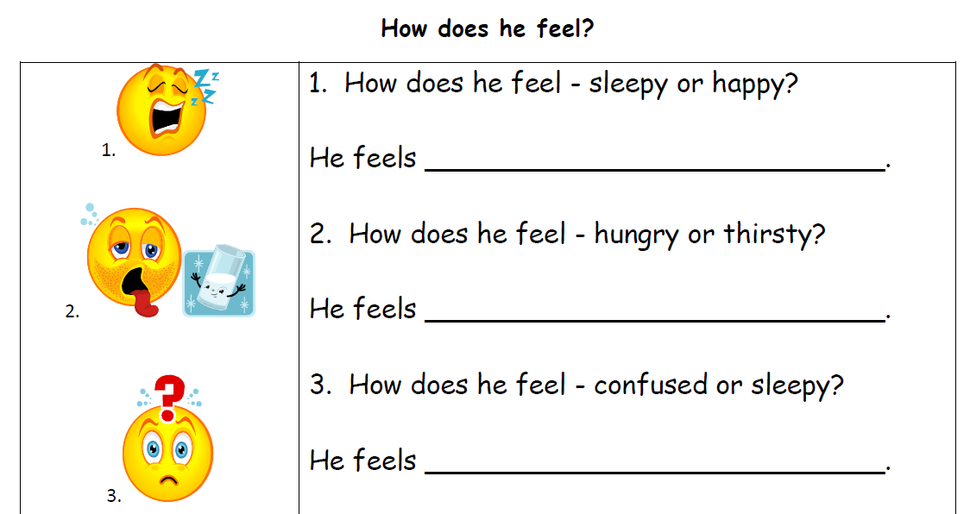

Slide 13

Do your Homework on→
- Chapter 1: Exercise 3. page 2
Ch. 1: Ex 4. page 3
Ch. 1: Ex 6. page 4
Ch. 1: Ex 10. page 7
Ch. 1: Ex 12. page 8
Ch 1: Ex 15. page 10
Ch 1: Ex17. page 12
Ch 1: Ex 25. page 19
Ch2: Ex 2. page 25 + 26
Ch 2: Ex 3. page 25 + 26
Ch 2: Ex 9. page 30

Slide 14

بحمد الله

