Slide 1

General English Language
اللغة الانجليزية العامة
Eng 121
Instructor: Ahmed H. Alhuwayshil
E-mail: aalhuwayshil@kfu.edu.sa
جامعة الملك فيصل
عمادة التعلم الإلكتروني والتعليم عن بعد
كلية الآداب
1

Slide 2
Lecture Three
Grammar – Vocabulary - Reading
Chapter Three

Slide 3
Elements of the Lecture
I- Articles ( A , An )
2- Verbs to Be
3- Have / Has / Had
4- Previewing Vocabulary

Slide 4
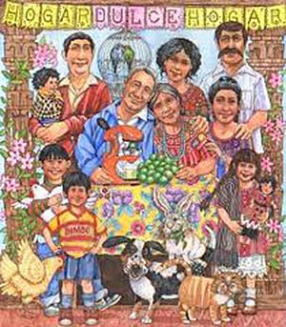
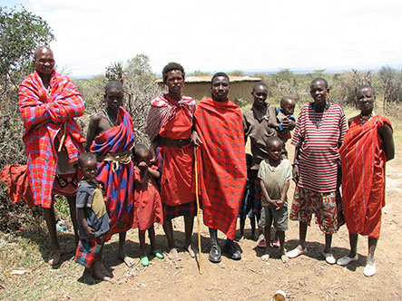
6. Scanning & Skimming Reading paragraph
( Interaction, Page 47)
Families in almost every country are changing. This is true in rich countries and poor ones. It is true in Africa, the Americas, Asia and Europe. All over the world, families are getting smaller.
In North Africa , in the past, many people lived in extended families. Fifty to hundred people lived together in a group of houses.
These were all family members- grandparents, aunts, uncles, cousins, children, and grandchildren. But now this traditional family is breaking into smaller groups.
The traditional family in Mexico was also big. One generation ago, the average Mexican woman had seven children. Today, she has an average of only 2.5 children. Now , without so many children, families don’t need to spend so much money on basics, such as food, clothing and housing.

Slide 5
Scan and skim the previous paragraph
1. The underlined word “ ones” refers to _______________.
a. families b. countries c. children d. Americas
2. Food and clothing are __________ .
a. grandchildren b. families c. members d. basics
3. The underlined pronoun “ she” refers to_______________ .
a. a brother b. an aunt c. a Mexican women d. a family
4. How many children did a Mexican woman have?
a. 2.5 b. 7 c. 4 d. 3
5. What happened to the traditional family?________________
a. getting larger b. breaking into smaller groups
c. became rich d. had no children

Slide 6
1. Articles- Indefinite
There are 2 indefinite articles in English:
A= used before singular nouns that begin with consonants.
An= used before singular nouns that begin with vowels
Consonants= all letters in English except ( a , e , i, o ,( u) ) u sometimes is a consonant in a word like university
Vowels= ( a, e , i ,o , u )
Examples.
__book __orange __ car __story __ egg __lecture
__ man __umbrella __apple __ pencil __table __ email
Note: 1.Remember that all the above words are Singular
2. We can’t use ( A or An ) before proper nouns, cities, days, months, etc

Slide 7
I. Exercise ( an & a )
1. Could you please give me _____ piece of cake?
a. an b. two c. a d. many
2. ___ dog is ____ animal.
a. An/a b. An/an c. A/an d. A/a
3. I visited ____Ahmed last week.
a. an b. the c. a d. Nothing
4. The capital of Saudi Arabia is ____ Riyadh.
a. Nothing b. an c. a d. the
5. I finished ____ unit in English language course.
a. an b. a c. three d. few
6. I take___ umbrella when it rains.
a. a b. an c. two d. several

Slide 8
I. Exercise ( an & a )
7. I bought_____ new pen.
a. an b. two c. a d. many
2. I rented a house last week. _____house is big.
a. A b. An c. The d. Nothing
3. I like____rice.
a. an b. the c. a d. Nothing
4. When I have a headache. I drink____cup of tea.
a. Nothing b. an c. a d. the
5. I eat ____ sandwich everyday.
a. an b. a c. nothing d. the
6. ___ teacher is nice.
a. a b. an c. the d. nothing

Slide 9
(The ) – Definite Article
The = definite article (a specific object that both the person speaking and the listener know)
The car over there is fast.
The teacher is very good, isn't he?
The first time you speak of something use "a or an", the next time you repeat that object use "the".
I live in a house. The house is quite old and has four

Slide 10
DO NOT use an article with countries, states, counties or provinces, lakes and mountains except when the country is a collection of states such as "The United States".
For example:
1-He lives in Washington near Mount Rainier.
2-They live in northern British Columbia.

Slide 11
DO NOT use an article when you are speaking about meals, places, and transport:
For example:
1-He has breakfast at home.
2-He comes to work by taxi.

Slide 12
III. Exercise ( verbs to be )
1. She______ at home now.
a. be b. was c. is d. been
2. My friends will_____________ here after 15 minutes.
a. are b. were c. been d. be
3. I ____in Riyadh two weeks ago.
a. was b. am c. be d. were
4. We _________ ready to start now.
a. were b. aren’t c. weren’t d. isn’t
5. ____ Hiba at university yesterday?
a. Is b. Are c. Were d. Was
6. Will Rashed___ at university tomorrow?
a. be b. is c. was d. been

Slide 13
IV. Exercise ( verbs have )
1. She______ a new car nowadays.
a. had b. have c. has d. hasn’t
2. My friends ___________been here for 15 minutes.
a. has b. have c. hasn’t d. aren’t
3. I ____an English lecture yesterday .
a. had b. have c. has d. haven’t
4. Hind _________ a dictionary now.
a. hasn’t b. doesn’t have c. haven’t d. didn’t have
5. Ahmed and Abdullah _________a mathematics test now?
a. has b. have c. doesn’t have d. had
6. _______ she been here before ?
a. Have b. Has c. Is d. Was

Slide 14
Exercise
1. You can go to the new ___________ and buy whatever you need.
A. hospital B. school
C. mall D. cinema
2. Doctors always advice smokers to give up smoking. The underlined word give up
has the same meaning as:
A. quit B. Start
C. help D. study
3. The children were afraid when they saw the ________________in the Luna park.
A. food C. monster
C. games D. juice

Slide 15
Exercise
4. The phrase “ write the same thing’ means ________________ .
A. cut B. paste
C. copy D. delete
5. The trip to the sea was very, very good. “ very, very good” means:-
A. wonderful B. dangerous
C. terrible D. easy
3. The men, women and children in Saudi Arabia are kind and generous. The
underlined phrase can be replaced by:
A. visitors C. people
C. soldiers D. vehicles

Slide 16

بحمد الله

