Slide 1

General English Language
اللغة الانجليزية العامة
Eng 121
Instructor: Ahmed H. Alhuwayshil
E-mail: aalhuwayshil@kfu.edu.sa
جامعة الملك فيصل
عمادة التعلم الإلكتروني والتعليم عن بعد
كلية الآداب
1

Slide 2
Lecture Four
Grammar – Vocabulary - Reading
Chapter Three

Slide 3
Elements of the Lecture
1- Do / Did / Done
2- Prepositions with Time ( at – on – in )
3-Vocabulary Previewing

Slide 4
1. Do- Does- Did- Done- doing
They are used as helping verbs in order to form Questions & Negative OR used as
main verbs.
- I, We, They, You or any plural subjects + do ( Present )
- He, She, It or any singular subjects+ does ( present)
Did (past) - Plural OR singular subjects+
- After (has, have, had) + done
- After ( is, am, are, was, were) + doing ( active progressive)
________________________________________________________________
e.g:- - We do the homework every week
- She does the homework every week
- The students did the homework last week
- They are doing the homework now/ at the moment
- Salma has done the homework.

Slide 5
1. Exercise
1. Sultan __________ his best to get full mark in the last homework.
a. do b. does c. did d. done
2. Fatin has _________ the homework perfectly.
a. done b. did c. do d. does
3. You will _______ me favor if you tell me the answer
a. doing b. do c. doing d. did
4. He always __________ the right thing.
a. do b. doing c. does d. done
5. The students are _________ the exercises now.
a. do b. doing c. done d. did
6. _______________ the homework yesterday?
a. Have you do b. Can you doing c. Do you d. Did you do

Slide 6
2.Prepositions with time ( at- on – in)
At = used before o’clock / night
On =before days
In = before years and months/ morning/ evening / seasons
======================================================================

Slide 7
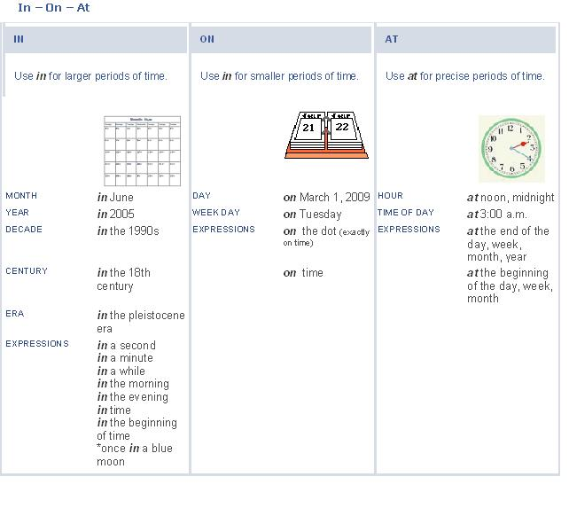

Slide 8
Exercise:
1. He goes to work____________ seven o’clock
a. in b. on c. at d. for
2. She was born_______ October.
a. at b. in c. on d. with
3. The weather is hot______ summer.
a. in b. on c. At d. From
4. Students don’t go to university_______ Friday.
a. in b. At c. Over d. on

Slide 9
3.Vocabulary Previewing
Meaning | Word | No.
A place to park your car | garage | 1
People who buy | customers | 2
Money you earn in business / interest | profit | 3
Buy | purchase | 4
Select | choose | 5
Look for | search | 6
A specialist in food | gourmet | 7
Separated from others/ nobody with you | alone | 8
Classifications | categories | 9
Opposite of difficult | easy | 10

Slide 10
Exercise
1. Where is the car? It’s in the___________
A. library B. bog
C. garage D. kitchen
2. If you didn’t find the book, you can look for it in the other room. the underlined
word look for means:
A. buy B. search
C. read D. eat
3. English language is_________________. It is not difficult.
A. beautiful C. boring
C. safe D. easy

Slide 11
Exercise
4. The word “ classifications’ means ________________ .
A. entertainments B. eatables
C. categories D. customers
5. The word “gourmet means__________________.
A. a policeman B. Food specialist
C. mechanic D. who works at hospital
6. “separated from others” . The underlined phrase means:
A. happy C. sick
C. alone D. busy

Slide 12

بحمد الله

