Slide 1

General English Language
اللغة الانجليزية العامة
Eng 121
Instructor: Ahmed H. Alhuwayshil
E-mail: aalhuwayshil@kfu.edu.sa
جامعة الملك فيصل
عمادة التعلم الإلكتروني والتعليم عن بعد
كلية الآداب
1

Slide 2
Fifth Lecture
Grammar – Vocabulary
Ch 3-4

Slide 3
Elements of Lecture 5
I- Previewing Vocabulary
2- Present Simple Tense
3-Excercises

Slide 4
1. Vocabulary Previewing ( Interaction Textbook pages 45, 50, 56,57, 61)
Meaning | Word | No.
A single state in a family history | Generation | 2
A state of being husband and wife | marriage | 3
very / so / | too | 4
Preparing meat on fire | barbecue | 5
one of the main Parts | branch | 6
a member of your family | relative | 7
A marriage ceremony | wedding | 8

Slide 5
Vocabulary Previewing ( pages 45, 50, 56,57, 61)
Meaning | Word | No.
accent | dialect | 9
Discuss angrily / debate | argue | 10
A group of people/ players | team | 11
percentage | Average | 14

Slide 6
I. Exercise
1. I speaks speak English fluently and Reem does, ___________
a. either b. too c. so d. neither
2. My ________ in this term is 84.3 %.
a. marriage b. package c. garage d. average
3. All members in __________ families were living in one house.
a. traditional b. nuclear c. rich d. bad
4. We went for a picnic by the sea and had a ___________.It was a very
delicious meal.
a. problem b. barbecue c. test d. camera
5. My uncle and my aunt are called my _______________.
a. relatives b. brothers c. friends d. neighbors
6. Group of people/ playing a sport is called a ________________.
a. family b. friend c. team d. match

Slide 7
I. Exercise
1. I speaks speak English fluently and Reem does, ___________
a. either b. too c. so d. neither
2. My ________ in this term is 84.3 %.
a. marriage b. package c. garage d. average
3. All members in __________ families were living in one house.
a. traditional b. nuclear c. rich d. bad
4. We went for a picnic by the sea and had a ___________.It was a very
delicious meal.
a. problem b. barbecue c. test d. camera
5. My uncle and my aunt are called my _______________.
a. relatives b. brothers c. friends d. neighbors
6. Group of people/ playing a sport is called a ________________.
a. family b. friend c. team d. match

Slide 8
The Simple Present Tense
Expresses a habit or often repeated action. The action can be a habit, a hobby, a daily event, a scheduled event or something that often happens. It can also be something a person often forgets or usually does not do.
Adverbs of frequency such as, often, seldom, sometimes, never, etc. are used with this tense.
-She goes to work everyday.
-They always eat lunch together.

Slide 9
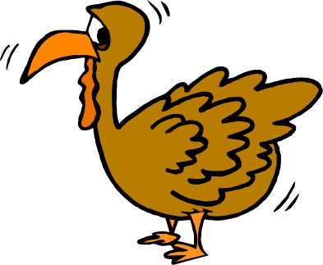
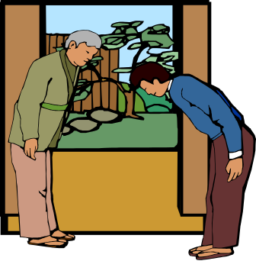
The Present Tense
Use the simple present tense to tell about things that happen again and again and again.
Americans eat turkey on Thanksgiving.
Japanese always bow to others.

Slide 10
The Simple Present Tense
This tense also expresses general truths or facts that are timeless.
Snow falls in the December in Minnesota.
Water boils at 100 degrees Celsius.

Slide 11


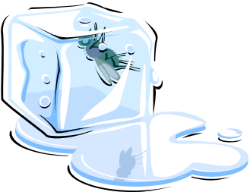
The Present Tense
Use the simple present tense to tell facts.
Water freezes at 32 degrees.
32º
Triangles have three sides.

Slide 12
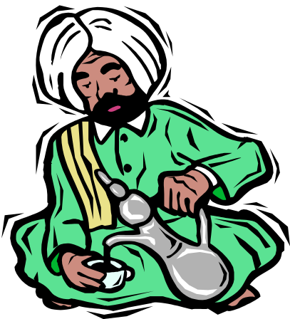
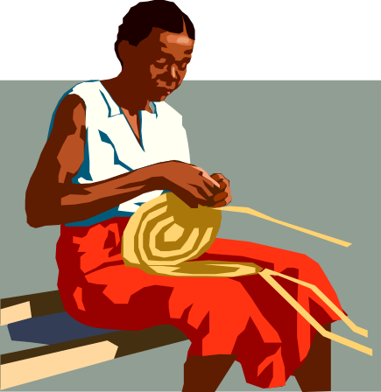
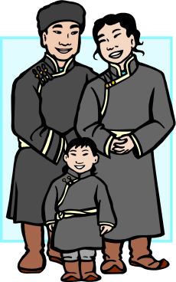
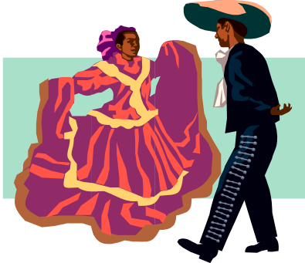
Daily Customs
She usually works on her basket after dinner.
He usually drinks tea after a meal.
They go to a dance every Sunday.
They take a walk with their son every day.

Slide 13
Exercise
1. She _______________ her mother in the house.
a. help b. doesn’t help c. don’t help d. doesn’t helps
2. The men __________ their work in the best way.
a. don’t do b. does c. doesn’t do d. don’t
3. _______________ doesn’t smoke nowadays .
a. My brothers b. You c. My father d. I
4. ____ they play football every week?
a. Do b. Does c. Are d. Done
5. Why ____ he always come late?
a. is b. do c. does d. was

Slide 14

بحمد الله

