Slide 1

General English Language
اللغة الانجليزية العامة
Eng 121
Instructor: Ahmed H. Alhuwayshil
E-mail: aalhuwayshil@kfu.edu.sa
جامعة الملك فيصل
عمادة التعلم الإلكتروني والتعليم عن بعد
كلية الآداب
1

Slide 2
Sixth Lecture
Grammar – Vocabulary –Chapter 4-5

Slide 3
Elements of Lecture
1. Negative Statements
2. Present Progressive Tense
3. Comparison: Simple present vs. present progressive
4. Spelling of Present Progressive Tense

Slide 4
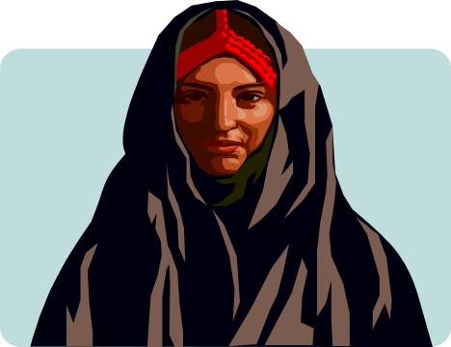

3. Negative Statements
-Some women don’t wear a lot of makeup.
-Maria doesn’t eat pizza.

Slide 5
4. Simple Present –Forming Questions
We have two forms forms:-
A. Doesn’t When the verb ends with s:-
Kamal Lives in an apartment.
Does Kamal live in an apartment ?
Where does Kamal live? – In an apartment
B. Don’t when the verb is infinitive without to
We live in an apartment
Do you live in an apartment ?
Where do you live? We live in ----

Slide 6
Present Simple, form:
Example: to think, present simple
Affirmative
Interrogative
Negative
I think
Do I think?
I do not think
You think
Do you think?
You don't think
he, she, it thinks
Does he, she, it think?
He, she, it doesn't think
We think
Do we think?
We don't think
You think
Do you think?
You don't think

Slide 7



5. Third-Person Singular (Spelling)
Put an –s or –es ending on third-person singular (he, she, it).
He need a shirt.
s
She want an apple.
s
It catch the stick.
es

Slide 8
Exercise
1. My uncle _________ us every week.
a. visit b. visits c. visiting d. has visited
2. Water __________ at 100 degree centigrade.
a. boiled b. boiling c. boil d. boils
3. They _______________ the work at 7 every morning.
a. begins b. have begun c. begin d. beginning
4. ____ drinks milk before sleeping.
a. The child b. The children c. The boys d. You
5. I usually ____ carefully when it rains.
a. drove b. drives c. driving d. drive
6. My mother cooks rice and meat _____________________.
a. now b. yesterday c. once a week d. last month

Slide 9
Exercise
1. The underlined letter /s/ in the word ‘ leaks” has the same
pronunciation of the letter /s/ in the word: ____________ .
a. hats b. toys c. windows d. rains
2. The underlined letter /es/ in the word ‘ fixes” has the same
pronunciation of the letter /s/ in the word: ____________ .
a. employs b. rooms c. matches d. helps
3. The underlined letter /s/ in the word ‘ goes” has the same
pronunciation of the letter /s/ in the word: ____________ .
a. heats b. repairs c. breaks d. catches

Slide 10
2.The Present Progressive (page 92)
This tense is used to describe an action that is occurring right now (at this moment, today, this year, etc.). The action has begun and is still in progress.
She is typing a paper for her class at the moment.
They are working right now.

Slide 11
The Present Progressive (page 92)
The present progressive can also be used to describe an action that is occurring in the present, but is temporary.
John is living in Modesto, but he might move soon.

Slide 12
6.The table shows how we form the –ing form of a verb.
+ ing
Most verbs
walk
walking
Verbs ending in e
-e + ing
come
coming
Verbs ending in ie
lie
lying
-ie + y + ing
Short verbs ending in a vowel + a consonant
Double the consonant + ing
run
running

Slide 13
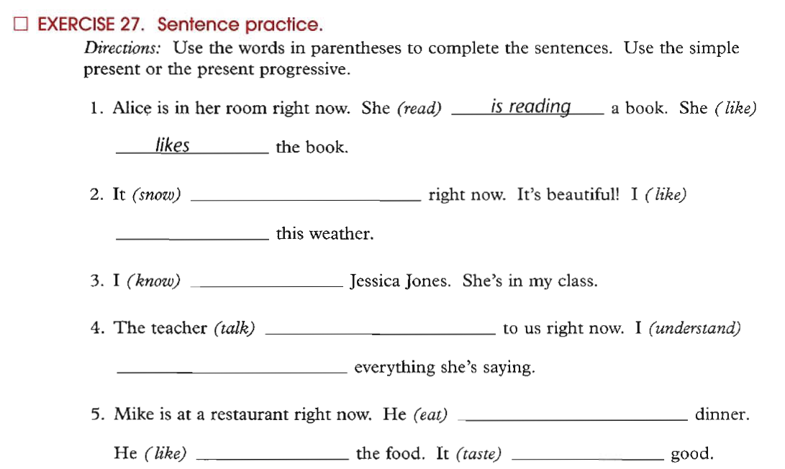

Exercise: Spelling Rules for Present Progressive (or continuous)
Pay Attention: Non-Action Verbs
begin
hop
swim
run
create
write
fill

Slide 14
Excercise
1. The men ____________ in the building now.
a. worked b. works c. are working d. working
2. ___________________ waiting me at the moment? – near the pharmacy.
a. Where he is b. Where does he
c. Where did he d. Where is he
3. The boys __________________________ football now .
a. are play b. play
c. is playing d. aren’t playing
4. Listen! The baby ________________ in the next room.
a. will cry b. crying
b. are crying d. is crying
5. I can’t go with you. I ______________ my homework now.
a. did b. have don c. am doing d. do

Slide 15
Excercise
6. She ____________ meat with rice now.
a. isn’t liking b. doesn’t like c. is liking d. like
7. She___________________ meat with rice at the moment.
a. eats b. doesn’t eats c. is eating d. eat
8. The boys __________________________ football now .
a. are play b. play
c. is playing d. aren’t playing
9. look! The car________________ coming toward us.
a. will come b. coming
b. are coming d. is coming
10. My mother is in the kitchen. She ______________ now.
a. cooked b. have cooked c. is cooking d. cook

Slide 16

بحمد الله

