Slide 1

General English Language
اللغة الانجليزية العامة
Eng 121
Instructor: Ahmed H. Alhuwayshil
E-mail: aalhuwayshil@kfu.edu.sa
جامعة الملك فيصل
عمادة التعلم الإلكتروني والتعليم عن بعد
كلية الآداب
1

Slide 2
^{12th} Class

Slide 3
Elements of the Lecture
The simple past tense.
Adverbs.
Exercises.
Reading.

Slide 4
3. Simple Past Tense
Chapter 8
Simple Past Tense is an action or event that happened in the past ; before now.
1. The verb is in the second form ( play- played/ go-went )
2. The indicators ( ago, yesterday, in the past, last , any date in the past)
3. No helping verbs
4. We use didn’t in forming Negative
5. We use did in forming questions
We have 2 kinds of verbs:
A- Regular verbs: end with –ed in past tense
B- Irregular verbs: they end with different forms in past tense

Slide 5
questions
Chapter 8
1. The students ___________ the homework last week.
a. do b. did c. will do d. are doing
2. We ________ to the new shopping mall yesterday.
a. go b. are going c. didn’t go d. didn’t went
3. ________ he _________ the accident two days ago?
a. Does/ see b. Does/ saw c. Did / saw d. Did/ see
4. The doctor________________ busy when I phoned him.
a. was b. is c. did d. are
5. She___________ a meeting with the doctor at university last Monday.
a. has b. doesn’t have c. had d. hadn’t
6. When he came, I __________ here.
a. didn’t was b. wasn’t c. am not d. didn’t do

Slide 6
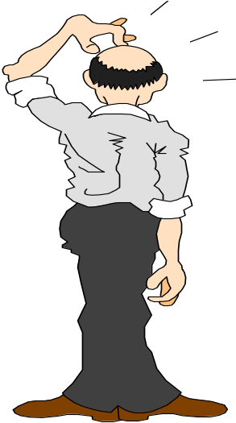
The Adverb
Modifies or describes
a verb, an adjective,
or another adverb.
Answers the questions:
How?
He ran quickly.
When?
She left yesterday.
We went there.
Where?
It was too hot!
To what degree or how much?

Slide 7
Kinds of Adverbs
Interrogative
Adverbs
introduce questions
How did you break your leg?
When does your plane leave?
How?
When?
How often do you run?
How often?
Where?
Where did you put the mouse trap?

Slide 8
Exercise
Circle the most suitable answer a, b, c or d for each of the following
- The final test will be similar to the questions in the lectures exercises.
1. The part speech of “ final” is __________________________________
A. a verb B. an adverb
C. a noun D. an adjective
2. The part speech of “ questions ” is _____________________________
A. a verb B. an adverb
C. a noun D. an adjective
3. The part speech of “ will” is __________________________________
A. a main verb B. a verb to be
C. a modal D. a preposition
4. The part speech of “ in” is ___________________________________
A. a verb B. a preposition
C. a noun D. an adjective

Slide 9
Exercise
Circle the most suitable answer a, b, c or d for each of the following
The doctor gave us the first homework last week.
5. The part speech of “ us” is _________________________pronoun
A. a possessive B. an object
C. a subject D. a reflexive
6. The part speech of “ gave ” is ______________________________
A. a present verb B. an auxiliary
C. a future verb D. a past verb
7. The part speech of “ last” is ________________________________
A. an adjective B. a verb to be
C. an article D. a preposition
8. The part speech of “ doctor” is _________________________________
A. a verb B. a subject noun
C. an object noun D. an adjective

Slide 10
4. Reading :
A. Word & Pronoun Reference
Ahmed and his sister are from Riyadh. They study English at university. She is older than him. He speaks English better than her. They always go there by bus. It is a very suitable place for practicing English. They always speak English with each other to improve their language.
1. She refers to : ___________
2. him refers to : ___________
3. They refers to: __________
4. There refers to : __________
5. He refers to:_____________
6. It refers to: ______________
7. Their refers to:____________

Slide 11
B. Scanning & Skimming
8. Where are Ahmed and his sister from? They’re from __________.
A. university B. Riyadh
C. English D. the bus
9. Who is better in English? _______________
A. Ahmed’s sister B. English language
C. Ahmed D. English
10. How do they go to university? _______________________
A. On foot B. In a taxi
C. By plane D. By bus

Slide 12

بحمد الله

