Slide 1

General English Language
Instructor: Ammar Sultan Al-Maani
King Faisal University
e- Learning Deanship
& Distance Education
1

Slide 2
^{11th} Class

Slide 3
Elements of Class
Comparatives and Superlatives

Slide 4
Contents
Introduction
  What is a noun?
  What is an adjective?
  What is a syllable?
    Syllable – further examples
Adjectives
  Comparative form
    How to built comparative forms?
  Superlative form
    How to built superlative forms?
Summary
  Comparison chart

Slide 5
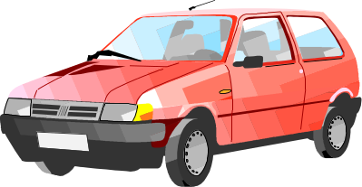

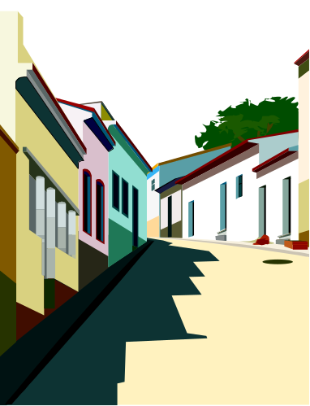
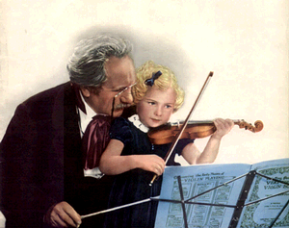
What is a noun?
Noun is a word which refers to a thing, person,activity, place etc.
car
reading
street
Teacher

Slide 6
What is an adjective?
Adjective is a word which describes a noun
adjectives
noun
big
car
fast
expensive

Slide 7
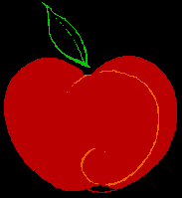
Examples
Adjectives
large larger largest
The first apple is large.
The second apple is larger than the first.
The third apple is the largest of the three.

Slide 8

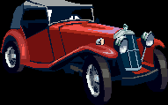

The jalopy is a fast car.
The racecar is the faster car.
The dragster is the fastest car.

Slide 9
What is a syllable?
Syllable is a part of a word containing vowel sound
read
ing
read
ing
1st syllable
2nd syllable

Slide 10
Syllables – examples
1. One-syllable adjectives
fast
big
cheap
long
2. Two-syllable adjectives
hap
py
cra
zy
dir
ty
3. Three-syllable adjectives
im
por
tant
won
der
ful

Slide 11
LET’S START ☺
Adjectives and adverbs are words the modify other words. The comparative form of an adjective or adverb compares two things. The superlative form of an adjective or adverb compares three of more things.

Slide 12
What is a “comparative form”?
Comaprative form expresses the idea of ‘more’
fast
-er
My car is fast.
But his car is faster.

Slide 13
“Comparative form”?
How is a ‘comparative’ form built?
long
er
one syllable adjectives
two syllable adjectives
ending in -ly
funn
y
ier
other two and three syllable adjectives
modern
more
modern
irregular adjectives
for example ‘good’
good
better

Slide 14
Change of ‘y’ into ‘i’
We want the comparative form
of the adjective ‘funny’
funny
+er
y ➔ i
funnier
funn
+ier

Slide 15
What is a “superlative form”?
Comaprative form expresses the idea of ‘most’
fast
-est
My car is fast.
Your car is fast.
But his car is the fastest.

Slide 16
“Superlative form”?
How is a ‘superlative’ form built?
long
est
one syllable adjectives
two syllable adjectives
ending in -ly
funn
y
iest
other two and three syllable adjectives
modern
most
modern
irregular adjectives
for example ‘good’
good
best

Slide 17
Summary comparison
comparative
superlative
long
long
er
long
est
funny
funn
iest
funn
iest
modern
more
modern
most
modern
good
better
best

Slide 18
To make comparative and superlative forms of adjectives some rules must be followed.

Slide 19
Rule 1
To form the comparative or superlative
of one syllable words with
more than one vowel OR ending
with more than one consonant at the
add -er OR -est.
tall | taller | tallest
neat | neater | neatest
deep | deeper | deepest

Slide 20
Rule 2
To form the comparative or
superlative of a one syllable word ending
in e add -r OR -st.
wide | wider | widest
fine | finer | finest
cute | cuter | cutest

Slide 21
Rule 3
To form the comparative or superlative of a one syllable word with one vowel and one consonant at the end double the consonant, and add -er OR -est.
sad | sadder | saddest
big | bigger | biggest
fat | fatter | fattest

Slide 22
Rule 4
To form the comparative or superlative of a two syllable word ending in y, change the y to i, then add -er OR -est.
happy | happier | happiest
jolly | jollier | jolliest
lazy | lazier | laziest

Slide 23
Rule 5
To form the comparative or superlative of a two syllable word ending a vowel-sound that is not stressed then add -er OR -est.
Adjectives ending in –le, -ow, er frequently take –er and –est.
yellow | yellower | yellowest
gentle | gentler | gentlest
simple | simpler | simplest

Slide 24
Rules at a Glance
Adjective form | Comparative | Superlative
Only one syllable, with more than one vowel or more than one consonant at the end. Examples: light, neat, fast, tall, neat, deep | Add -er: lighter, neater, faster, taller, neater, deeper | Add -est: lightest, neatest, fastest, tallest. neatest, deepest
Only one syllable, ending in E. Examples: wide, fine, cute | Add -r: wider, finer, cuter | Add -st: widest, finest, cutest
Only one syllable, with one vowel and one consonant at the end. Examples: hot, big, fat, sad | Double the consonant, and add -er: hotter, bigger, fatter, sadder | Double the consonant, and add -est: hottest, biggest, fattest, saddest
Two syllables, ending in Y. Examples: happy, silly, lonely, jolly | Change y to i, then add -er: happier, sillier, lonelier, jollier | Change y to i, then add -est: happiest, silliest, loneliest, jolliest
two syllable word ending a vowel-sound that is not stressed yellow, simple | Add -er: yellower, simpler | Add -est: yellower, simpler
Two syllables or more, not ending in Y. Examples: modern, interesting, beautiful, | Use more before the adjective: more modern, more interesting, more beautiful | Use most before the adjective: most modern, most interesting, most beautiful

Slide 25
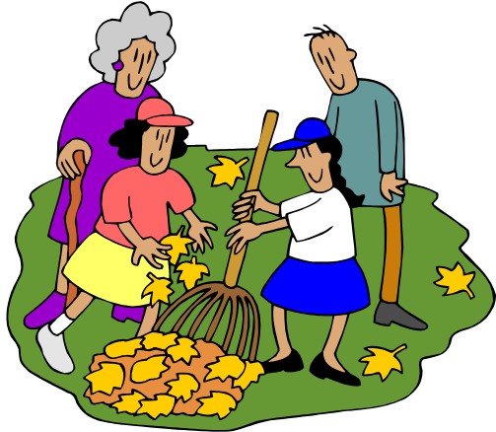
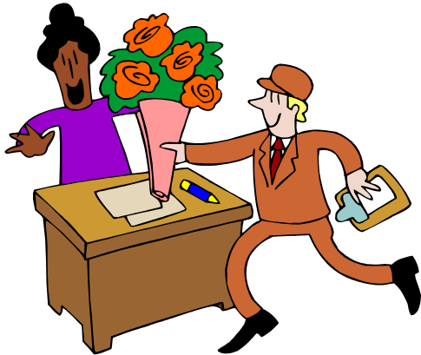

NOTE: Like adjectives some adverbs can take comparative and superlative forms, with -er and -est:
Sally works hard.
Steve works harder than Sally
Kathy and Sue work the hardest of all.

Slide 26
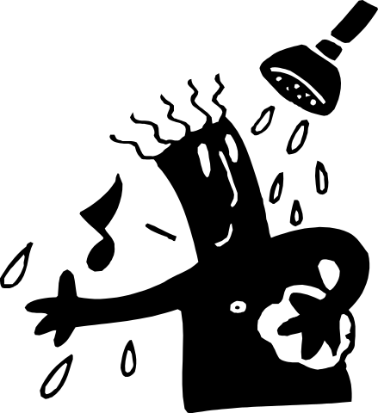


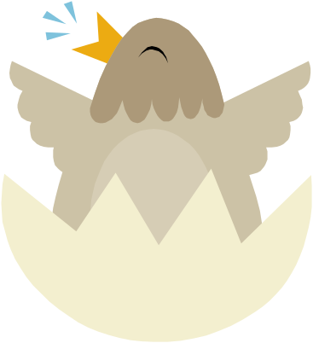
loud | louder | loudest
The bird sings loudly.
The moose sang louder than the bird.
Pete sang the loudest of them all.

Slide 27
List of Adverbs in Which -er and -est May Be Added
Adverb | Comparative | Superlative
fast | faster | fastest
slow | slower | slowest
quick | quicker | quickest
early | earlier | earliest
bright | brighter | brightest
high | higher | highest

Slide 28
However, the majority of adverbs do not take these endings. Instead, they form the comparative using more and the superlative using most:
Adverb | Comparative | Superlative
recently | more recently | most recently
effectively | more effectively | most effectively
frequently | more frequently | most frequently

Slide 29
Irregular Comparative and Superlative Adjectives and Adverbs
Some comparative and superlative forms are irregular and do not follow any rules or patterns. These must be memorized.

Slide 30
Irregular Adverbs
Word | Comparative | Superlative
badly | worse | worst
much | more | most
little | less | least
much | more | most
well | better | best

Slide 31
Irregular Adjectives
Word | Comparative | Superlative
good | better | best
bad | worse | worst
much | more | most
little | less | least
far | farther | farthest
old | older elder | oldest eldest

Slide 32
Example:
Nathan made good stew.
Molly's stew was better than Nathan's.
Ezra made the best stew of all.

Slide 33

بحمد الله

