Slide 1

Course: Reading 102
Instructor: Abdullah Almulhim
جامعة الملك فيصل
عمادة التعلم الإلكتروني والتعليم عن بعد
1

Slide 2
Lecture 2
Unit 1
The Cycle of Life

Slide 3
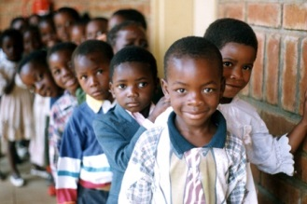
Reading 2:The People of Malawi were Kind to Her son

Slide 4
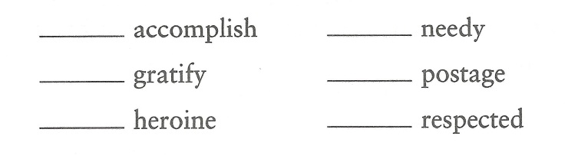
New Vocabulary

Slide 5
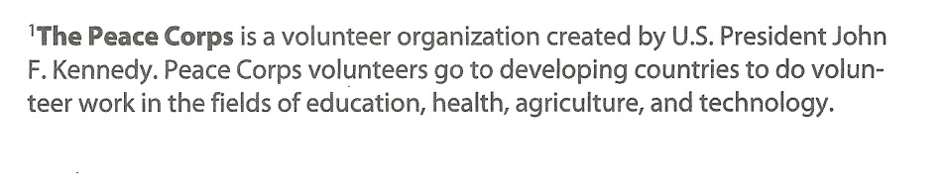
Vocabulary definitions

Slide 6
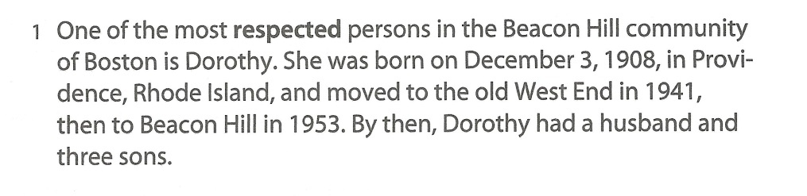
Reading Passage

Slide 7
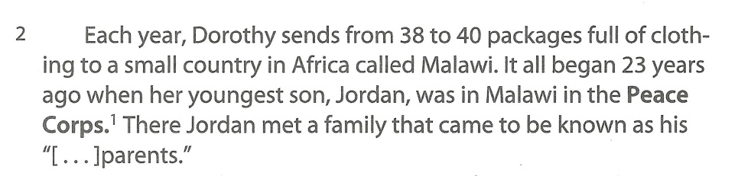

Slide 8
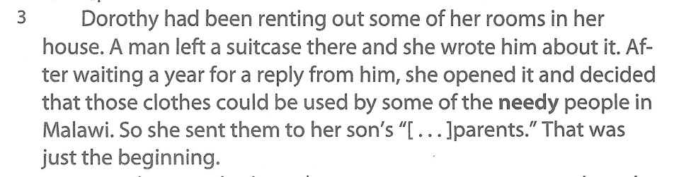

Slide 9
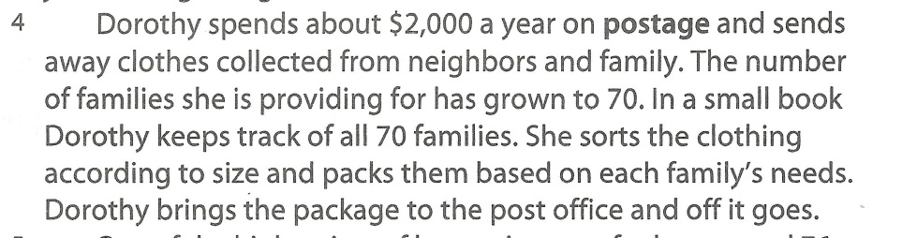

Slide 10
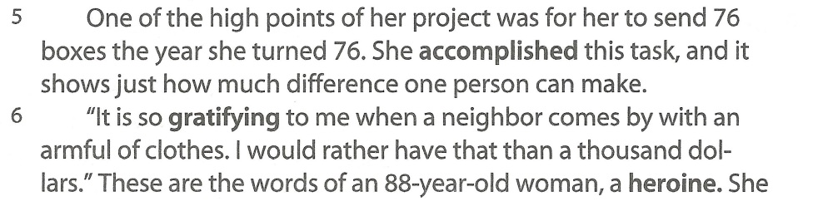

Slide 11
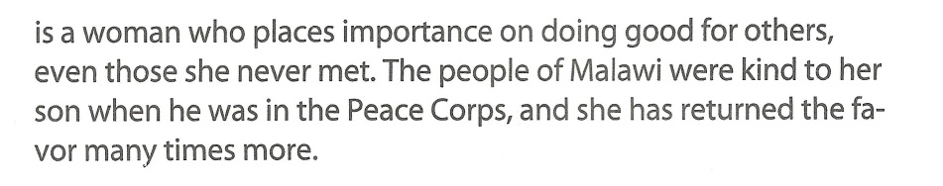

Slide 12
End of The Reading Passage

Slide 13
Comprehension Questions
1- How did Dorothy begin sending packages to Malawi?
2- What is the greatest number of packages Dorothy has ever sent to Malawi?

Slide 14

بحمد الله

