Slide 1
Oncology
Cancer is a disease process that begins when an abnormal cell is transformed by the genetic mutation of the cellular DNA.
This abnormal cell forms a clone and begins to a self-controlling growth formed by the unlimited multiplication in one of the body tissue or organ.

Slide 2
Oncology
Incidence:
Cancer affects all age groups, most cancers occur over 65 years of age. Men experience higher incidence than women. It is higher in industrial areas.
Mortality rate:
It is the second leading cause of death after cardio vascular disease.

Slide 3
Pathophysiology
Abnormal cells arise from normal body cells due to a poorly understood mechanism.
This cells proliferate and invade surrounding tissues. cancer cells infiltrate this tissue gain access to lymph & blood vessels, are (transported through it to distant organs) and form metastasis (or cancer spread) to other parts.

Slide 4
Malignant | Benign | characteristic
-Little resemblance to normal cells -Grows at the periphery infiltrate and destroy the surrounding tissue -Usually rapid -Reach blood &lymph vessels& metastasizes to other body parts -Tends to recur when removed -cause extensive tissue damage due to pressure e.g. on blood supply -Anemia, weakness, weight loss -cause death, unless it growth is controlled | -Resembles normal cells -Grows by expansion dose not infiltrate encapsulated -Slow -Dose not spread by metastasis -Dose not recur when removed -Dose not cause tissue damage -Usually localized -Rarely cause death unless located near vital functions | 1-cell characteristic 2-mood of growth 3-Rate of growth 4-Metastasis 5-Recurrence 6-Destruction of tissues 7-General effects 8-Ability to cause death

Slide 5
Etiology
1- viruses:
Viruses are thought to incorporate themselves into genetic structure of cells thus altering future generation
e.g. Herpes simplex and hepatitis B virus.
2- physical agents:
E.g. exposure to sunlight, radiation, chronic irritation, inflammation e.g. repeated x-ray procedures
E.g. of chronic irritation: Lip cancer among pipe smokers, oral cancer in prolonged tobacco use liver cancer with liver cirrhosis etc….

Slide 6
Etiology
3- chemical agents:
E.g. in work industries, the liver and kidneys are commonly affected due to their detoxification of chemicals.
4- genetic and familial factors:
Abnormal chromosomal patterns specific cancers e.g. leukemia, skin cancer.
Familial inheritance e.g. breasts, stomachs, prostate.
5- dietary factors:
Long term ingestion of carcinogens substances in diet cause cancer.

Slide 7
Etiology
6- hormonal agents:
Tumor growth is promoted by hormonal imbalance from either:
-Body own hormonal production.
Administration of exogenous hormones e.g. cancer breast, uterus, prostate, depend on endogenous hormonal level for growth.
e.g. administration of oral contraceptives are associated with liver and vaginal carcinoma.

Slide 8
Diagnostic procedures:-
Diagnosis of cancer: include:
*Assessment of physiologic and functional changes.
*Diagnostic evaluation :
-to determine presence of the tumor
-to determine the extent of the disease.
-spread or metastasis
*Functions of involved and uninvolved body organs.
*Obtaining cells for analysis for cancer stag and grade.
*Computerized topography scanning {CT scan}
*Biopsy magnetic resonance images {MRI}
*Ultrasound ,endoscopies.

Slide 9
Staging of cancer:
*Stage o :No evidence of primary tumor.
*Stage I :Regional lymph node can not be assessed.
*Stage II :Abnormalities of regional lymph nodes.
*Stage III :Distant metastasis Present.

Slide 10
Ten steps of protective factors in cancer prevention:
1-Increase fresh vegetables
2-Increase fiber intake.
3-Increase intake of vitamin A.
4-Increase intake of vitamin C .
5-Practice weight control
6. Reduce amount of dietary fat.
2-Cut down on salt cured, smoked and nitrates cured foods
3-Stop cigarette smoking.
4-Reduce alcohol intake.
5-Avoid exposure to sun.

Slide 11
Role of the nurse in detection and prevention of cancer :
*Provide education to community about cancer prevention e.g. :
-Health behavior.
-Screening methods.
-Decrease sun exposure.
-Decrease tobacoo used and alcohol.
-Exercise.
-Risk factor.
-Dietary habits.
-General health habits.

Slide 12
Management of cancer:
Goals:
1-Eradication of malignant disease (cure).
2-Prolonged survival with the presence of malignancy.
3-Relief of symptoms associated with the cancer process.

Slide 13
Oncology
I-Surgery:
Means removal of the entire cancer. It may be:
1-The primary method of treatment.
2-Diagnostic.
3-Prophylactic.
4-Palliative.
5-Reconstructive.

Slide 14
Oncology
a- Surgery as primary treatment:
Removal of entire tumor is called "debunking" attempts to remove wide margins of tissues in order to (get all the cancer cells) is not realistic since there is often, micro metastasis. Therefore, after surgery one or more other treatment modalities are indicated to increase cancer cells destruction.

Slide 15
Oncology
b-Diagnostic surgery: is done to:
1- Obtain biopsy (excision of a piece of tissue from a suspicious growth).
2-Analyze the tissue and cell of suspected malignancy.

Slide 16
Oncology
c-Palliative surgery:
When cure is not possible, the goal is to provide the patient with as much as comfort as possible and a productive life as long as possible e.g. remove complications of cancer as ulcerations, pressure, obstruction, hemorrhage ,pain.

Slide 17
Oncology
e-Reconstructive surgery:
Follow curative or radical surgery to produce a better function or cosmetic effect.

Slide 18
Oncology
II-Radiation therapy:
Definition: it is the use of ionizing radiation to interrupt cellular growth.
Causes:
*When treatment goal is curative e.g. cancer head neck, cancer cervix.
*control tumor growth, when it cannot be removed surgically.

Slide 19
Oncology
Toxicity of radiation therapy:
Is usually localized to the region being irradiated.
1-Local reactions:
Normal cells in treatment area are destroyed fall of cellular regeneration or alteration of integrity these local reactions include:
*Alopecia (fall of hair).
*Erythematic (redness).

Slide 20
Oncology
*Shedding or skin (desquamation).
Reepithelialization occurs once treatments have been stopped.
*Alteration in oral mucous membrane include:
*Stomatitis
*Dryness of mouth
*Decrease salivation.
*Chest pain.
*Dysphasia.
*Anorexia, nausea, vomiting (if stomach and colon are in the irradiated field).
*Esophageal.

Slide 21
Oncology
2-General systemic side effects include:
*Fatigue.
*Malaise.
*Headache.
*Nausea.
*Vomiting.
These are thought to be due to substances released on the breakdown of tumor and are usually temporary.

Slide 22
Oncology
iii. chemotherapy:
it is the use of anti-nepotistic drugs to promote tumor cell death by interfering with cellular functions and reproduction.
It is used primarily to treat systemic disease rather than lesions that are localized and amenable to surgery or irradiation. It may be combined with surgery or radiation or both to reduce tumor size preoperatively.
Destroy remaining tumor cells postoperatively.
Treat some forms of leukemia.

Slide 23
Oncology
Goals:
-Cure
-Control
-Palliative.
About 20-99% of the tumor cells exposed to chemotherapeutic agent is destroyed. Repeated dose is necessary over a prolonged period of time regression of disease. 100% eradication is impossible but the goal of treatment is that the remaining cells can be destroyed by body immune system.

Slide 24
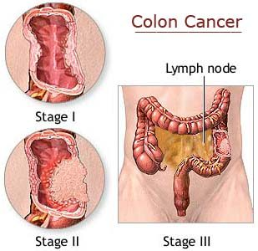
Oncology

Slide 25
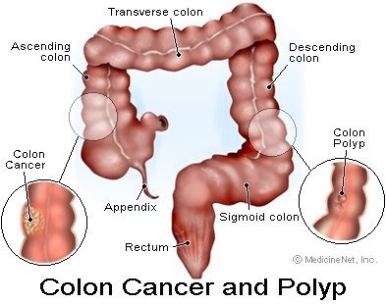
Oncology

Slide 26
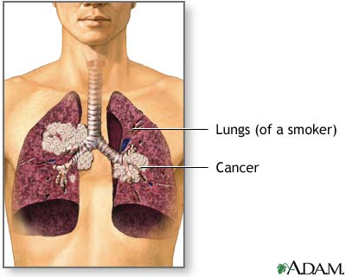
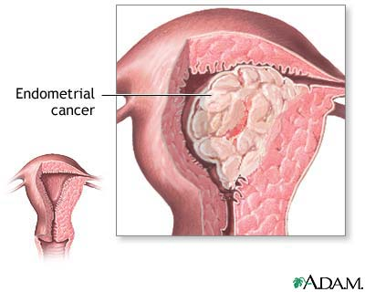

Slide 27
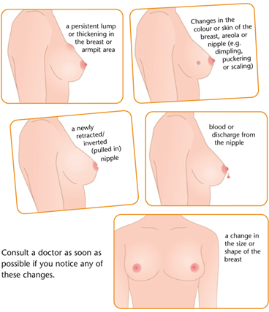
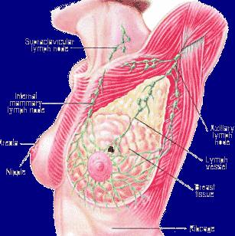

Slide 28
NURSING PROCESS OF CANCER
ASSESSMENT
Regardless of the type of cancer treatment or prognosis, many patients with cancer are susceptible to these problems and complications. An important role of the nurse on the oncology team is to assess the patient for these problems and complications.

Slide 29
nursing Diagnosis
Impaired tissue integrity related to the effects of treatment and the disease
Altered nutrition: less than body requirements related to anorexia and gastrointestinal changes
Pain and discomfort related to disease and treatment effects
Fatigue related to physical and psychological stressors

Slide 30
Nursing diagnoses
5-Grieving related to anticipated loss and altered role function
6-Body image disturbance related to changes in appearance and role functions

Slide 31
Collaborative problems/potential complications
Infection and sepsis
Hemorrhage
Superior vena cava syndrome
Spinal cord compression
Hypercalcemia
Pericardial effusion
Disseminated intravascular coagulation
Syndrome of inappropriate secretion of antidiuretic hormone

Slide 32
Planning and goals
The major goals for the patient may include maintenance of tissue integrity, maintenance of nutrition, relief of pain, relief of fatigue, effective progression through the grieving process, improved body image, and absence of complications

Slide 33
Nursing interventions
1-The pt with cancer is at risk for various adverse effects of therapy and complications. The nurse in all health care settings assists the patient and family in managing these problems.

Slide 34
Oncology
2-Maintaining tissue integrity
The pt who is experiencing skin and tissue reactions to radiation therapy requires careful skin care to prevent further skin irritation, drying, and damage.

Slide 35
Oncology
3-Managing stomatitis
Stomatitis, an inflammatory response of the oral tissues, commonly develops within 5 to 14 days after the pt receives certain

Slide 36
Oncology
4-Explaining alopecia
The temporary or permanent thinning or complete loss of hair is a potential adverse effect of various radiation therapies and chemotherapeutic agents.

Slide 37
Oncology
5-Managing malignant skin lesions
Promoting nutrition
Relieving pain
Decreasing fatigue
Purpose
Study sample and design
Findings
Nursing implications

Slide 38
Oncology
Improving body image and self esteem
Assisting in the grieving process
Monitoring and managing potential complications

Slide 39
evaluation
Maintains adequate tissue ( skin and mucous membrane)integrity
Maintains adequate nutritional status
Achieves relief of pain and discomfort

