Slide 1

General English Language
Eng 121
First Lecture
Instructor: Dr. Ghassan M Nayfi
e- learning System For Distance Education
e- Learning Deanship
English Language Department
1

Slide 2
Contents of Lecture 1
Present verbs to Be [ is, am , are ]
Contractions with Be
Negative with be
Yes/ No question with Be
Prepositions with PLACE
Common Adjectives & Opposites
Practice

Slide 3
Chapter ONE
Using Be
English Language
Basic English Grammar

Slide 4
Present Verbs to Be
There are 3 present verbs to be;
Am
Is
Are

Slide 5
How to use each on of them
Am (used with I only) :-
Iam a student.
Iam happy.
Iam in the library now.
Iam from Saudi Arabia.
Is ( used with singular subjects)
He is a boy.
She is a girl.
It is an insect.
The car is new.
My friend is from Jordan.
Summer is hot now in Saudi Arabia.
Your pen is on the table.
Are ( used with plural subjects )
We are students
They are girls
You are boys/ a boy
The books are in the bag now
Samia and Reem are sisters
Our friends are very kind
His brothers are Fahd and Rami

Slide 6
Contractions with Be
Am (used with I only) :-
Iam / I’m a student.
Iam / I’m happy.
Iam / I’m in the library now.
Iam / I’m from Saudi Arabia.
________________
Is ( used with singular subjects)
He is / H’s a boy.
She is / She’s a girl.
It is / It’s an insect.
The car is / The car’s new.
My friend is / My friend’s from Jordan.
Summer is hot now in Saudi Arabia.
Your pen is on the table.
Are ( used with plural subjects )
We are / We’re students
They are / They’re girls
You are / You’re boys/ a boy
The books are in the bag now
Samia and Reem are sisters
Our friends are very kind
His brothers are Fahd and Rami

Slide 7
Negative with BE
Am (used with I only) :-
Iam not/ I’m not a student.
Iam happy.
Iam at work now.
Iam from Saudi Arabia.
________________
Is ( used with singular subjects)
He is not/ He’s not / He isn’t a boy.
She is a girl.
It is an insect.
The car is new.
My friend is from Jordan.
Summer is hot now in Saudi Arabia.
Your pen is on the table.
Are ( used with plural subjects )
We are not /We’re not/We aren’t students
They are girls
You are boys/ a boy
The books are in the bag now
Samia and Reem are sisters
Our friends are very kind
His brothers are Fahd and Rami

Slide 8
Yes/No Question with BE
1. He is a mechanic.
Is he a mechanic? – Yes, he is
- No, he isn’t
2. They are at home.
Are they at home ? – Yes, they are.
- No, they aren’t
3. Iam a student.
Are you a student? – Yes, Iam
_ No, Iam not
4. The car is expensive.
Is the car expensive? - Yes, it is
- No, it isn’t

Slide 9
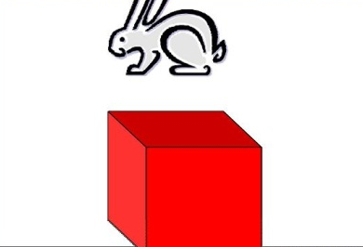
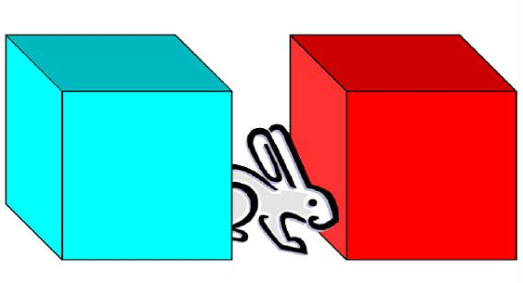
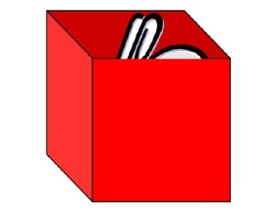
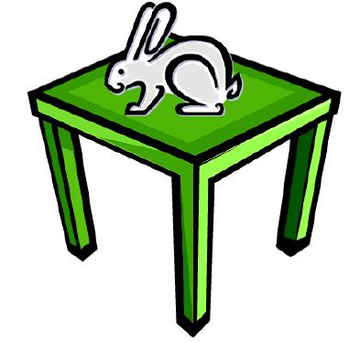
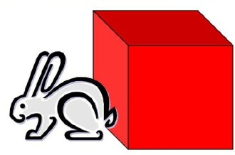
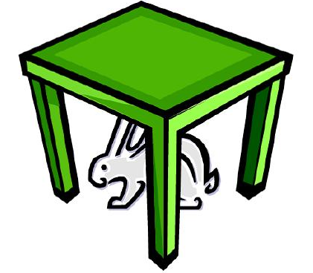
Prepositions ( place )
in
over
between
Next to
under
On

Slide 10









ON
IN
ABOVE
UNDER
BETWEEN
BEHIND
IN FRONT OF
NEXT TO
NEAR

Slide 11
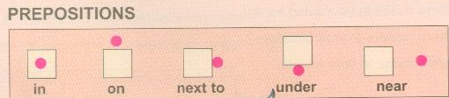
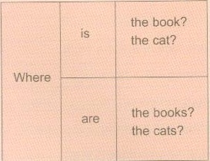

Slide 12
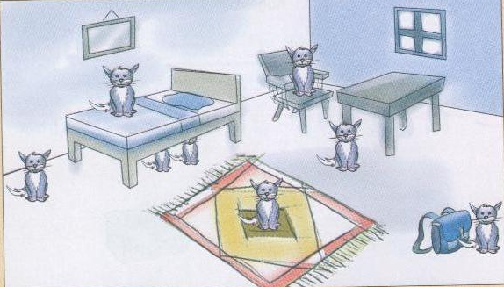
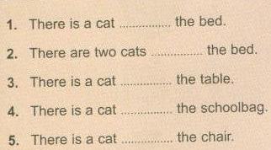
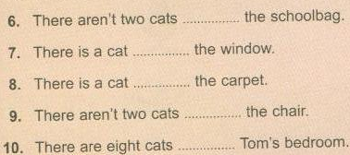
ON
NEXT TO
UNDER
NEAR
NEXT TO
ON
NEXT TO
ON
ON
IN

Slide 13
The Opposite Meaning
Opposite meaning | word | No.
Happy | Sad | 1
Poor | Rich | 2
Short | Long | 3
Clean | Dirty | 4
Beautiful | Ugly | 5
Expensive | Cheap | 6
Fast | Slow | 7
Easy | Difficult | 8
Noisy | Quiet | 9
Old | Young | 10
Cold | Hot | 11
Safe | Dangerous | 12
then | fat | 13
Full | Hungry/ thirsty | 14
Narrow | wide | 15

Slide 14
Exercise 1
English language _______ easy to learn.
it is
are
is
am
2. Ahmed and Sami _________ free today.
am
aren’t
is
am n’t
3. ______ is my sister.
She
He
They
We

Slide 15
Exercise 1
4. You are _____ man.
a
an
not
nothing
5. Airplanes aren’t slow. ___________ very fast.
He’s
They aren’t
It isn’t
They’re
6. ______ my uncle. He is my father.
He is
He’sn’t
He isn’t
It is not

Slide 16
Exercise 1
7. The food _____ very delicious.
are
am
aren’t
is
8 ______ cat is________ animal.
An / a
A / a
An / an
A / an
9. Ibrahim is a doctor. ____ ____ a doctor?
He is
Is he
He isn’t
Isn’t she

Slide 17
Exercise 1
___ your father at home?
Are
Is
Aren’t
Am
11. Flowers aren’t ugly. They are very _____________.
hot
rich
beautiful
Safe
12. English language is _____________ to learn. It isn’t difficult.
slow
easy
noisy
Cheap

Slide 18
Exercise 1
13. Look! The bird is flying ____________ our heads.
in
under
On
over
14. You should keep your money ________ your pocket.
on
over
under
in
15. My friend is_________. He can’t come to work.
healthy
sick
Rich
beautiful
End of Lecture ONE
Good Luck For All

Slide 19

بحمد الله

