Slide 1

General English Language
Eng 121
Dr. Mohamed Fathi
King Faisal University
e- Learning Deanship
& Distance Education
1

Slide 2

First Class
English Language
Basic English Grammar

Slide 3
In this lesson
let’s make sentences with the verb “be” (am, are, is).
Sentence = SUBJECT + VERB.
Subject = noun and pronoun (I, you, he, she, it ,
we, they ,this, these.)
Subject + form of verb “be”

Slide 4
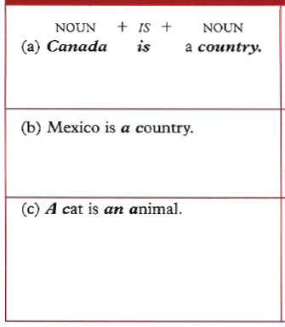
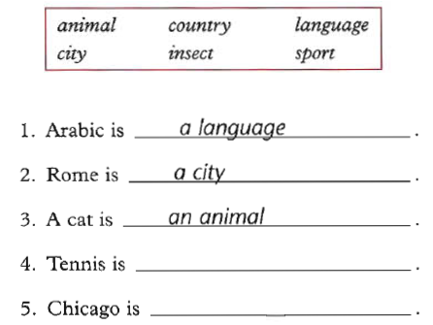

Slide 5

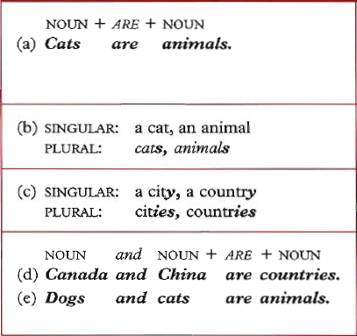
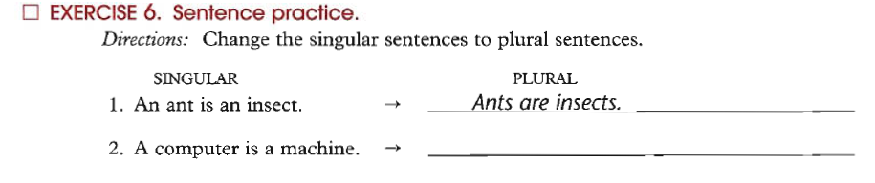

Slide 6

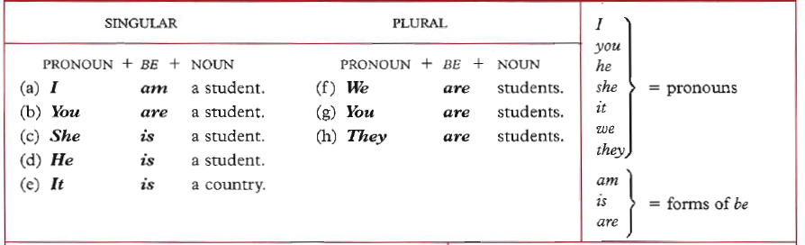
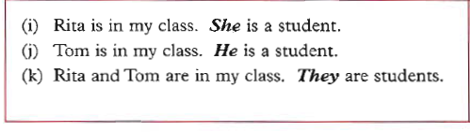

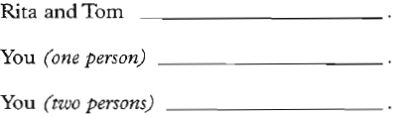

Slide 7

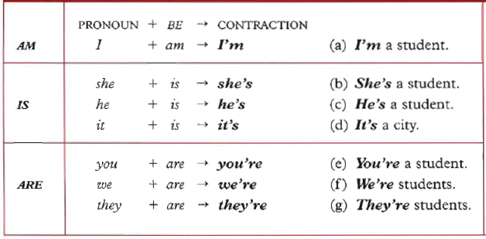
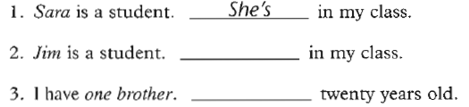

Slide 8

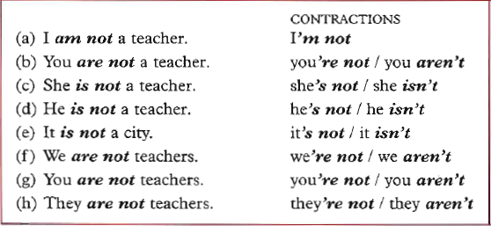
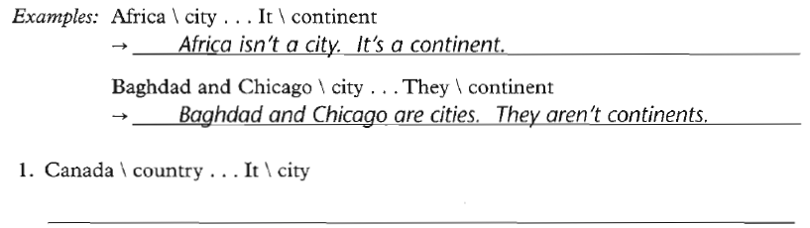

Slide 9

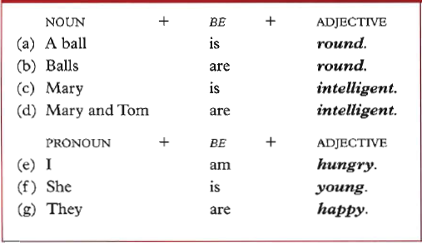
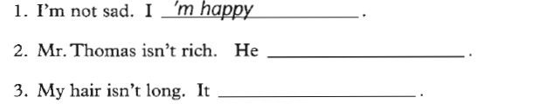

Slide 10

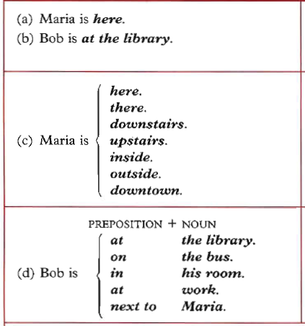

Slide 11
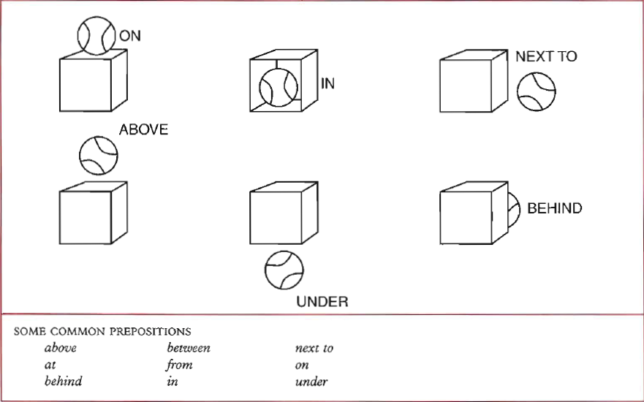

Slide 12
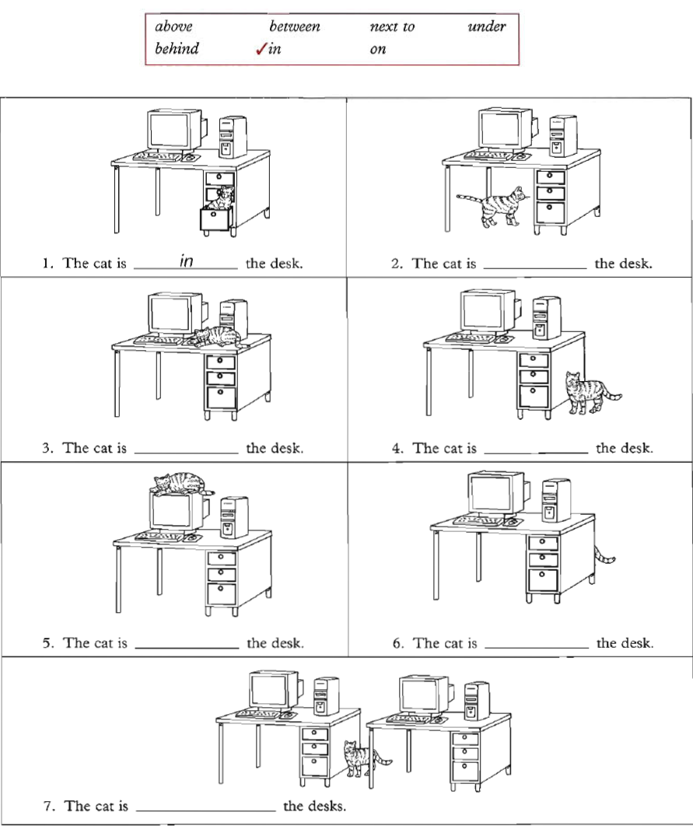

Slide 13

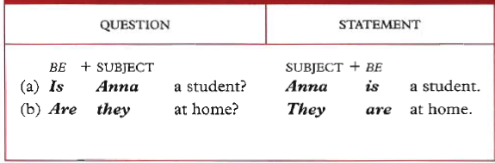
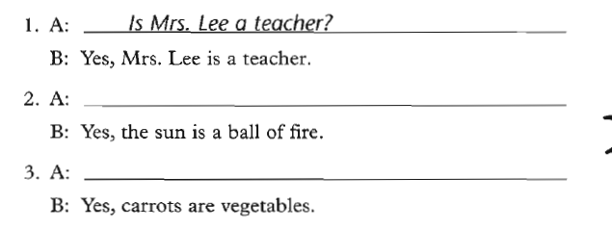

Slide 14
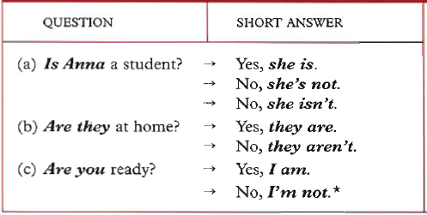
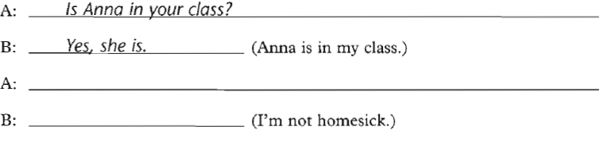

Slide 15
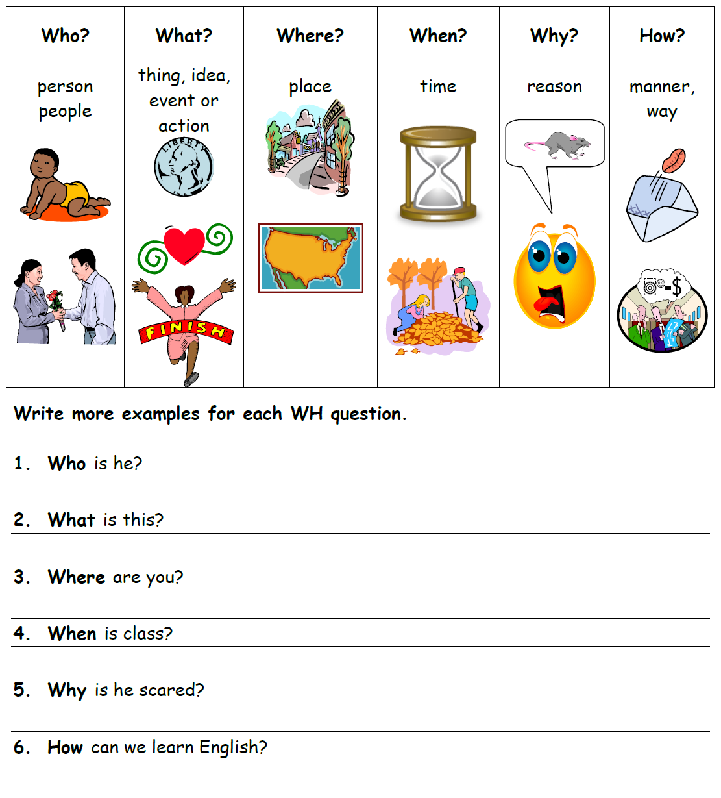
WH Questions Chart

Slide 16

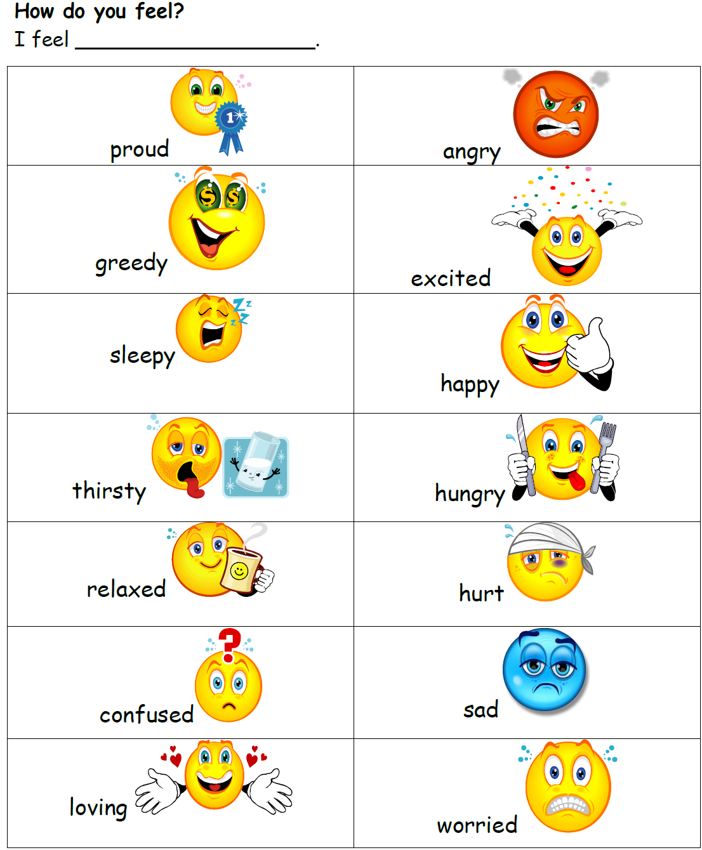

Slide 17
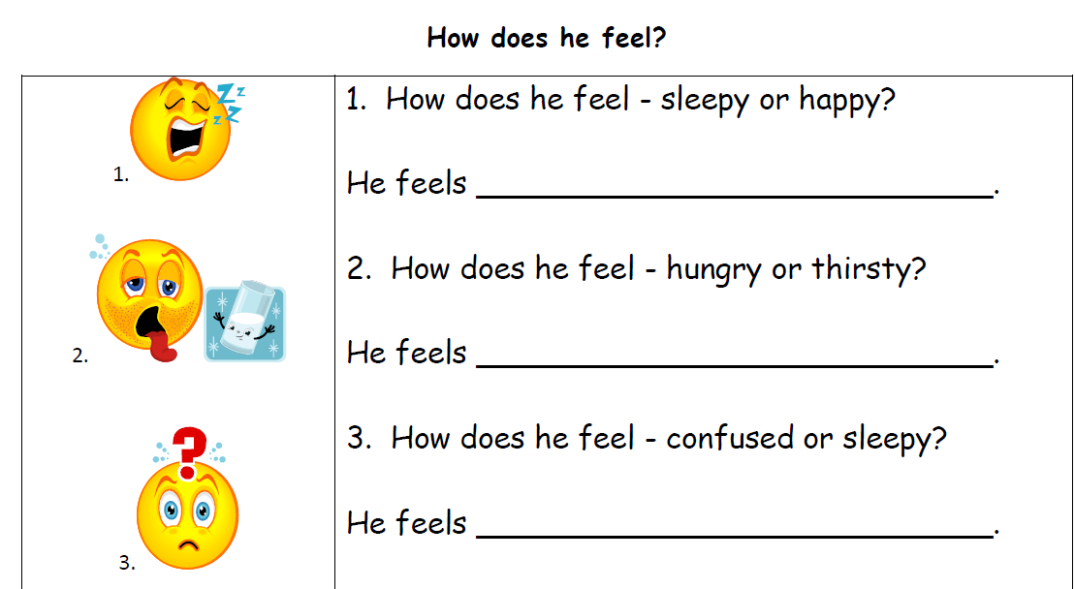

Slide 18
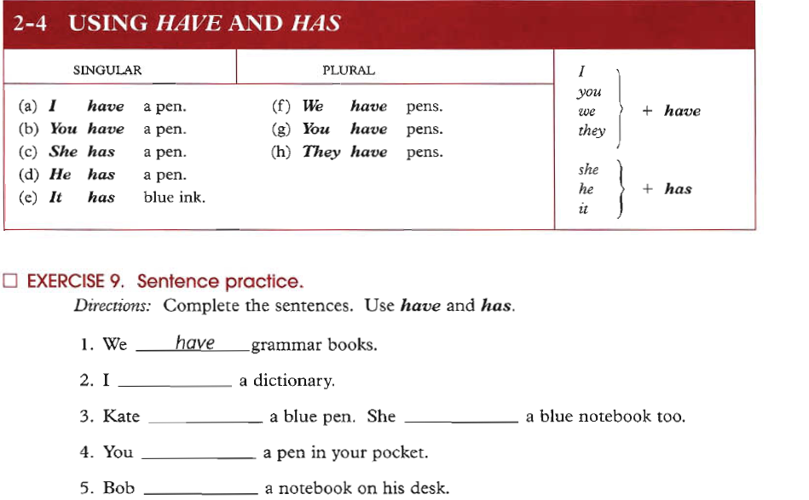
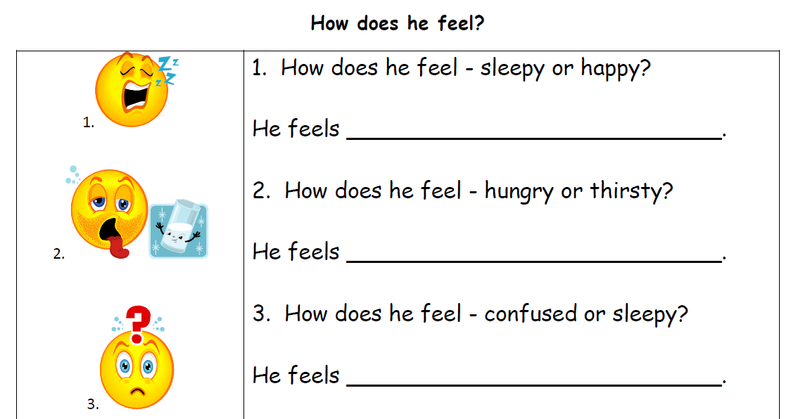

Slide 19

Do your Homework on→
- Chapter 1: Exercise 3. page 2
Ch. 1: Ex 4. page 3
Ch. 1: Ex 6. page 4
Ch. 1: Ex 10. page 7
Ch. 1: Ex 12. page 8
Ch 1: Ex 15. page 10
Ch 1: Ex17. page 12
Ch 1: Ex 25. page 19
Ch2: Ex 2. page 25 + 26
Ch 2: Ex 3. page 25 + 26
Ch 2: Ex 9. page 30

Slide 20

بحمد الله

