Slide 1

**
General English Language
Instructor: Ammar Sultan Almaani
King Faisal University
e- Learning Deanship
& Distance Education

Slide 2
Sixth Lecture
Grammar – Vocabulary – Reading
Chapter 4-5

Slide 3
Elements of Lecture
1. Previewing Vocabulary
2. Present Progressive Tense
3. Non-Action Verbs
4. Negative Form of Present Progressive
5. Forming Questions with Present Progressive
6. Spelling for Progressive Tense
7. Comparison: Simple present vs. present progressive

Slide 4
1. Vocabulary Previewing
( Interaction- pages 65 / 70 )
Adverbs | Adjectives | Verbs | Nouns | No.
often | bilingual | age | beverages | 1
never | chronic | damage | blood pressure | 2
sometimes | healthy | Exercise | brain | 3
 | mental | solve | diseases | 4
 | physical |  | Junk food | 5
 | Sleep- deprived |  | Stress | 6
 | Overweight |  | wrinkles | 7
 |  |  | dentist | 8
 |  |  | toes | 9
 |  |  |  | 10

Slide 5
Vocabulary Exercise
1. The word ‘ ___________” means lines on one’s skin
a. stress b. wrinkles c. beverages d. toes
2. “________” means that a person is unable to sleep.
a. sleep- deprived b. sleep too much
c. relaxed d. healthy
3. The word that has the same meaning as sickness is __________ .
a. wealth b. disease c. health d. earth
4. My friend suffers from ___________.He has become too fat.
a. overweight b. poorness c. English d. hard work
5. “ __________________” means worry.
a. Relaxation b. Stress c. Health d. highness
6. The opposite meaning of sick is ________________.
a. rich b. happy c. healthy d. tired

Slide 6
Vocabulary Exercise
7. The phrase “ get older” means ___________.
a. age b. to be young c. fat d. strong
8. “________” means not even once.
a. Always b. never c. sometimes d. rarely
9. The word that has the same meaning as “ drinks of all kinds” is___ .
a. water b. food c. vegetables d. beverages
10. “ Unhealthy things to eat” means__________________.
a. overweight b. junk food c. honey d. milk
11. “ __________________” means find an answer.
a. solve b. shake c. draw d. watch
12. The opposite meaning of “Physical” is ________________.
a. successful b. happy c. healthy d. mental

Slide 7
2.The Present Progressive (page 92)
This tense is used to describe an action that is occurring right now (at this moment, today, this year, etc.). The action has begun and is still in progress.
She is typing a paper for her class.
He can’t talk. He is fixing the sink right now.

Slide 8
The Present Progressive (page 92)
The present progressive can also be used to describe an action that is occurring in the present, but is temporary.
John is living in Modesto, but he might move soon.

Slide 9
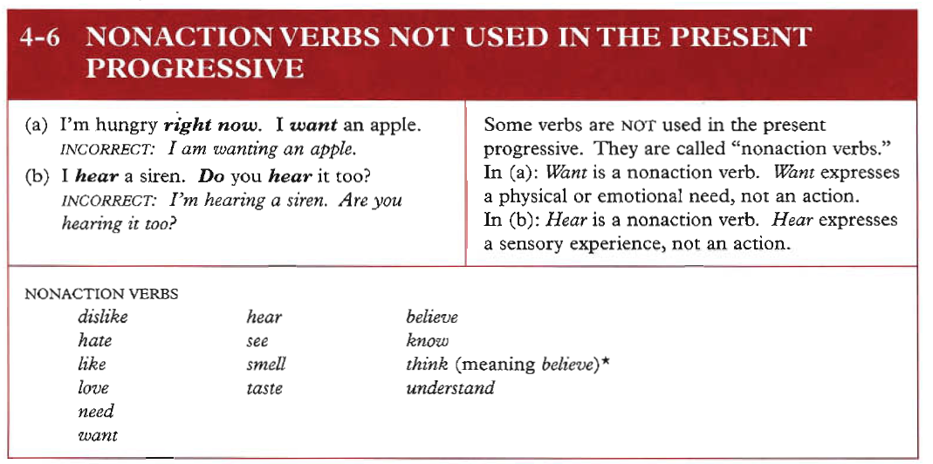
3.
Azar’s Basic Grammar Textbook: page 111
Examples:
1. I hear you now clearly.
2. They understand the lesson now.
3. Be careful! We smell dangerous chemical gas.

Slide 10
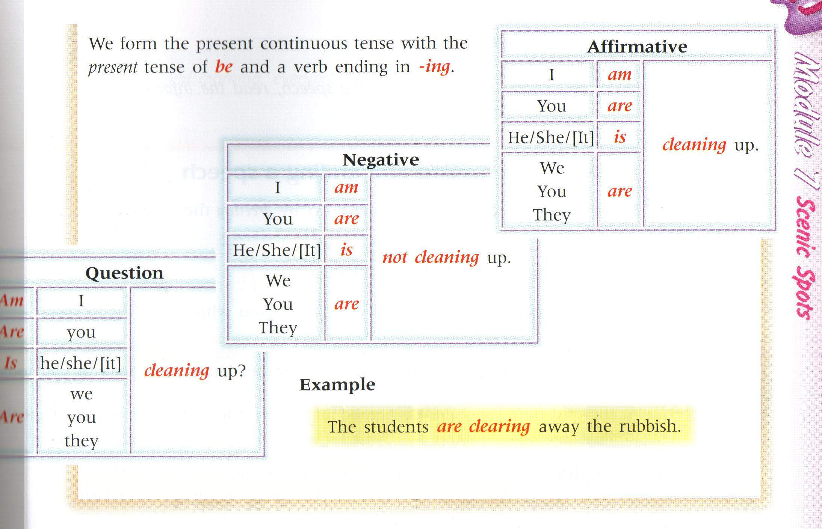
Elements : 4 + 5
We form the present continuous tense with the present tense of be and a verb ending in ing.
See Azar: Page: 99
See Azar: Page: 102

Slide 11
6.The table shows how we form the –ing form of a verb.
+ ing
Most verbs
walk
walking
Verbs ending in e
-e + ing
come
coming
Verbs ending in ie
lie
lying
-ie + y + ing
Short verbs ending in a vowel + a consonant
Double the consonant + ing
run
running

Slide 12

AzNow try these ones:
ar’s Basic Grammar: Page 111
drive
hope
smile
dance
joke
shake
choose
come
driving
hoping
smiling
dancing
joking
shaking
choosing
coming

Slide 13
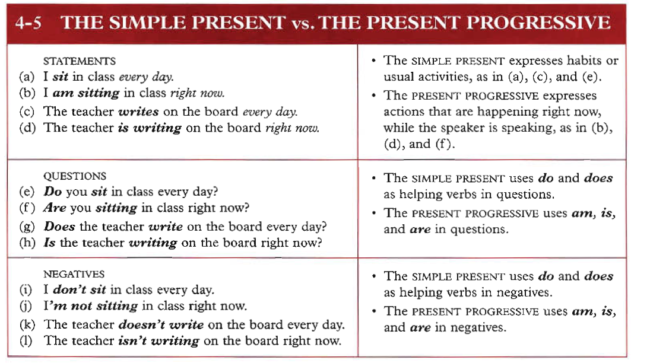
7.

Slide 14
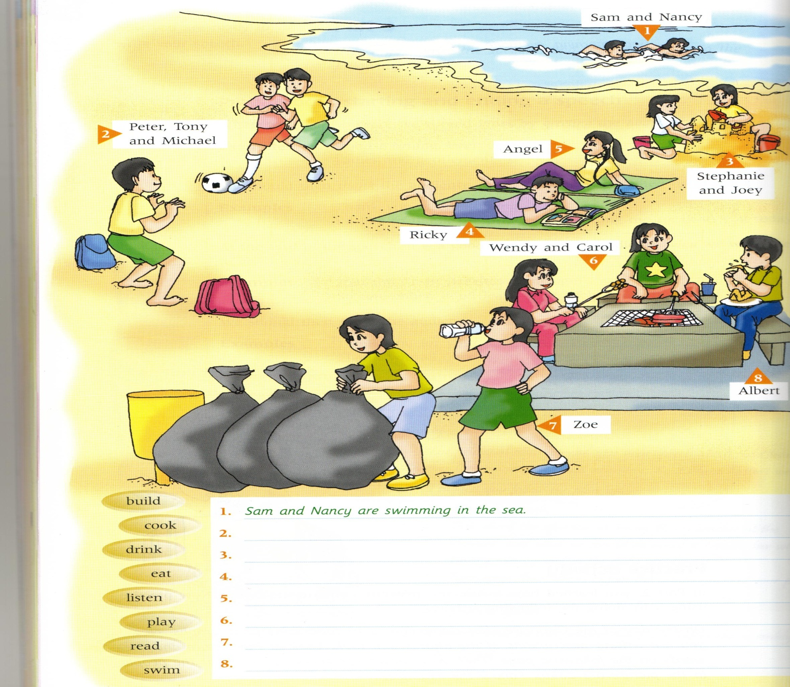
Activities

Slide 15
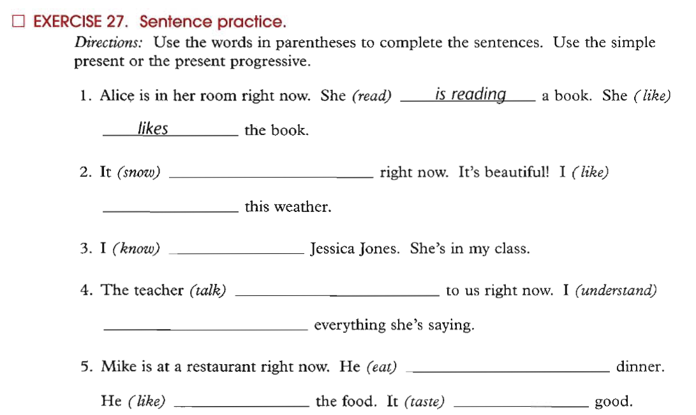

Exercise: Spelling Rules for Present Progressive (or continuous)
Pay Attention: Non-Action Verbs
begin
hop
swim
run
create
write
fill

Slide 16
Sample Questions
1. The men ____________ in the building now.
a. worked b. works c. are working d. working
2. ___________________ waiting me at the moment? – near the pharmacy.
a. Where he is b. Where does he
c. Where did he d. Where is he
3. The boys __________________________ football now .
a. are play b. play
c. is playing d. aren’t playing
4. Listen! The baby ________________ in the next room.
a. will cry b. crying
b. are crying d. is crying
5. I can’t go with you. I ______________ my homework now.
a. did b. have don c. am doing d. do

Slide 17
Sample Questions
6. She ____________ meat with rice now.
a. isn’t liking b. doesn’t like c. is liking d. like
7. She___________________ meat with rice at the moment.
a. eats b. doesn’t eats c. is eating d. eat
8. The boys __________________________ football now .
a. are play b. play
c. is playing d. aren’t playing
9. look! The car________________ coming toward us.
a. will come b. coming
b. are coming d. is coming
10. My mother is in the kitchen. She ______________ now.
a. cooked b. have cooked c. is cooking d. cook

Slide 18

بحمد الله

