Slide 1

John W. Slocum, Jr.
Susan E. Jackson
Don Hellriegel
COMPETENCY-BASED MANAGEMENT
11th Edition
Chapter 16—Designing Organizations

Slide 2


Learning Goals
Explain the two fundamental principles of designing organizations
State the major concepts of vertical organizational design
Describe four types of horizontal organizational design
Describe the major options for achieving organizational integration

Slide 3
Organizing: the process of creating a structure of jobs that enables employees to implement management’s goals and plans.
Organization Design, which means quite simply the decisions and actions that result in a structure

Slide 4


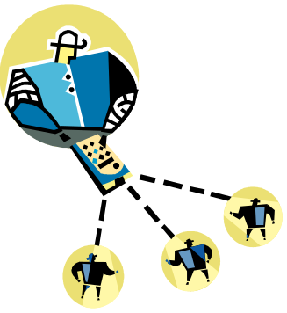
Fundamentals of Organizing
Organization chart: a diagram that illustrates the reporting lines between units and people within the organization
The organization chart conveys four kinds of information?
Boxes represent different units
Titles in each box show the work performed by that person
Reporting relationships are shown by the lines connecting superiors and subordinates
Levels of the organization are indicated by the number of vertical layers in the chart

Slide 5
Benefits and limitations of the Organizational Chart
Benefits of the Organizational Chart:
  Gives some insight into how the entire organization fit together
  Indicate gaps and duplication of activities
Limitation of the Organizational Chart:
  It’s just a picture and doesn't show how things really get done in the organization

Slide 6
Fundamentals of Organizing: Abbreviated
Organization Chart for Lowe's
Chairman, President and CEO
Sr. Vice President,
Human Resources
Executive Vice
President, Logistics
& Distribution
Executive Vice
President, Store
Operations
SVP,
South Central
Division
SVP,
South East
Division
SVP,
Western
Division
Region
1
Region
2
Region
3
District
Manager
District
Manager
District
Manager

Slide 7



TWO Fundamentals of Organizing:
(1) Differentiation
Organization is composed of units that work on specialized tasks using different work methods and requiring employees with unique competencies
Division of labor: work of the organization is divided into smaller tasks
Specialization: process of identifying particular tasks and assigning them to departments, teams, or divisions

Slide 8

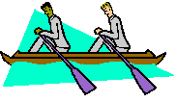
Two Fundamentals of Organizing:
(2) Integration
Various units coordinate their work to achieve common goals

Slide 9
Two Types of Organizational Design
Vertical Design: explain how communication
among employees and departments to
accomplish the goals of the organization
Organization use five ways to achieve these
goals
Horizontal Design: different types of
organizational charts exists in the real world
Four basic types of designs

Slide 10


Vertical Design
Hierarchy: a pyramid showing relationships among levels
Span of control: the number of employees directly reporting to a person
Competence of both the manager and the employee
Similarity or dissimilarity of tasks being supervised
Incidence of new problems in the manager’s department
Extent of clear operating standards and rules
(continued)

Slide 11




Vertical Design
Authority: right to make a decision
Responsibility: an employee’s duty to perform the assigned task
Accountability: manager’s expectation that the employee will accept credit or blame for his or her work

Slide 12



Vertical Design
Delegation: process of giving authority to a person (or group or team) to make decisions and act in certain situations
Barriers to delegation
Failure to define authority and responsibility clearly
Managers fear to delegate to others
Cultural values

Slide 13







Vertical Design: Building Blocks
for Effective Delegation
Establish goals
and standards
Ensure clarity
Involvement
Expect completed
work
Provide training
Timely feedback

Slide 14




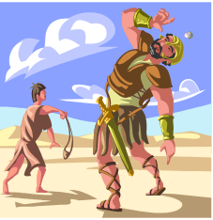
Vertical Design
Centralization: concentration of authority at the top of an organization or department
Decentralization: delegation of authority to lower level employees or departments
No absolutes for centralization versus decentralization

Slide 15
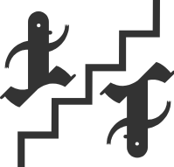
Vertical Design: Interrelated Factors
Affecting Decision to Centralize or Decentralize
Desire for uniformity
of policy
Environmental influences that require uniformity
Cost of
decisions
Competency levels of managers and employees
Need for
formal control
mechanisms

Slide 16





Horizontal Organization Design
Functional
design
Product
design
Major
types
Network
design
Geographical
design

Slide 17

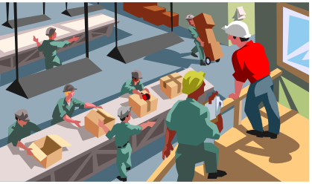
Functional Design
Grouping managers and employees according to their areas of expertise and the resources they use to perform their jobs

Slide 18

Functional Design: Harley-Davidson
Organization Chart
CEO
General
Counsel
Chief
Financial
Officer
Chief
Operating
Officer
Treasurer
Financial
Services
Strategic
Planning
Styling
Officer
Human
Resources

Slide 19

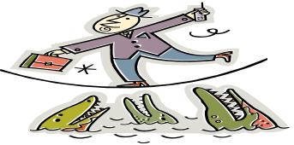
Functional Design: Potential Benefits
Versus Pitfalls
Potential Benefits
Potential Pitfalls
Supports skill specialization
Reduces duplication of resources & increases coordination with the function
Enhances career development & training within functional area
Allows superiors and subordinates to share common expertise
Promotes high-quality technical decision making
Inadequate communication across functional areas
Conflicts over product priorities
Focus on departmental rather than organizational issues and goals
Develops managers who are experts only in a narrow field

Slide 20


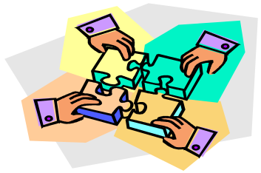
Product Design
All functions that contribute to a product are organized under one manager
Divides the organization into self-contained units

Slide 21
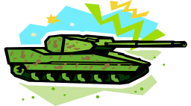
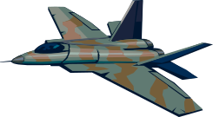
Product Design: General Dynamics
Organization Chart
Chairman & Chief
Executive Officer
Information
Systems &
Technology
Combat
Systems
Marine
Systems
Aerospace
Land
Systems
Armament
Systems
Ordinance
& Tactical
Systems
Aviation
Services
Bath
Iron
Works
Electric
Boat

Slide 22


Product Design: Potential Benefits
and Pitfalls
Potential Benefits
Potential Pitfalls
Permits fast changes in a product line
Allows greater product line visibility
Fosters a concern for customer demand
Clearly defines responsibilities for each product line
Develops managers who can think across functional lines
Inefficient utilization of skills and resources
Not fostering coordination of activities across product lines
Encourages politics and conflicts in resource allocation across product lines
Limits career mobility for personnel outside their own product lines

Slide 23


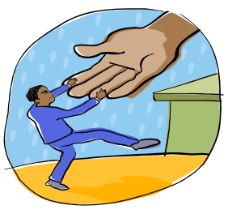
Geographical Design
Organizes activities around location
Helps to develop competitive advantage in each region according to that area’s customers, competitors, and other factors

Slide 24

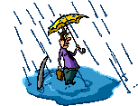
Geographical Design: Potential Benefits
and Pitfalls
Potential Benefits
Potential Pitfalls
Facilities and the equipment used for production and/or distribution all in one place, saving time and costs
Able to develop expertise in solving problems unique to one location
Understanding of customers’ problems and desires in the location
Getting production closer to raw materials and suppliers
Duplication of functions, to varying degrees, at each regional or individual unit location
Conflict between each location’s goals and the organization’s goals
Adds levels of management and extensive use of rules and regulations to coordinate and ensure uniformity of quality among locations

Slide 25


Network Design
Subcontracts some or many of its operations to other firms and coordinates them to accomplish specific goals
Sometimes called virtual organizations
Connects people regardless of their locations

Slide 26


Network Design: Potential Benefits
and Pitfalls
Potential Benefits
Potential Pitfalls
Ability to gain special knowledge and skills of others without having to hire employees
Allows managers the flexibility to work with a wide variety of different suppliers, customers, and other organizations
Other organizations may fail to live up to established deadlines
Managers must constantly monitor the quality of work provided by other organizations
Employees in the outsourced organization may not hold the same values and sense of time urgency to which employees in the organization are committed

Slide 27
Network Design: DreamWorks
SKG Network Design
Computer
Hardware
Software
Legal
Marketing
Makeup
Artists
Senior Managers of
DreamWorks, SKG
Future
Games
Costume
Designers
Agents
Technicians
Actors
Media
Relations
Talent
Scouts

Slide 28
Organizational Integration:
Means how to coordinate organizational activities to achieve organizational goal
Managers use two type of systems to integrate the activities of their employees
    Integration through Mechanistic and Organic Systems
    Integration through types of interdependence

Slide 29
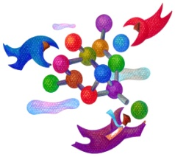
Mechanistic and Organic Systems
Organic
Mechanistic
Tasks tend to be ill defined
Tasks are continually adjusted and redefined through communication as situations change
Network structure of control, authority, and communication
Tasks are highly specialized
Tasks tend to remain rigidly defined unless changed by top management
Specific roles are prescribed for each employee
(continued)

Slide 30
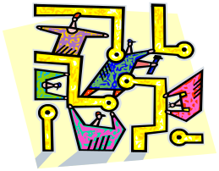
Mechanistic and Organic Systems
Organic
Mechanistic
Communication and decision making are both vertical and horizontal, depending on where information and expertise reside
Communication emphasizes the form of mutual influence and advice among all levels
Hierarchical structure of control, authority, and communication
Communication and decision making are primarily vertical, top-down
Communication emphasizes directions and decisions issued by superiors

Slide 31


Types of
Interdependence
Interdependence: the degree of coordination required between individuals and units to transform information and raw materials into goods and services
Pooled interdependence: little sharing of information or resources among individuals within a unit or among units in the performance of tasks (e.g., golf teams)
Output
Input
Input
Input

Slide 32

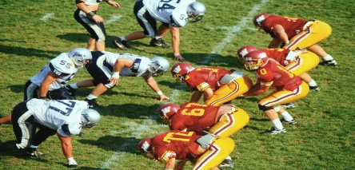
Types of Interdependence (cont’d)
Sequential interdependence: the orderly step-by-step flow of information, tasks, and resources from one individual or team to another within the same unit or from one unit to another (e.g., football teams)
Input
Output

Slide 33


Organizational Integration: Types
of Interdependence (cont’d)
Reciprocal interdependence: the need for every individual and unit to work with every other individual and unit; information and resources flow back and forth freely until the goal is achieved (e.g., volleyball teams)
Input
Output
Input
Output
Input
Output

