Slide 1
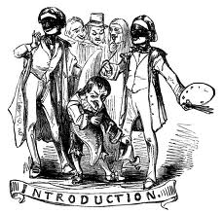

Slide 2
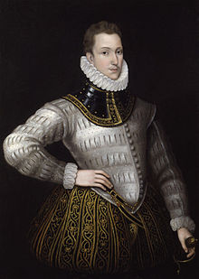
Sir Philip Sidney

Slide 3

Sidney’s birth
&
The beginning of his life

Slide 4
Born at Penshurst Place, Kent, he was the eldest son of Sir Henry Sidney and Lady Mary Dudley. His mother was the eldest daughter of John Dudley, 1st Duke of Northumberland, and the sister of Robert Dudley, 1st Earl of Leicester. His younger brother, Robert was a statesman and patron of the arts, and was created Earl of Leicester. His younger sister, Mary, married Henry Herbert, 2nd Earl of Pembroke. Mary Sidney, who upon her marriage became the Countess of Pembroke, was a writer, translator and literary patron. Sidney dedicated his longest work, the Arcadia, to her. After her brother's death, Mary reworked the Arcadia, now known as The Countess of Pembroke's Arcadia.
Philip Sidyey was educated at Shrewsbury School and Christ Church, Oxford. In 1572 he was elected to Parliament as Member of Parliamentfor Shrewsbury^{[1]} and in the same year travelled to France as part of the embassy to negotiate a marriage between Elizabeth I and the Duck D'Alençon. He spent the next several years in mainland Europe, moving through Germany, Italy, Poland, the Kingdom of Hungaryand Austria. On these travels, he met a number of prominent European intellectuals and politicians.

Slide 5
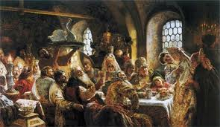
The society which he lived in

Slide 6
Philip Sidney was the eldest son of Sir Henry Sidney and his wife, Lady Mary Dudley, daughter of the duke of Northumberland, and godson of King Philip II of Spain. After Elizabeth I succeeded to the throne, his father was appointed lord president of Wales (and later served three times as lord deputy of Ireland), while his uncle, Robert Dudley, was created earl of Leicester and became the queen’s most trusted adviser. In keeping with his family background, the young Sidney was intended for a career as a statesman and soldier. At age 10 he entered Shrewsbury School, where his classmate was Fulke Greville (later a court official under Elizabeth), who became his lifelong friend and was his early biographer. In February 1568 he began a three-year period of studies at Christ Church, Oxford, afterward traveling in Europe between May 1572 and June 1575, perfecting his knowledge of Latin, French, and Italian. He also gained firsthand knowledge of European politics and became acquainted with many of Europe’s leading statesmen.

Slide 7
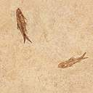
His first court appointment came in the spring of 1576, when he succeeded his father as cupbearer to the queen, a ceremonial position. Then in February 1577, when he was only 22, he was sent as ambassador to the German emperor Rudolf II and the elector palatine Louis VI, carrying Queen Elizabeth’s condolences on the deaths of their fathers. But along with this formal task, he also had secret instructions to sound out the German princes on their attitude toward the formation of a Protestant league—the chief political aim being to protect England by associating it with other Protestant states in Europe that would counterbalance the threatening power of Roman Catholic Spain. Sidney apparently brought back enthusiastic reports on the possibilities of forming such a league, but the cautious queen sent other emissaries to check on his reports, and they returned with less-optimistic accounts of the German princes’ reliability as allies. He did not receive another major official appointment until eight years later.

Slide 8


Significance

Slide 9

An apology for poetry is one of the most important contributions to literary theory written in English during the renaissance.
He advocates a place for poetry within the framework of an aristocratic state, while showing concern for both
literary and national identity .
It is a defense of the nobility of poetry .
It was England’s first philosophical defense in which he describes poetry’s ancient and indispensable place in society and its mimetic nature and ethical function. It includes his famous definition of poetry as art, imitation, and exercise.
Among his gifts to his contemporaries were his respect for tradition and his notion to experiment.

Slide 10
Sidney’s method

Slide 11

Rhetorical devices .
Courtier ship .
He uses the structure of classical oration from his humanist education .
He uses this method to build argument by making use of the Rhetorical methods .
Metaphor and allegory to conceal and reveal his position .

Slide 12
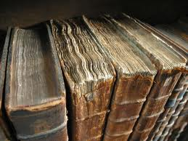
Names of his works

Slide 13

1- Lady of may : is one of his lesser known works , it is a play written for Queen Elizabeth in 1578
2- Astrophel and stella : the first of the famous sonnet
sequences , it was probably composed in the early 1580.
3- The countess of Pembroke Arcadia : the arcadia , by far is Sidney’s most ambitious work , it is as significant in its own way as his sonnets .
4- An Apology for poetry : an important critical essay.

Slide 14
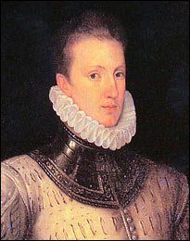

Sydney's death

Slide 15
Sidney joined Sir John Norris in the Battle of Stephen, fighting for the Protestant cause against the Spanish. During the battle, he was shot in the thigh and died of gangrene twenty-six days later, at the age of 32. According to the story, while lying wounded he gave his water to another wounded soldier, saying, "Thy necessity is yet greater than mine". As he lay dying, Sidney composed a song to be sung by his deathbed. This became possibly the most famous story about Sir Phillip, intended to illustrate his noble and gallant character.
. Sidney's body was returned to London and was buried in St. Paul's Cathedral on 16 February 1587. Already during his own lifetime, but even more after his death, he had become for many English people the very epitome of a Castiglione courtier: learned and politic, but at the same time generous, brave, and impulsive. The funeral procession was one of the most elaborate ever staged, so much so that his father-in-law, Francis Willingham, almost went bankrupt. Never more than a marginal figure in the politics of his time, he was memorialized as the flower of English manhood in Edmund Spenser's Strophe, one of the greatest English Renaissance elegies.

Slide 16


