Slide 1

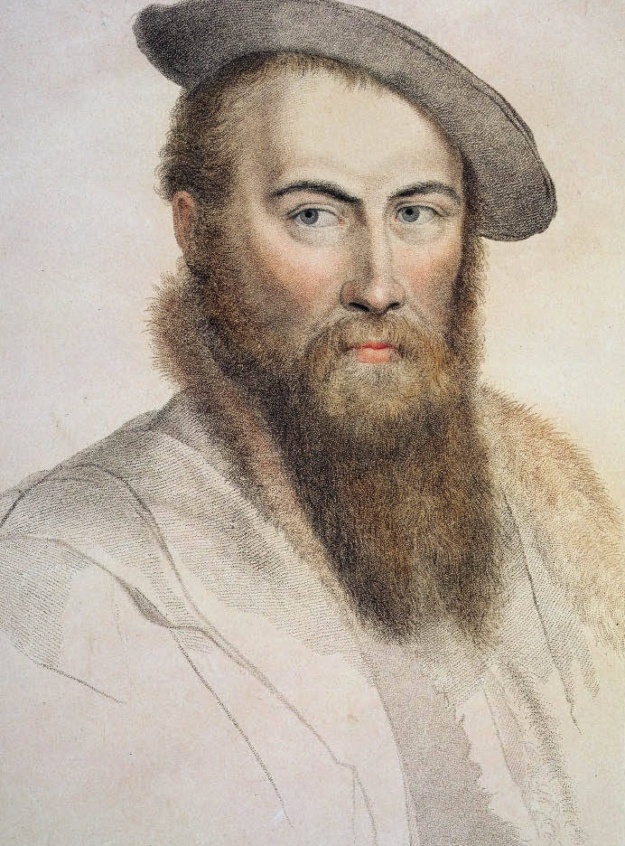

(1503 – 11 October 1542)
A 16th-Century
English Ambassador
and
Lyrical Poet.
Nicknamed
The Father of English Poetry

Slide 2

Personality & Appearance:
Sensitive
Brilliant.
Quintessential
Incurable
Romantic.
Popular
Tall & Handsome
Admired for his skill in music and languages.

Slide 3
Highly intelligent.
Witty.
Fearless of speech to the point of indiscretion.
Impulsive and unsteady.
Melancholy.
Physically strong
Spoilt by an admiring father and friends.

Slide 4
Family:
Sir Henry Wyatt; Father
Anne Skinner; Mother
Elizabeth Brooke; Wife
His Six Children:
Thomas Wyatt the younger, who led a thwarted rebellion against Queen Mary I
Walter Wyatt
Frances Wyatt
Anne Wyatt
Henry Wyatt
Edward Wyatt

Slide 5
His Beginning:
Thomas was born to Sir Henry Wyatt and Anne Skinner in 1503 at Allington Castle, Kent.
Being the son of a man who dutifully served Henry VII and Henry VIII, Thomas’s life looked prosperous even peering out of his cradle.
He first began court life at the age of thirteen as a “Sewer Extraordinary,” which was; a servant who waited the table. This same year he began at St. John’s College, Cambridge; Thomas showed literary and scholarly potentials early in years.

Slide 6
Marriage and Love Life:
By the late 1510’s Thomas Wyatt was a tall man, at least six feet tall, handsome, and athletic.
He married Elizabeth Brooke, a daughter of royal descent. They were both young when Elizabeth gave birth a year later, to a son named Thomas.
After his teenage fatherhood. Anne Boleyn, the future love of his life, returned from serving the French Queen Claude. Years later, Wyatt’s grandson George Wyatt would chronicle that when he saw “this new beauty” return that winter he quickly fell in love with her.

Slide 7
The pair became friends, for both were well educated, clever with words, and engaging to converse with.
George Wyatt told that Wyatt had taken one of Anne’s jewels
“hanging by a lace out of her pocket or otherwise loose, which he thrust into his bosom.”
He wore this jewel around his neck.
By 1524, Wyatt had separated from his wife due to her adultery and began wooing with other women, including Anne Boleyn. Also around this time he was appointed an Ambassador for Henry VIII at home and abroad.

Slide 8
The king had an eye on Anne Boleyn and had no intentions of sharing.
Thomas Wyatt could not compete with the King of England for the heart of Anne Boleyn. He dropped into the background, but not too far. He continued intertwining Anne into his poems, comparing her to an elusive deer which another hunter had claimed.
Now, without a wife or a prospect of one, Wyatt could focus on his court duties and his poetry.
.The prelude to William Shakespeare was Thomas Wyatt. He adopted literary forms often not used in England such as the rondeau and satire, and is famous for creating the poetic form of sonnet.
Court duties & Poetry:

Slide 9
Wyatt’s best known poems are about the hardships of love known as the convention of courtly love.
Many years after his death, Thomas Wyatt was called;
“the father of English poetry.”
and
“the father of the Drab Age”
which was the predecessor of the Golden Age of Elizabeth Tudor, the daughter of the woman he pursued and who his son would later die for.
The former suitor and lady remained friends through Henry VIII’s courtship and became a favorite of the King.

Slide 10
Wyatt travelled to Rome on orders of petitioning the pope to annul Henry’s dead marriage to Catherine of Aragon. In 1533, he was sworn as a member of the Privy Council.
On February 22nd, a curious incident occurred, Eustace Chapuys, the Spanish Ambassador took it upon himself to report seeing Wyatt, “one she loves well”, come out of her room. The King said; “for the last three days she had had such an incredible fierce desire to eat apples as she had never felt before, and that the King had said to her that it was a sign that she was with child, and she had said no, it was not so at all.”
The beginning of his end:

Slide 11
He also played a part in Anne Boleyn’s coronation and poured scented water upon the new Queen’s hands. In 1535, he was knighted. But later on in May 1536 he was charged of adultery with Queen Anne and was imprisoned in the Tower of London. Now he had to try to convince the court that his passionate poetry was not concerning Queen Anne and explain his harmless friendship with her.
During his time in the Tower of London, where so many had met their end, Wyatt, having been burdened with the over-imaginative mind of a true poet, did what he always did best. He wrote.

Slide 12
Anne Boleyn, Queen of England, was found guilty and was sentenced to death along with 5 men including her brother.
The woman Sir Thomas Wyatt loved and praised and wooed in his poetry, was to die.
When the five accused men and the Queen died, Wyatt was thirty-three years old, and he had been separated from Elizabeth Brooke for twelve years.
Thomas Wyatt was released from the Tower of London later that year and returned to his duties as member of the Privy Council and Ambassador.

Slide 13
By 1540, Wyatt was restored to full favour. But, just as before, downfall quickly followed fortune. He was again arrested for treason and held in the Tower in 1541. Fortunately, the current wife of Henry VIII, the young Katherine Howard, first cousin to Anne Boleyn, interceded on his behalf on the terms that he would reconcile with his estranged wife. He agreed, and was released.

Slide 14
His Death:
On October 11th, 1542 Sir Thomas Wyatt died at the age of thirty-nine at Sherborne, Dorset
One might think that something as trivial as a fever would never claim the man who had competed against the King of England over a woman, the man who had survived two treason charges and months in the Tower. But that was the way sir Thomas Wyatt’s life came to an end..

Slide 15
Farewell, love
Farewell, Love, and all thy laws for ever:
Thy baited hooks shall tangle me no more.
Senec and Plato call me from thy lore,
To perfect wealth my wit for to endeavour.
In blind error when I did persever,
Thy sharp repulse, that pricketh aye so sore,
Hath taught me to set in trifles no store,
And scape forth, since liberty is lever.

Slide 16
Farewell, love
Therefore farewell, go trouble younger hearts,
And in me claim no more authority;
With idle youth go use thy property,
And thereon spend thy many brittle darts.
For, hitherto though I've lost my time,
Me lusteth no longer rotten boughs to climb.

Slide 17
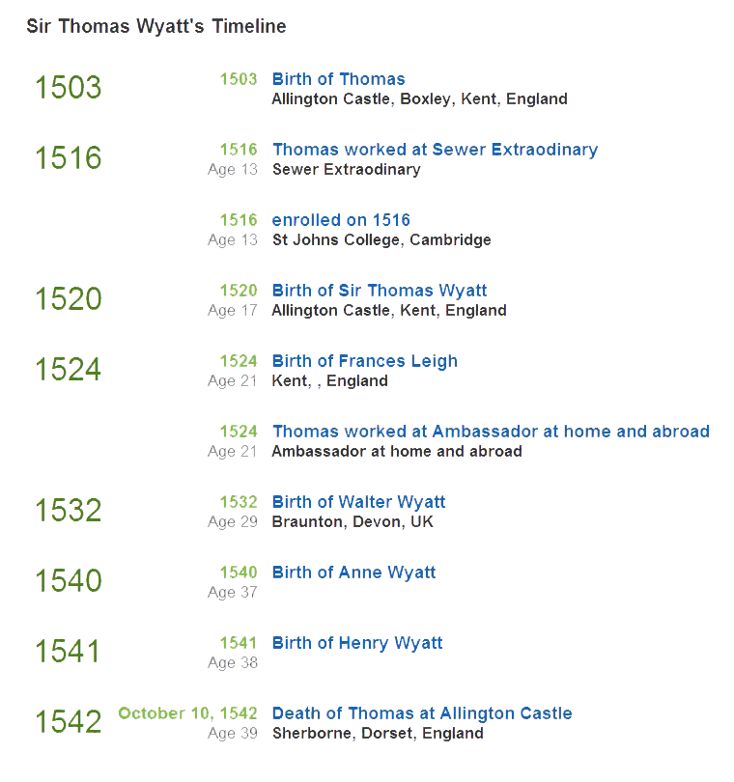

Slide 18
Saja Almubarazi
Gehan Fakanaz
Manal Alghamdi
Alanood Alshimiri
Mahiyah Alzahrani
Amjad Alhosain

