Slide 1
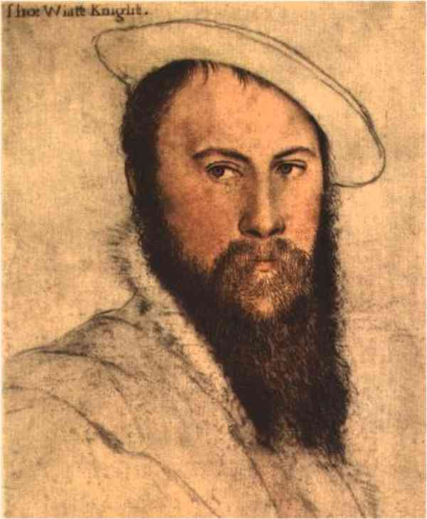
Sir Thomas Wyatt
(1503-1542)

Slide 2
The Life of Sir Thomas Wyatt (1503-1542)
Thomas Wyatt was born to Henry and Anne Wyatt at Allington Castle, near Maidstone, Kent, in 1503. Little is known of his childhood education. His first court appearance was in 1516 as Sewer Extraordinary to Henry VIII. In 1516 he also entered University of Cambridge. Around 1520, when he was only seventeen years old, he married Elizabeth Brooke. She bore him a son, Thomas Wyatt, the Younger, in 1521. He became popular at court, and carried out several foreign missions for King Henry VIII.

Slide 3
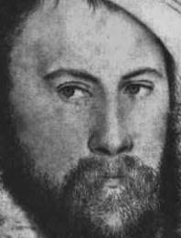
Wyatt was knighted in 1535, but in 1536 he was imprisoned in the Tower for quarreling with the Duke of Suffolk, and possibly also because he was suspected of being one of Anne Boleyn's lovers.

Slide 4
None of Wyatt's poems had been published in his lifetime, with the exception of a few poems entitled The Court of Venus. His first published work was Certain Psalms (1549), metrical translations of the penitential psalms.
Until modern times it was called simply Songs and Sonnets, but now it is generally known as Tottel's Miscellany. The rest of Wyatt's poetry, lyrics, and satires remained in manuscript until the 19th and 20th centuries "rediscovered" them.

Slide 5
Wyatt’s Poetry and Influence
Wyatt's professed object was to experiment with the English tongue. A significant amount of his literary output consists of translations and imitations of sonnets by the Italian poet Petrarch. He took subject matter from Petrarch's sonnets, but his rhyme schemes make a significant departure. However his poems never ended in a rhyming couplet.

Slide 6
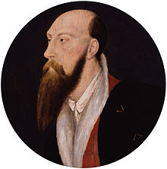
While Wyatt's poetry reflects classical and Italian models, he also admired the work of Chaucer and his vocabulary reflects Chaucer’s. Also many of his poems deal with the trials of romantic love.

Slide 7
Wyatt was one of the earliest poets of the Renaissance. He was responsible for many innovations in English poetry. His lyrics show great tenderness of feeling and purity of diction. He is one of the originators of the convention in love poetry.

Slide 8
Major Themes of his poetry
Change
The Tudor court was filled with change. Henry VIII's reign was in a time of great political, social, national and international upheaval. Wyatt was central to all of these areas as a lover, a courtier, an ambassador and a diplomat. Wyatt seems to have concluded that change is inevitable, as illustrated in 'Divers Doth Use’, but also that change without direction can be dangerous, if not deadly, as in ‘My Galley Charged’. Wyatt suggests that change is natural and inevitable but nonetheless dangerous, and sometimes fatal.

Slide 9
Loyalty and Betrayal
Wyatt appears to have had a strong sense of justice with regard to relationships. His work contains criticism and condemnation of the treachery of those around him. His translations of sonnets such as ‘Whoso List To Hunt?’, ‘They Flee From Me’ and ‘Forget Not Yet’ are used to present his disappointment and conviction of the transitory, sometimes even fatal, implications of the bonds which are made, and broken, within the court. Often his acknowledgement of betrayal can work on several levels, with criticism being implied of not just his lady, but also his peers and his king.

Slide 10
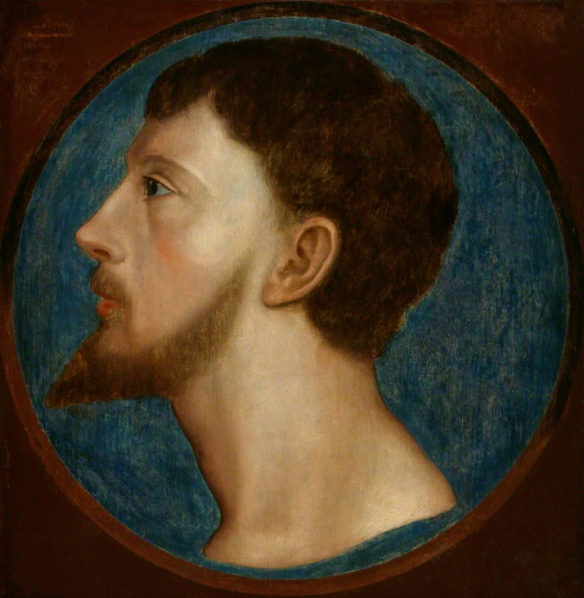
Forsaken Love
A popular theme for courtly poetry, forsaken love is often a surface theme in Wyatt’s works, though sometimes it is used to cover a deeper political sentiment. Poems which refer to abandoned lovers would be ‘Madam, Withouten Many Words’, And Wilt Thou Leave Me Thus?’, ‘Farewell, Love’, ‘What no, Perdie!’ and ‘My Heart I Gave Thee’.

Slide 11
Some poems Summary
'Forget Not Yet': a song of warning indicating that the betrayal of the narrator will have consequences.
'Lux, My Fair Falcon': an epigram that uses the metaphor of falconry to express the frustration of friendships that fail at a simple challenge.
'My Galley Charged': a sonnet translated from an original by Petrarch. The poem uses the metaphor of a tempestuous sea voyage to highlight the narrator's loss of faith.

Slide 12
'Whoso List To Hunt?': a sonnet translated from Petrarch. The poem utilizes the metaphor of hunting to reflect on the narrator's unsuccessful pursuit of a lady already claimed by another.
'They Flee From Me': a ballad detailing the abandonment of a friend by first a lady, then a group of associates. The song deals with the complex social relationships within the court of King Henry VIII

Slide 13
'A Renouncing of Love (Farewell, Love)': a sonnet which uses the personification of Love to clarify the narrator’s rejection of his unsuccessful suit.
'Blame Not My Lute': a ballad highlighting that the messenger is not responsible for the harshness or cruelty of the communication made.
'My Lute, Awake': a song calling upon the lute to assist the narrator in the futile attempt to gain his audience’s attention and understanding.
'What No, Perdie': a rondeau expressing the frustration of a narrator rejected by a former lover.

Slide 14
The End of The Presentation
Done By:
Hayfa AlKahlan.
Hadeel Abahussain.
Alanoud Al-Marri.
Tagreed Al-Otaibi.

