Slide 1
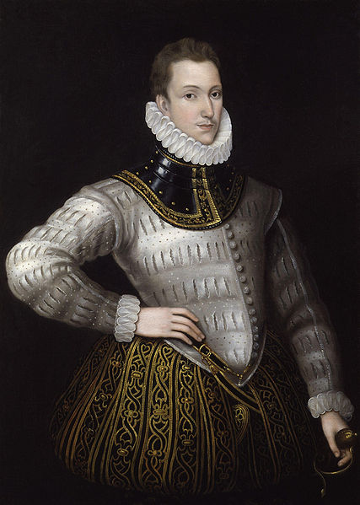
Sir. Philips Sidney

Slide 2
Sir Philip Sidney (30 November 1554 – 17 October 1586) was an English poet, courtier and soldier, and is remembered as one of the most prominent figures of the Elizabethan Age. His works include Astrophel and Stella, The Defense of Poesy (also known as The Defense of Poetry or An Apology for Poetry), and The Countess of Pembroke's Arcadia.

Slide 3
Early life:
Born at Penshurst Place, Kent, he was the eldest son of Sir Henry Sidney(Lord Deputy of Ireland) and Lady Mary Dudley. He was named after his godfather, King Philip II of Spain. His mother was the eldest daughter of John Dudley, 1st Duke of Northumberland, and the sister of Robert Dudley, 1st Earl of Leicester. His younger brother, Robert was a statesman and patron of the arts, and was created Earl of Leicester. His younger sister, Mary, married Henry Herbert, 2nd Earl of Pembroke. Mary Sidney, who upon her marriage became the Countess of Pembroke, was a writer, translator and literary patron. Sidney dedicated his longest work, the Arcadia, to her. After her brother's death, Mary reworked the Arcadia, now known as The Countess of Pembroke's Arcadia.

Slide 4
Philip Sidney was educated at Shrewsbury School and Christ Church, Oxford; After private tutelage, he entered Shrewsbury School at the age of ten in 1564, on the same day as Fulke Greville, Lord Brooke, who became his fast friend and, later, his biographer. After attending Christ Church, Oxford, (1568-1571) he left without taking a degree in order to complete his education by travelling the continent.
In 1572 he was elected to Parliament as Member of Parliament for Shrewsbury and in the same year travelled to France as part of the embassy to negotiate a marriage between Elizabeth I and the Duck D'Alençon. He spent the next several years in mainland Europe, moving through Germany, Italy, Poland, the Kingdom of Hungary and Austria. On these travels, he met a number of prominent European intellectuals and politicians.

Slide 5
Politics:
Sidney returned to England in 1575, living the life of a popular and eminent courtier. In 1577, he was sent as ambassador to the German Emperor and the Prince of Orange. Officially, he had been sent to condole the princes on the deaths of their fathers. His real mission was to feel out the chances for the creation of a Protestant league. Yet, the budding diplomatic career was cut short because Queen Elizabeth I found Sidney to be perhaps too ardent in his Protestantism, the Queen preferring a more cautious approach.

Slide 6
Upon his return, Sidney attended the court of Elizabeth I, and was considered "the flower of chivalry." He was also a patron of the arts, actively encouraging such authors as Edward Dyer, Greville, and most importantly, the young poet Edmund Spenser, who dedicated The Shepheardes Calender to him. Also, Sidney met Penelope Devereux, the future Lady Rich; though much younger, she would inspire his famous sonnet sequence of the 1580s, Astrophel and Stella. Her father, the Earl of Essex, is said to have planned to marry his daughter to Sidney, but he died in 1576. In England,1580, Sidney occupied himself with politics and art. He defended his father's administration of Ireland in a lengthy document. More seriously, he quarrelled with Edward de Vere, 17th Earl of Oxford, probably because of Sidney's opposition to the Queen Elizabeth's French marriage(to the Duke of Anjou, Roman Catholic heir to the French throne), which de Vere championed.

Slide 7
In the aftermath of this episode, Sidney challenged de Vere to a duel, which Elizabeth forbade. He then wrote a lengthy letter to the Queen detailing the foolishness of the French marriage. Characteristically, Elizabeth bristled at his presumption, and Sidney prudently retired from court.
He left the court for the estate of his cherished sister Mary Herbert, Countess of Pembroke. During his stay, he wrote the long pastoral romance Arcadia.

Slide 8
Literary writings:
His artistic contacts were more peaceful and more significant for his lasting fame. During his absence from court, he wrote Astrophel and Stella and the first draft of The Arcadia and The Defence of Poesy. Somewhat earlier, he had met Edmund Spenser, who dedicated the Shepheardes Calendar to him. Other literary contacts included membership, along with his friends and fellow poets Fulke Greville, Edward Dyer, Edmund Spenser and Gabriel Harvey, of the (possibly fictitious) 'Areopagus', a humanist endeavour to classicise English verse.

Slide 9
Sidney had returned to court by the middle of 1581 and in 1584 was MP for Kent. That same year Penelope Devereux was married, apparently against her will, to Lord Rich. Sidney was knighted in 1583. An early arrangement to marry Anne Cecil, daughter of Sir William Cecil and eventual wife of de Vere, had fallen through in 1571. In 1583, he married Frances, teenage daughter of Sir Francis Walsingham. In the same year, he made a visit to Oxford University with Giordano Bruno, who subsequently dedicated two books to Sidney. Later on , the Sidneys had one daughter, Elizabeth, later Countess of Rutland.

Slide 10
Astrophel and Stella:
Likely composed in the 1580s, Philip Sidney's Astrophil and Stella is an English sonnet sequence containing 108 sonnets and 11 songs. The name derives from the two Greek words, 'aster' (star) and 'phil' (lover), and the Latin word 'stella' meaning star. Thus Astrophil is the star lover, and Stella is his star. Sidney partly nativized the key features of his Italian model Petrarch, including an ongoing but partly obscure narrative, the philosophical trappings of the poet in relation to love and desire, and musings on the art of poetic creation. Sidney also adopts the Petrarchan rhyme scheme, though he uses it with such freedom that fifteen variants are employed.

Slide 11
Some have suggested that the love represented within the sequence may be a literal one as Sidney evidently connects Astrophil to himself and Stella to Penelope Rich, the wife of a courtier, Robert Rich, 3rd Baronet. Payne and Hunter suggest that modern criticism, though not explicitly rejecting this connection, leans more towards the viewpoint that writers happily create a poetic persona, artificial and distinct from themselves.

Slide 12
Publishing History: (of Astrophil and Stella)
Many of the poems were circulated in manuscript form before the first edition was printed by Thomas Newman in 1591, five years after Sidney's death.This edition included ten of Sidney's songs, a preface by Thomas Nashe and verses from other poets including Thomas Campion, Samuel Daniel and the Earl of Oxford. The text was allegedly copied down by a man in the employ of one of Sidney's associates, thus it was full of errors and misreadings that eventually led to Sidney's friends ensuring that the unsold copies were impounded.

Slide 13
Newman printed a second version later in the year, and though the text was more accurate it was still flawed. The version of Astrophil and Stella commonly used is found in the folio of the 1598 version of Sidney's Arcadia. Though still not completely free from error, this was prepared under the supervision of his sister the Countess of Pembroke and is considered the most authoritative text available. All known versions of Astrophil and Stella have the poems in the same order, making it almost certain that Sidney determined their sequence.

Slide 14
Military activity:
Both through his family heritage and his personal experience (he was in Walsingham's house in Paris during the St. Bartholomew's Day Massacre), Sidney was a keenly militant Protestant. In the 1570s, he had persuaded John Casimir to consider proposals for a united Protestant effort against the Roman Catholic Church and Spain. In the early 1580s, he argued unsuccessfully for an assault on Spain itself. In 1585, his enthusiasm for the Protestant struggle was given a free rein when he was appointed governor of Flushing in the Netherlands by the Queen Elizabeth. In the Netherlands, he consistently urged boldness on his superior, his uncle the Earl of Leicester. He conducted a successful raid on Spanish forces near Axel in July, 1586.

Slide 15
Injury and death:
Later that year(1586), he joined Sir John Norris in the Battle of Zutphen, fighting for the Protestant cause against the Spanish. During the battle, he was shot in the thigh and died of gangrene twenty-six days later, at the age of 32. According to the story, while lying wounded he gave his water to another wounded soldier, saying, "Thy necessity is yet greater than mine". As he lay dying, Sidney composed a song to be sung by his deathbed. This became possibly the most famous story about Sir Phillip, intended to illustrate his noble and gallant character. It also inspired evolutionary biologist John Maynard Smith to formulate a problem in signaling theory which is known as the Sir Philip Sidney game.

Slide 16
Sidney's body was returned to London and interred in St. Paul's Cathedral on 16 February 1587. Already during his own lifetime, but even more after his death, he had become for many English people the very epitome of a Castiglione courtier: learned and politic, but at the same time generous, brave, and impulsive. The funeral procession was one of the most elaborate ever staged, so much so that his father-in-law, Francis Walsingham, almost went bankrupt. Never more than a marginal figure in the politics of his time, he was memorialised as the flower of English manhood in Edmund Spenser's Astrophel, one of the greatest English Renaissance elegies.

Slide 17
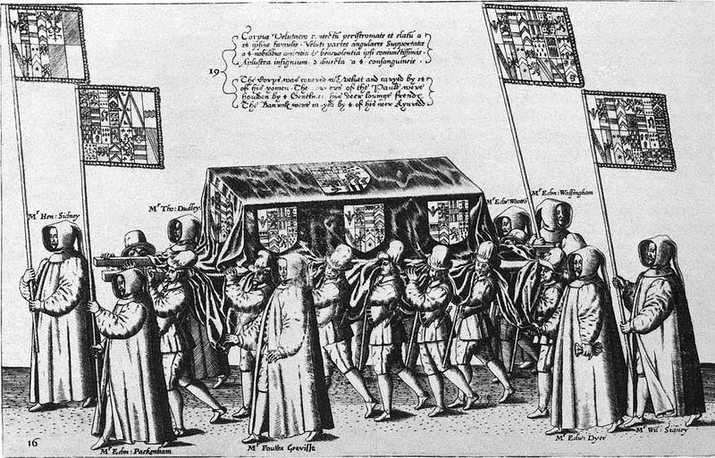
The casket of Sir Philip Sidney, Plate 16 from Procession at the Obsequies of Sir Philip Sidney by Thomas Lant, engraved by Theodor de Bry

Slide 18
His other works:
The Lady of May – This is one of Sidney's lesser-known works, a masque written and performed for Queen Elizabeth in 1578 or 1579.
The Countess of Pembroke's Arcadia – The Arcadia, by far Sidney's most ambitious work, was as significant in its own way as his sonnets. The work is a romance that combines pastoral elements with a mood derived from the Hellenistic model of Heliodorus. In the work, that is, a highly idealised version of the shepherd's life adjoins (not always naturally) with stories of jousts, political treachery, kidnappings, battles, and rapes. As published in the sixteenth century, the narrative follows the Greek model: stories are nested within each other, and different storylines are intertwined. The work enjoyed great popularity for more than a century after its publication..

Slide 19
Cont.
William Shakespeare borrowed from it for the Gloucester subplot of King Lear; parts of it were also dramatised by John Day and James Shirley. According to a widely-told story, King Charles I quoted lines from the book as he mounted the scaffold to be executed; Samuel Richardson named the heroine of his first novel after Sidney's Pamela. Arcadia exists in two significantly different versions. Sidney wrote an early version (The Old Arcadia) during a stay at Mary Herbert's house; this version is narrated in a straightforward, sequential manner. Later, Sidney began to revise the work on a more ambitious plan, with much more backstory about the princes, and a much more complicated story line, with many more characters. He completed most of the first three books, but the project was unfinished at the time of his death—the third book breaks off in the middle of a swordfight.

Slide 20
There were several early editions of the book. Fulke Greville published the revised version alone, in 1590. The Countess of Pembroke, Sidney's sister, published a version in 1593, which pasted the last two books of the first version onto the first three books of the revision. In the 1621 version, Sir William Alexander provided a bridge to bring the two stories back into agreement.<Evans, 12-13> It was known in this cobbled-together fashion until the discovery, in the early twentieth century, of the earlier version.

Slide 21
An Apology for Poetry (also known as A Defence of Poesie and The Defence of Poetry) – Sidney wrote the Defence before 1583. It is generally believed that he was at least partly motivated by Stephen Gosson, a former playwright who dedicated his attack on the English stage, The School of Abuse, to Sidney in 1579, but Sidney primarily addresses more general objections to poetry, such as those of Plato. In his essay, Sidney integrates a number of classical and Italian precepts on fiction. The essence of his defence is that poetry, by combining the liveliness of history with the ethical focus of philosophy, is more effective than either history or philosophy in rousing its readers to virtue. The work also offers important comments on Edmund Spenser and the Elizabethan stage.

Slide 22
- Amal Mubarak AL.Dossary
- Aisha Abdullah AL.Sarawi
- Noura Ali AL.Bouanin
- Shahla Abdullatif AL.Fehaid
- Sara Khalid AL.Rashid

