Slide 1

The Victorians
At Home and At Work

Slide 2
What were they like?
Were they conservative?
They called for changes and reforms.
Were they insular?
They travelled to trade, fight, explore, build or for “curiosity’s sake”.
Were they narrow-minded?
They were imaginative and innovative in all sphere of knowledge.
Notes:
avelle

Slide 3
.
Were they church-goers?
It varied. Free thinkers were outspoken, and stood by their non-belief.
Were they prudish?
Their moral attitudes was closer to “open frankness” the of 18th century than previous generations.

Slide 4
The Aristocracy
Mathew Arnold: “ One has often wondered whether upon the whole earth there is anything so unintelligent, so unapt to perceive how the world id really going, as an ordinary young Englishman of our upper class.”
-They were “unimaginably rich”, they inherited their forefathers values, estates and money.
-They saw themselves superior to others. They neglected the troubles of others.
-They enjoyed “full-time leisure”. Ex. Hunting – shooting.
Arnold called them “Barbarians”. They knew nothing about their roles and responsibilities in society

Slide 5
The Middle Classes
- They gave the Victorian community its “backbone”.
They demanded the right to elect the leaders.
They created the conventions and values of the age.
They caused the railways, factories … to be constructed
They fought for “ better living and working conditions for all the community”.
They achieved more than “Magna Carta”.
They lived by the motto “ Time is money”, they sacrificed everything for business.
They were called by Arnold “Philistines”.

Slide 6
The Working Classes
The British workman did different kinds of jobs. He built canals, railways, bridges. He drove locomotives and sailed the ships. He farmed and served in houses and offices.
Engel: “ this race must really have reached the lowest stage of humanity.”
Their conditions got better after many acts have been passed.

Slide 7
Shared Values
Confidence – in themselves, in their country and in their way of life. They believed in their efforts. Many of them were self-employed.
Self-satisfaction – Victorians felt superior to other nations. They watched revolutions that took over Europe. They were aware of their success in commerce and building of railways. They believed that their country took the lead.
Colonialism – Though Victorians were blamed for their ruthless colonialism, many questioned the mortality of imperialism and its actions in far-off lands.

Slide 8
The Victorians at Home

Slide 9
- Many country people migrated to the towns. And towns spread farther into the country,
Domestic arts flourished. Periodicals were entitled Home Friend, Cassell’s Family Magazine ….
Every country has its own leading family living in the “big house”. Ex. Chatsworth, Hatfield.
The aristocracy spent part of the year in towns. Ex. Mayfair, Belgravia. And the rest of the year from April to July was spent in the country.
In towns, successful doctors, lawyers and entrepreneurs could afford to have houses.

Slide 10
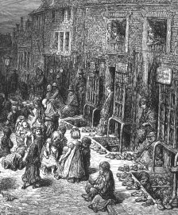
The impecunious ( penniless) crowded in lodging-houses. Those who could afford it, built or rented houses.
Working people lived in rooms in old houses ( slums ). The limited facilities that existed were communal. The children spend their times in streets due to the lack of comfort and facilities.
With time, housing conditions were improved.

Slide 11
The Victorians at Work

Slide 12
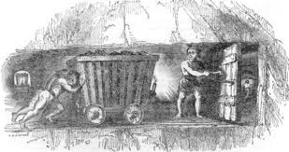
- The middle class Victorians considered work to be the “honest toil”. It was something sacred.
Carlyle: “ Blessed is he who has found his work. “
Upper classes tried to give the illusion of practicing in the national efforts.
The lower classes had to do the dirty work.
Working conditions and wages were the result of bargaining until the Trades Union was legalised in 1871. Employers would look for cheapest labour they could get like women and children.

Slide 13
It was the middle classes who called for the lower classes rights and made them aware of their human rights.
Ex. 1844 Factory Act

Slide 14
Education

Slide 15
In the first half of the Victorian era, schools existed. But there was no obligation for children to attend.
Victorians believed that spiritual welfare depended on intellectual enlightenment.
Tennyson: “ Let knowledge from more to more.”
After 1870, elementary education was available for all, with reasonable prices.
National schools were run by the Church of England. Many villages and small towns had a parish or charity school.
Those who could afford it hired a governess.

Slide 16
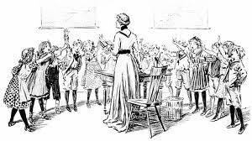
In 1880, attendance became compulsory for children between 5 and 10.
The education of girls was still behind. There was the foundation of the Girls Public Day School Trust in 1872. Colleges for women were established at Oxford and Cambridge.
Victorians valued art. Many museums were built during that time.

Slide 17
Travel
and
Communication

Slide 18
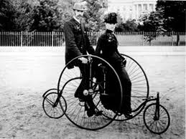
At the beginning of the Victorian era, primary form of communication was the stage-coaches. Prices of coach travel were high, consequently it was only for the fortunate. The majority travelled on foot or by waggon.
The railways brought about a great social revolution that any other factor in British history. By 1848, a network of routes was constructed which covered every part of the country.
In the 1850s and 1860s bicycles and tricycles were developed. At first, cycling was a leisure activity for upper classes. Then it was within the reach of all.

Slide 19
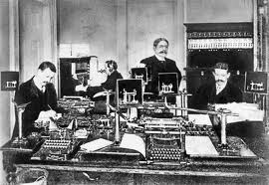
Another revolution was the expansion of the British canal system. Steamships were established.
Telecommunication: telegraph and telephone

Slide 20
Health
And
Sickness

Slide 21
- Remarkable progress in medical science, anaesthetics, vaccinations, sanitation, better hospitals.
Upper classes hired family doctors.
National and regional Boards of Health were established : sewers were built, enforcement of compulsory vaccination.

Slide 22
e
Exercise became an integral part of the British way of life.
The two great evils of Victorian Britain were drinking and prostitution.

Slide 23
Invention
and
Exploration

Slide 24
-”Even when the pursuit of knowledge had no conceivable practical application, it had a positive aim. The Victorian who believed himself to be the heir to all the ages wanted to feel he had the control of his inheritance. Just as the fruits and products of the entire world flowed into his warehouses and museums, so knowledge and wisdom from all ages and all places were garnered in his libraries and laboratories. And where there were gaps, he set about filling them.”
- The British Association for the Advancement of Sciences was founded in 1831.

