Slide 1


Lecture 1
Psychlinguistics
Overwiew

Slide 2
Psycholinguistics
Definitions
Branches and Goals
Language Processing
Language Acquisition
Neurolinguistics

Slide 3

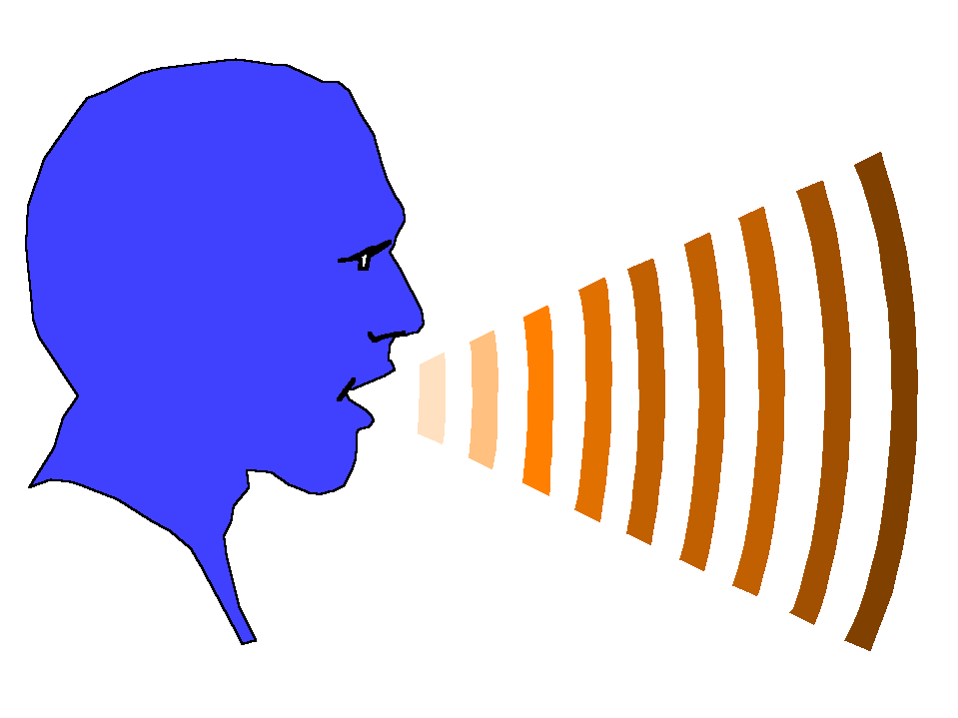
Psychology Linguistics
Psycholinguistics
Definitions

Slide 4

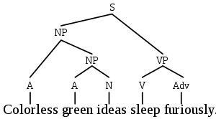
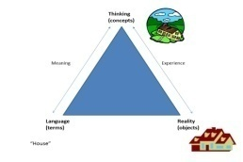
Linguistics
Psycholinguistics
Sociolinguistics Historical linguistics Computational Linguistics
Linguistics
Phonetics Morphology Semantics
Phonology Syntax Pragmatics

Slide 5


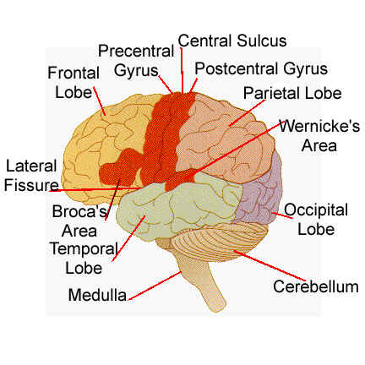
Branches and Goals
language processing
Language acquisition
Neurolinguistics

Slide 6
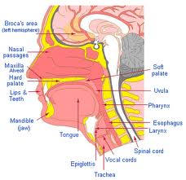
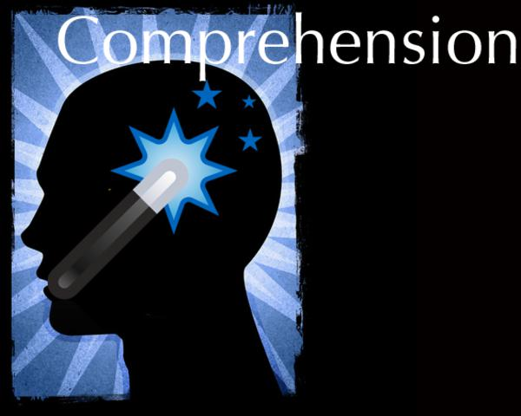
Language Processing
Speech production
Comprehension

Slide 7
Language Acquisition
Acquisition studies
Strategies
Phases

Slide 8
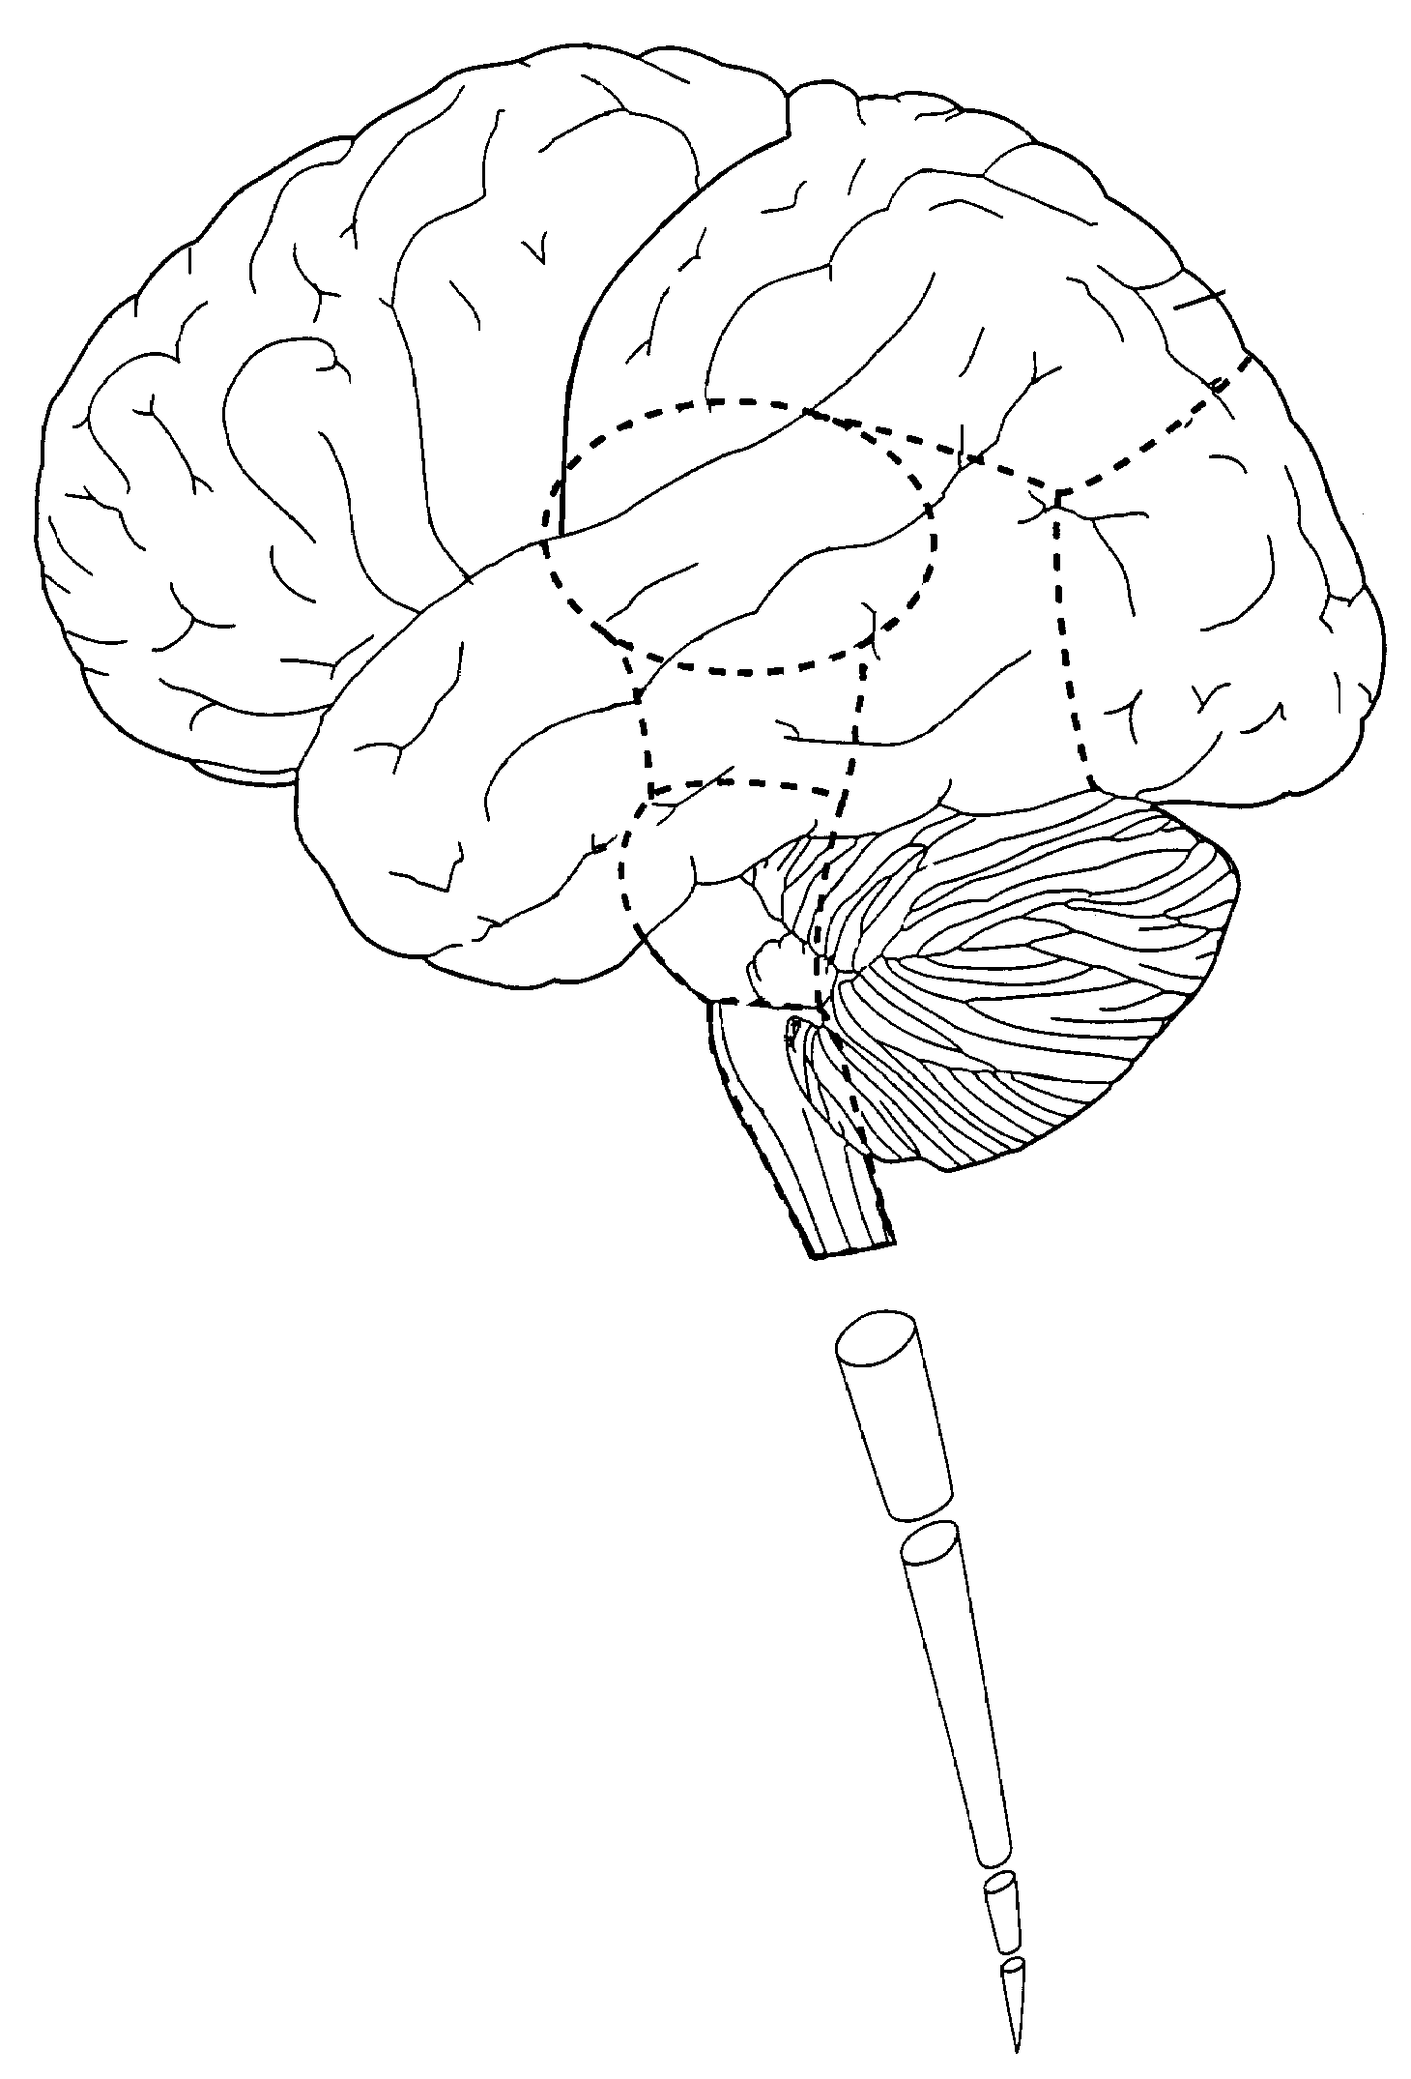
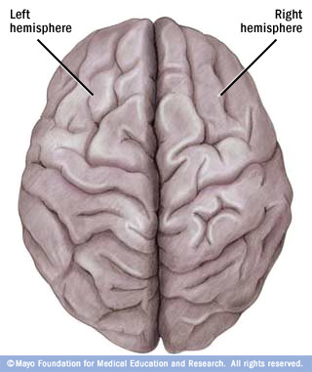

Neurolinguistics
The CNS
Brain centres
Language disorders

Slide 9
Definitions
Semantics: The study of the meaning of words and sentences
Syntax: The study of grammatical arrangement of words in a sentence or phrase or the study of sentence structure
Phonology: The study of the sound systems of languages
Pragmatics: The study of the factors influencing how language is used in a social context

Slide 10
Definitions
linguistics: The scientific study of the language
Psychology: The scientific study of the human mind
Psycholinguistics: The study of language in relation to mental processes
Psycholinguistics or psychology of language is the study of the psychological and neurobiological factors that enable humans to acquire, use, comprehend and produce language.

