Slide 1
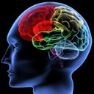

Lecture 3
Language and the Brain (Part 1)

Slide 2
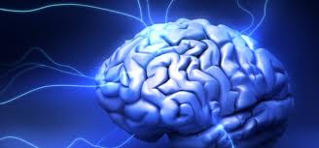
NUEROLINUISTICS
Neurolinguistics: The study of how language is represented and processed in the brain.
This involves attempting to combine theory from neurology & Neurophysiology ,(how the brain is structured and how it functions) with linguistic theory, (how the language is structured and how it functions).

Slide 3
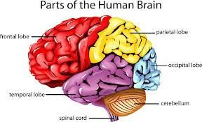
THE BRAIN
The role of the brain in language functioning has been a central concern in psycholinguistic inquiry.
So, it is only natural that we take a brief look at the brain and the areas that have been identified for language.

Slide 4
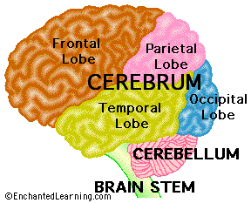
THE BRAIN
Your brain is your most powerful organ, yet weighs only about three pounds. It has a texture similar to firm jelly. The brain is composed of the cerebrum , cerebellum , and brainstem .

Slide 5
THE BRAIN
The cerebrum fills up most of your skull. It is involved in remembering, problem solving, thinking, and feeling. It also controls movement.
The cerebellum sits at the back of your head, under the cerebrum. It controls coordination and balance.
The brain stem sits beneath your cerebrum in front of your cerebellum. It connects the brain to the spinal cord and controls automatic functions such as breathing, digestion, heart rate and blood pressure

Slide 6
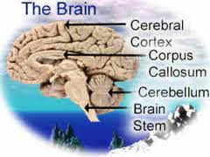
THE CEREBRUM
The cerebrum is the largest part of the brain and is composed of right and left cerebral hemispheres . It performs higher functions like interpreting touch, vision and hearing, as well as speech, reasoning, emotions, learning, and fine control of movement.

Slide 7
THE CEREBRAL CORTEX
The cerebral cortex is the outermost sheet of neural tissue of the cerebrum of the brain. It covers the cerebrum and is divided into left and right hemispheres. The cerebral cortex plays a key role in memory, attention, perceptual awareness, thought, language, and consciousness. It consists of up to six horizontal layers, each with a different composition in terms of neurons and connectivity. The human cerebral cortex is 2 to 4 millimeters thick.

Slide 8
THE CEREBRAL CORTEX
The cerebral cortex is the gray wrinkled outermost covering of the brain. It sits over the rest of the brain and accounts for language representation and processing.
The cerebrum contains about 70 - 75% of the 100 billion neurons of the brain. The gray matter has a folded structure.

Slide 9
THE CEREBRAL CORTEX
The cerebral cortex, is composed of six thin layers of neurons, which sit on top of a large collection of white matter pathways. The cortex is heavily convoluted, so that if you were to spread it out, it would actually take up about 2 1/2 square feet (2500 sq cm). It includes about 10 billion neurons, with about 50 trillion synapses.

Slide 10
THE CEREBRAL CORTEX
The folding of the cortex increases the brain’s surface area allowing more neurons to fit inside the skull and enabling higher functions. Each fold is called a convolution or gyrus , and each groove between folds is called a sulcus .
The longitudinal fissure separates the left and right hemispheres of the brain.
The corpus callosum is the bundle of nerve fibers that connects the two hemispheres.

Slide 11
THE CEREBRAL CORTEX
Specific regions of the cortex:
Interpret sensations from your body, and sights, sounds and smells from the outside world.
Generate thoughts, solve problems and make plans.
Form and store memories.
Control voluntary movement.

Slide 12
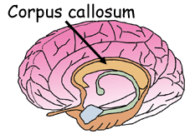
THE CORPUS CALLOSUM
The two cerebral hemispheres are connected by a thick, tough band of neural fibers (axons) called the corpus callosum. The corpus callosum allows the left and right hemispheres to communicate with each other”.
It has been a widely accepted fact that the right and left hemispheres of the brain have control over different bodily functions and tasks, referred to as hemispheric specialization or brain lateralization. However, despite their differences, both hemispheres do share the common understanding of language and are physically connected by the corpus callosum.
Notes:
The corpus callosum is a wide, flat bundle of neural fibers beneath the cortex in the eutherian brain . It connects the left and right cerebral hemispheres and facilitates interhemispheric communication. It is the largest white matter structure in the brain.

Slide 13
THE CORPUS CALLOSUM
The corpus callosum connects the left and right cerebral hemispheres and facilitates communication between the hemispheres. It is the largest white matter structure in the brain, consisting of 200–250 million myelinated axons.
Notes:
The corpus callosum is a wide, flat bundle of neural fibers beneath the cortex in the eutherian brain . It connects the left and right cerebral hemispheres and facilitates interhemispheric communication. It is the largest white matter structure in the brain.

Slide 14
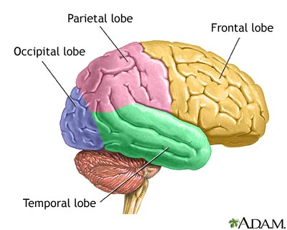
LOBES OF THE CEREBRUM
Each of the two cerebral hemispheres has four major areas or lobes.
The Occipital lobe is involved in processing and creating visual information.
The Temporal lobe is involved in hearing, memory, emotion, language comprehension(Wernicke’s area) , Sequencing and organization and it further processes visual information.

Slide 15
LOBES OF THE CEREBRUM
The Frontal lobe is involved in thought, imagination, planning (including planning and execution of movements), language, acting, learning, personality, behavior, emotions, judgment, problem solving, and speech: speaking and writing (Broca’s area) body movement (motor strip) Intelligence, concentration, and self awareness.
The Parietal lobe is involved in further processing of visual information, it also receives motor and sensory information (Sense of touch, pain, temperature) from the rest of the body.

Slide 16
THE BRAIN STEM
located at the base of the brain, the brain stem includes the midbrain , pons , and medulla oblongata. It acts as a relay center connecting the cerebrum and cerebellum to the spinal cord and performs many of the body’s automatic functions. e.g. it keeps our heart pumping, our lungs breathing. It controls our digestion, blood pressure and other autonomic functions. It also controls the information that goes into and out the brain through the spinal cord. Many neurotransmitters are produced in the brainstem. Including those involved in keeping us awake or asleep.

Slide 17
CEREBELLUM
Second largest portion of the brain located beneath the posterior part of the cerebrum; aids in coordinating voluntary body movements and maintaining balance and equilibrium.

Slide 18
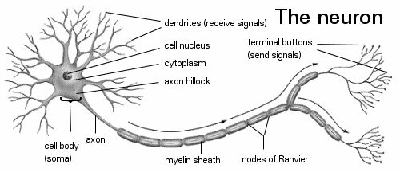
NEURONS
The brain is composed of neurons, nerve cells that are the basic information processing units of the nervous system. The neuron is the nervous system cell. It is the working unit of our nervous system. It carries, processes and transmits electrical signals at incredible speeds. Neurons connect with thousands of other neurons. Their connections are called synapses.

Slide 19
LATERALIZATION
Through lateralization, the left hemisphere has been identified as the language brain due to the presence of language processing areas there.

Slide 20
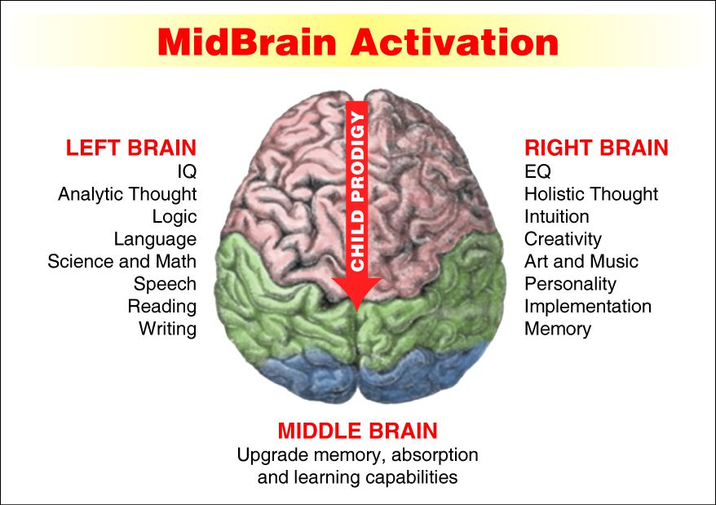
LATERALIZATION

Slide 21
In terms of muscle movement, each hemisphere is responsible for half of the body – contralateral responsibilities.
  Right hemisphere -> left side of body
  Left hemisphere -> right side of the body
In terms of higher cognitive functions, the hemispheres are lateralized –
  Left hemisphere -> analytic tasks
    Math, Language
  Right hemisphere -> recognition of complex patterns
    Faces, Melodies
FUNCTIONS OF THE BRAIN HEMISPHERES

Slide 22
Left-hemisphere:
  Sequential analysis
    Analytical
    Problem solving
  Language
Right-hemisphere:
  Simultaneous analysis
    Synthetic
  Visual-Spatial skills
    Cognitive maps
    Personal space
    Facial recognition
    Drawing
  Emotional functions
    Recognizing emotions
    Expressing emotions
  Music
LATERALIZATION OF THE BRAIN FUNCTIONS

Slide 23
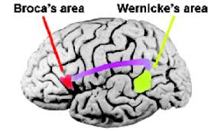
THE LANGUAGE HEMISPHERE
The center for speech is in the left
hemisphere of the cerebral cortex.
Two areas known as the Broca’s area
and the Wernicke’s area are involved
in storing information related to speech.

Slide 24
BROCA’S AREA
Located at the base of the motor cortex.
Broca’s area stores information needed for speech production. It is responsible for programming the motor cortex to move the tongue, lips and speech muscles to articulate words.
In simple terms, once a linguistic stimulus is processed and understood, impulses will be sent out from Broca’s area to order the speech mechanism to form the right response.

Slide 25
WERNICKE’S AREA
Wernicke’s area stores information needed for arranging the words of a learned vocabulary into meaningful speech.
This is part of the left hemisphere that has been identified as the comprehension center. Linguistic stimuli, either visual or auditory, are turned into electrical impulses and processed in this area.
We could say that it is this area that does the actual listening and seeing.

Slide 26
ARCUATE FASCICULUS
A white matter tract that connects Broca’s area and Wernicke’s area through the Temporal, Parietal and Frontal lobes. Allows for coordinated comprehensible speech.

Slide 27
MOTOR CORTEX
Motor cortex is an area that generally controls movement of the muscles( hands, feet, arms..etc) it sits close to Broca’s area. This area is involved in the physical articulation of speech.

Slide 28
APHASIA
Also known as language disorders, are caused by damage to the language processing areas of the brain, namely Broca’s and Wernicke’s areas. Damage or lesions to these areas could cause serious language impairment.
Aphasia causes problems in the ability to perceive, process, or produce language. Aphasia occurs in various forms and degrees, depending upon the situation, extent, and severity of the cerebral lesions which is responsible.
The cause of the brain injury may be a stroke, a severe blow to the head, a brain tumor, or brain infection.

Slide 29
BROCA’S APHASIA
Broca’s aphasia would affect speech production. Speech that is produced becomes short, almost telegraphic in nature. The language is however meaningful. In simple terms, although the input is understood, the response is impaired because impulses cannot get through from Broca’s area.
Example:
“Cookie jar…fall over…chair…water…empty…ov…ov…[Examiner: “overflow?”] Yeah.”
(Heny 637)

Slide 30
BROCA’S APHASIA
Lesions in the left inferior frontal region (Broca’s area)
Nonfluent, labored, and hesitant speech
Most also lost the ability to name persons or subjects (anomia)
Can utter automatic speech (“hello”)
Comprehension relatively intact
Most also have partial paralysis of one side of the body (hemiplegia)
If extensive, not much recovery over time

Slide 31
WERNICKE’S APHASIA
Werniche’s aphasia is characterized by speech that is nonsense or meaningless, though it is phonologically and grammatically accurate. In simple terms, input that is received cannot be deciphered. As a result it is not understood. Hence, this amounts to nonsensical response.

Slide 32
WERNICKE’S APHASIA
Well, this is…mother is away here working out o’here to get her better, but when she’s working, the two boys looking in the other part. One their small tile into her time here. She’s working another time because she’s getting, too.”
(Heny 638)

Slide 33
WERNICKE’S APHASIA
In girls we see many happy days.
I’ll challenge a new bike.
I surprise no new glamour.
Is there three chairs in this room?
Mike and Peter is happy.
Bill and John likes hot dogs.

Slide 34
CENTRAL APHASIA
Central aphasia or Goldstein, syntactical aphasia
This results from damage to the arcuate fasciculus which results in severing the connection between the Broca's and Wernicke's areas. Patients understand speech and correctly interpret words from the mental lexicon but will not be able to transmit information to Broca's area so that words can be articulated.

Slide 35
BROCA’S APHASIA
Pierre Paul Broca made the first diagnosis of the condition resulting from damage to the Broca’s area. That condition has since been named Broca’s aphasia, and it involves a lack of ability to produce coherent language, including spoken, written or signed forms.
Patients suffering from Broca’s aphasia are able to use the organs of speech, the articulators, to produce sounds and even single words, but they cannot produce sentences or express thoughts.

Slide 36
WERNICKE’S APHASIA
Lesions in posterior of the left superior temporal gyrus, extending to adjacent parietal cortex
Fluent speech
But contains many paraphasias
  “girl”-“curl”, “bread”-“cake”
Syntactical but empty sentences
Cannot repeat words or sentences
Unable to understand what they read or hear
Usually no partial paralysis

Slide 37
WERNICKE’S APHASIA
Often, patients will find one word or a short string of words, and repeat them over and over in an attempt to communicate thoughts and may sometimes be successful in communicating but they will not be able to grammatically express themselves. Similarly, they can draw, but are not capable of writing coherent speech.
The key is that they can understand speech and often can form ideas to communicate, but they cannot put words together to communicate those ideas.

Slide 38
LEFT BRAINS
It has been suggested over the years that problems with Broca’s area may be able to be compensated for by other areas of the brain, including the corresponding area of the non-dominant hemisphere. This suggestion is due to the somewhat transient nature of Broca’s aphasia symptoms as stroke and injury victims can regain use of their speech mechanisms.
Stuttering has also been linked to areas encompassed by Broca’s area, though this disorder is not well understood or explained.

Slide 39
RIGHT BRAINS
Patients suffering from damage to Wernicke’s area have difficulty in understanding language in any form. They can speak fluently, forming long and complex sentences, but their strings of words often lack coherent meaning. They frequently use vague terms and roundabout descriptions that never coalesce into complete thoughts.

Slide 40
RIGHT BRAINS
From the prolific speech production of patients, it is easy to see that this is not a difficulty with speech production but with language production. It has also been shown that damage to Wernicke’s area is not as transient as that done to Broca’s area.

Slide 41
Split-brain
Split-brain patients are good examples of lateralization of language functions.
Epileptic activity spreads from one hemisphere to the other through corpus callosum
Since 1930, such epileptic treated by severing the interhemispheric pathways.

Slide 42
THE ANATOMY AND PHYSIOLOGY OF SPEECH
The source for acoustic energy for speech sound production comes from modulation in the air flowing from the lungs to the lips called “air stream”.
We breathe in air into our lungs to serve as the power supply for the production of speech.
During regular quiet breathing, the vocal tract is open and the air flows freely either through the nose or mouth.

Slide 43
THE ANATOMY AND PHYSIOLOGY OF SPEECH
Some sounds are produced by modeling the air stream by the periodic opening and closing of the vocal folds of the glottis.
The voiced or phonated sounds have a buzz-like quality. You can actually feel the vibration of your vocal folds by placing your fingers on your throat when you produce the sustained [z].
Sounds produced without the regular glottal pulsing are called voiceless sounds. You can feel the absence of vibration when you produce the sustained [s].

Slide 44
SUMMARY
In this topic we have identified the brain and the areas that have been identified for language are:
the language hemisphere of the brain
The Broca's area and the Wernicke's area
Aphasia
The Physiology of Speech

