Slide 1
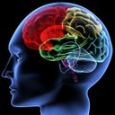

Lecture 4
Language and the Brain (Part 2)

Slide 2
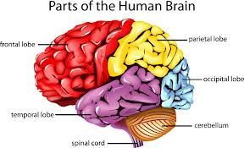
THE BRAIN
For most people the areas of the brain involved in language processing are the frontal and the temporal areas of the left hemisphere. This is true whether a language is spoken or whether it is a signed language.
How the brain processes language
Is the brain hard wired for language ?

Slide 3
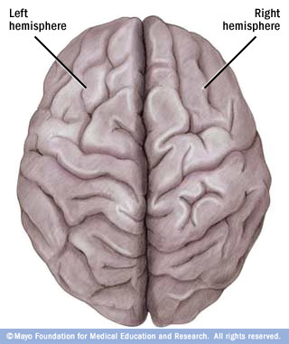
Language is primarily a left hemisphere operation. When there is damage in specific areas in the left hemisphere, we see language impairment
Aphasia is an impairment of language, usually caused by left hemisphere damage either to :
  Broca's area (impaired speaking) or to
  Wernicke's area (impaired understanding).
THE BRAIN

Slide 4
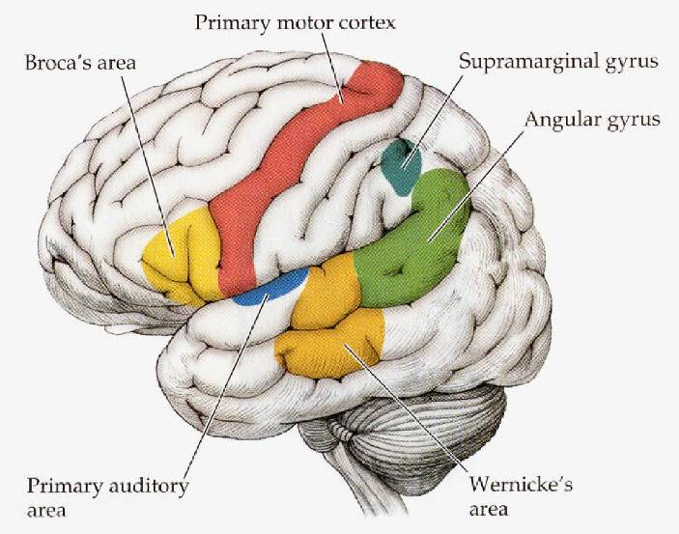
LANGUAGE CENTRES IN THE BRAIN
The visual cortex: receives written words as visual stimulation.
it is needed to process anything we see including words in reading.
angular gyrus: transforms visual representations into an auditory code.
In the Angular Gyrus you transforming the visual representations into a voice in your head ( like when you read to yourself) auditory code.

Slide 5
LANGUAGE CENTRES IN THE BRAIN
Wernicke's area: interprets auditory code.
Broca's area: controls speech muscles via the motor cortex (the frontal lobe Broca's area tells the motor cortex what to say) ( language production)
Motor cortex: word is pronounced

Slide 7
Brain activity when hearing, seeing, and speaking words
Hearing words
Auditory cortex & Wernicke's area
Seeing words (reading)
Visual cortex & angular gyrus
Speaking words
Broca's area and the motor cortex

Slide 8
Specialization and Integration
Neuroscientists now agree that running around the lateral sulcus in the left hemisphere of the brain, there is a sort of neural loop that is involved both in understanding and in producing spoken language. At the frontal end of this loop lies Broca's area, which is usually associated with the production of language, or language outputs . At the other end (more specifically, in the superior posterior temporal lobe), lies Wernicke's area, which is associated with the processing of words that we hear being spoken, or language inputs. Broca's area and Wernicke's area are connected by a large bundle of nerve fibers called the arcuate fasciculus.
Notes:
The arcuate fasciculus (Latin, curved bundle) is the bundle of axons connecting the Wernicke's area to the Broca's area.

Slide 9
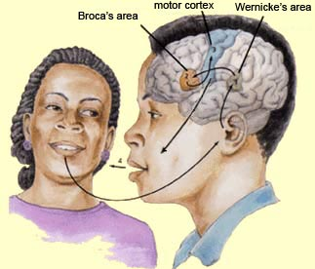
WERNICKE-GESCHWIND MODEL OF SPOKEN AND WRITTEN LANGUAGE FUNCTIONS IN THE BRAIN
A first model of the general organization of language functions in the brain was proposed by American neurologist Norman Geschwind in the 1960s and 1970s. This “connectionist” model drew on the lesion studies done by Wernicke and his successors and is now known as the Geschwind-Wernicke model.

Slide 10
WERNICKE-GESCHWIND MODEL OF SPOKEN AND WRITTEN LANGUAGE FUNCTIONS IN THE BRAIN
According to this model, each of the various characteristics of language (perception, comprehension, production, etc.) is managed by a distinct functional module in the brain, and each of these modules is linked to the others by a very specific set of serial connections. The central hypothesis of this model is that language disorders arise from breakdowns in this network of connections between these modules.

Slide 11
WERNICKE-GESCHWIND MODEL OF SPOKEN AND WRITTEN LANGUAGE FUNCTIONS IN THE BRAIN
1. REPEATING A SPOKEN WORD
According to this model, when you hear a word spoken, this auditory signal is processed first in your brain’s primary auditory cortex, which then sends it on to the neighboring Wernicke’s area . Wernicke’s area associates the structure of this signal with the representation of a word stored in your memory, thus enabling you to retrieve the meaning of the particular word.

Slide 12
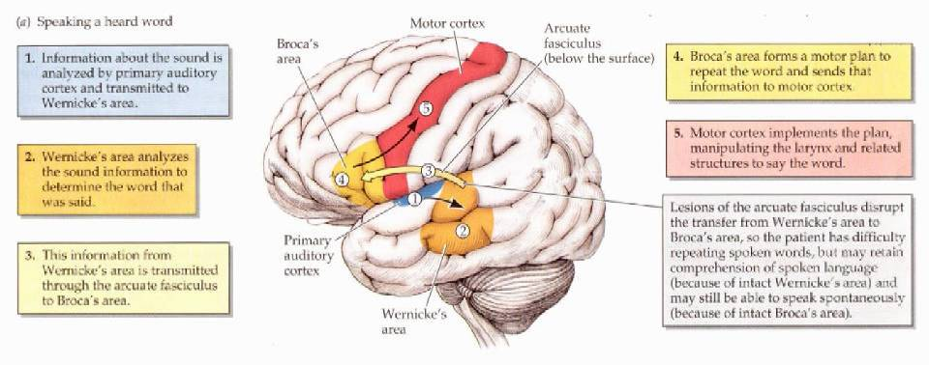
WERNICKE-GESCHWIND MODEL OF SPOKEN AND WRITTEN LANGUAGE FUNCTIONS IN THE BRAIN
1. REPEATING A SPOKEN WORD
Notes:
Arcuate fasciculus is the bridge from the Wernicke’s area to the Broca’s area

Slide 13
WERNICKE-GESCHWIND MODEL OF SPOKEN AND WRITTEN LANGUAGE FUNCTIONS IN THE BRAIN
1. REPEATING A WRITTEN WORD
In contrast, when you read a word aloud, the information is perceived first by your visual cortex, which then transfers it to the angular gyrus , from which it is sent on to Wernicke’s area.

Slide 14
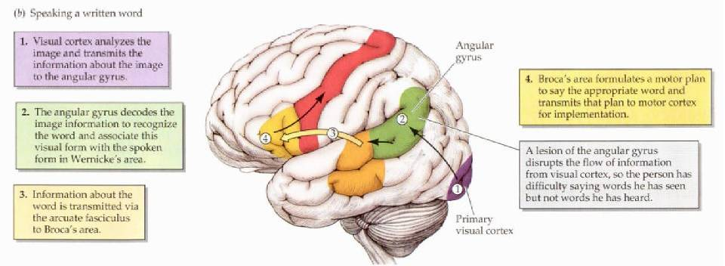
WERNICKE-GESCHWIND MODEL OF SPOKEN AND WRITTEN LANGUAGE FUNCTIONS IN THE BRAIN
1. REPEATING A WRITTEN WORD
Notes:
Angular gyrus is the gateway from visual cortex to Wernicke’s area

Slide 15
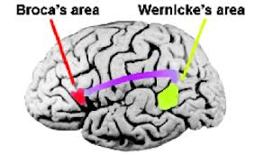
SPEAKING THE HEARD WORD
To speak a word that is heard, information must first get to the primary auditory cortex. From the primary auditory cortex, information is transmitted to the posterior speech area, including Wernicke’s area. From Wernicke’s area, information travels to Broca’s area, then to the Primary Motor Cortex.

Slide 16
SPEAKING THE WRITTEN WORD
To speak a word that is read, information must first get to the primary visual cortex. From the primary visual cortex, information is transmitted to the posterior speech area, including Wernicke’s area. From Wernicke’s area, information travels to Broca’s area, then to the Primary Motor Cortex.

