Slide 1
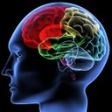

Lecture 2
Language

Slide 2
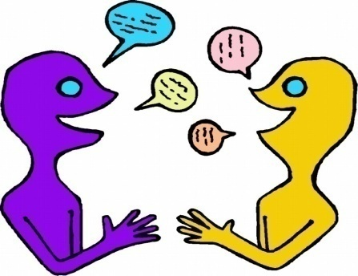

language
Language enables us to express our thoughts, ideas, and feelings to others and also to understand theirs. Linguistics is the scientific study of this rich and varied human ability. It seeks among others to answer a number of fundamental questions; for example , what is the nature of language?

Slide 3
language - Definition
Language is the institution whereby humans communicate and interact with each other by means of habitually-used, oral-auditory, arbitrary symbols.
(R.A. Hall. 1968 An Essay on Language. New York.

Slide 4
LANGUAGE
Let's look at key words in more detail.
Humans: language is confined to humans? Animals communicate with one another, however, all animal communication systems lack the ability to communicate about anything beyond the here and now. So language is confined to humans in a strict sense.
Communication and interaction: certainly, animals communicate and interact, yet the communications system the humans use is more complicated than that of animals.

Slide 5
LANGUAGE
Language is used habitually: people use language everywhere and every day and usually with little cognitive effort. Words and sentences seem to follow out of the mouth in a subconscious almost automatic way.
Language is used oral-auditorily: the oral-auditory channel; communication via the mouth and the ear is the most important mode of human communication and English has reserved a special label for it namely speech.

Slide 6
PROPERTIES OF HUMAN LANGUAGE
Mode of Communication:
  Vocal-auditory
Interchangeability:
  Individuals who use a language can both send and receive any permissible message within that communication system.

Slide 7
Semanticity:
Words or signs or symbols stand for other things (e.g., objects, actions, or concepts); the symbols or words should evoke a mental representation of the objects that they symbolize.
Arbitrariness:
There is no logical connection between the form of the signal and its meaning. The symbols that stand for things have no inherent relationship with the thing they stand for (e.g., different languages actually have different symbols for the same thing, pomme = apple)
Animal communication: a strong link between the signal and message: an animal wishes to warn off an opponent may simulate an attacking attitude-cats
In human language: Mostly no link between the signal and the message. The symbols used are arbitrary.
Onomatopoeic words are exceptions: miuow…

Slide 8
Discreteness:
Messages in the system are made up of smaller, repeatable parts; the sounds of language are perceived categorically, not continuously.

Slide 9
Displacement:
linguistic messages may refer to things remote in time and space, or both, from the site of the communication.
  Animals: communicate in the immediate environment only. For ex. A bird utters its danger cry when danger is present like baby’ emotional cries of pain, hunger…
  Human language can cope with any subject whatever, and it does not matter how far away the topic of conversation is in time and space.

Slide 10
Productivity - Creativity
  Animals can send and receive very limited messages
  Humans can produce infinite novel utterences.
8. Acquisition through traditional transmission
Most animals automatically know how to communicate without learning= Genetically inbuilt. (Genetically inbult to develop in human). Bee-dancing is the same in colonies in diffrent part of the world.
Human language is culturally transmitted. A human being brought up in isolation doesn’t acquire language. Also there is innate predisposition towards language in a new-born child. This latent potentiality is activated by long exposure to language.

Slide 11
LANGUAGE
It is a grass roots phenomenon. It is the original wiki which aggregates the contributions of hundreds of thousands of people who invent jargon and slang
and new constructions some of them get accumulated into the language as people seek out new ways of expressing their thoughts. That's how we get a language in the first place.
6000 languages spoken on Earth
Language is a window into the human mind.

Slide 12
LANGUAGE
Language is not:
Written language: spoken language is found in all human cultures writing was invented by the Canaanites 3700 years ago.
Proper grammar
Thought

Slide 13
LANGUAGE
Language is not thought but, can affect thought
Linguistics has long been interested in the Linguistic Relativity Hypothesis or the Sapir- Whorf Hypothesis
( named after the two linguists who formulated it) namely that language can affect though.
Language systematically influences how one perceives and
conceptualizes the world.

Slide 14
LANGUAGE
There is a lot of controversy over the status of the Linguistic Relativity Hypothesis, but no one believes that language is the same thing as thought and that all of our mental life consists of reciting sentences.

Slide 15
How Language works
In a nutshell you can divide language into 3 topics:
Words: the basic components of sentences which are stored in our long-term memory which we can call the mental lexicon or the mental dictionary.
Rules: the recipes or algorithms that we use to assemble bits of language into more complex stretches of language (syntax, morphology, phonology)
Interfaces : (connect to the world) allow us to understand language coming from others and produce language so that others can understand us.

Slide 16
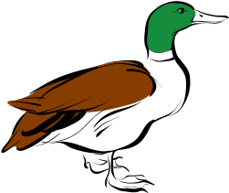
How Language works
The basic principle of the word was identified by the Swiss Linguist Ferdinand De Saussure ( 1857-1913) more than 100 years ago when he called attention to the arbitrariness of the sign e.g. the word duck (doesn't look like a duck or quack like a duck) its entry in the mental lexicon looks like this: a symbol for the word duck , specification for its sound [duhk] and
specification of its meaning

Slide 17
How Language works
Words: The mental lexicon is capacious ( a typical high school graduate has a vocabulary of 60,000 words which works out to the rate of learning of one new word every 2 hours starting from the age of 1.

Slide 18
Noam Chomsky
We don't just speak words, we combine them into phrases and sentences
The modern study of grammar is inseparable from the contributions of one linguist, the famous Noam Chomsky (Granddaddy of modern linguistics) who set the agenda for the field of linguistics for the last 60 years.

Slide 19
Noam Chomsky
Chomsky's contributions (insights) to linguistics:
Focus on Creativity or Productivity
Languages have a syntax unrelated to their meaning
Syntax doesn't consist of linear associations

Slide 20
Definitions
The mental lexicon is defined as a mental dictionary that contains information regarding a word's meaning, pronunciation, syntactic characteristics, and so on. Although this definition has been challenged over the years, this remains the most consistent definition of the term.

