Slide 1
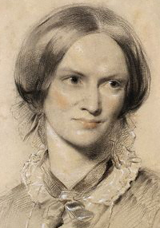
Charlotte Brontë

Slide 2
Biography
Born in 1816, Yorkshire
Family moved to Haworth
Daughters enrolled at the Clergy Daughter's School at Cowan Bridge
Took up many positions as governess to families in Yorkshire
Moved to Brussels
In 1849 Charlotte, visiting London, began to move in literary circles, making the acquaintance of Thackeray, Elizabeth Gaskell …
Married Arthur Bell Nicholls
Died with her unborn child in1855

Slide 3
Works
Charlotte and her siblings created their own literary fictional worlds, wrote stories about their imagined country “ Angria “
Collection of poetry under the name of Currer (1846 )
The Professor (1857 )
Jane Eyre: An Autobiography (1847 )
Shirley (1849 )
Villette (1853 )

Slide 4
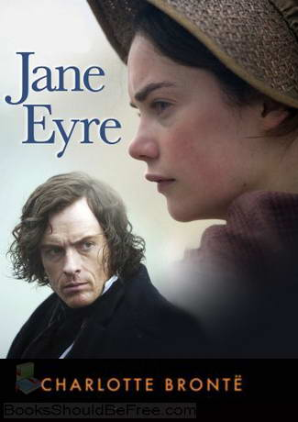
under the pen name Currer Bell
Published in 1847
under the pen name Currer Bell

Slide 5
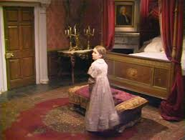
Gateshead Hall
( Reed’s House )
Jane Eyre is an orphan who lives with the Reeds.
Jane is mistreated and bullied by her aunt and cousins.
After a fight with her cousin, Jane is locked in the “red-room”.
Mrs. Reed decides to send Jane away to school.
Jane is accused of lying and deceit.
Jane confronts her aunt.

Slide 6
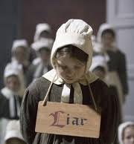
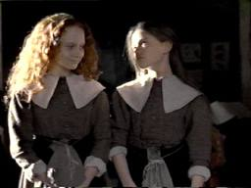
Lowood School
Jane learns that life at the school is harsh.
Jane finds consolation in her friendship with Helen Burns and Miss Temple.
Jane studies hard. She excels at drawing.
Helen dies of consumption.
Jane continues to excel in her studies and teaches for two years.
She decides to leave Lowood and advertises in search of a job as a governess.

Slide 7
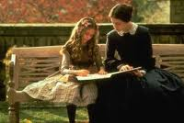
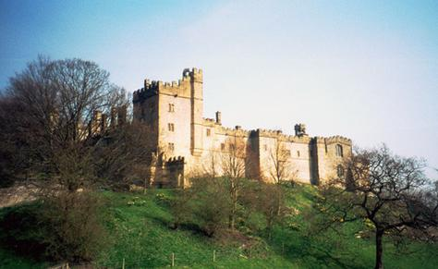
Thornfield Hall
Jane tutors Adele.
She helps a man whose horse has slipped, he turns out to be Mr. Rochester.
Jane learns about Mr. Rochester through Mrs. Fairfax.
Jane saves Rochester’s life after his bed curtains were on fire.
Jane begins to have feelings for Mr. Rochester.

Slide 8
Thornfield Hall
Jane is looked down upon by some of Rochester’s guests.
Rochester asks Jane for help with his injured quest Mr. Mason.
Jane goes back to Gateshead to visit her aunt Mrs. Reed who has suffered a stroke.
Jane is told about her uncle.

Slide 9
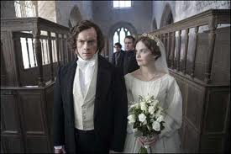
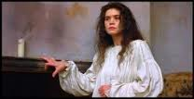
* A few days after her arrival at Thornfield, Jane confesses her love to Rochester and they decide to get married.
Jane becomes aware of her social inferiority to Rochester, and has nightmares before the wedding.
Jane and Rochester’s wedding is interrupted, and the truth is revealed.
Jane decides to leave Thornfield.

Slide 10
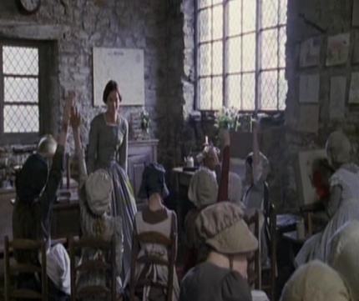
Moor House - Morton
Jane is taken in by the Rivers.
Jane finds a job in a charity school.
Jane inherits her dead uncle John Eyre.
St. john proposes to Jane who refuses his marriage proposal.
Jane decides to go back to Thornfield.

Slide 11
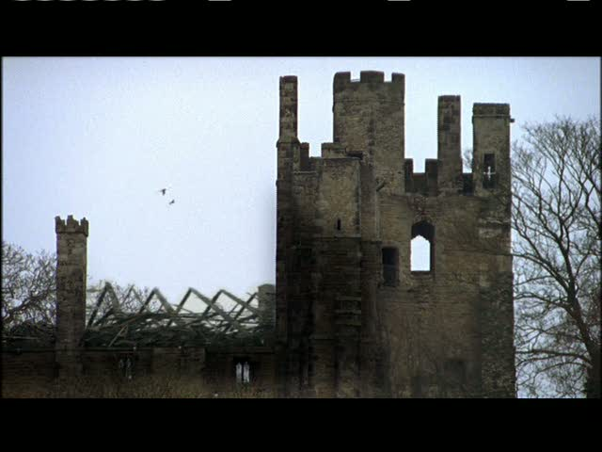
Ferndean
Thornfield is ruined as it has been burnt.
Bertha died and Rochester lost his hand and eyesight.
Rochester and Jane get married and live happily ever after.

Slide 12
search
Bildungsroman
Gothic Novel and its elements
Wide Sargasso Sea plot and author
Cinderella theme
Postcolonial theory in Jane Eyre
Realism in Jane Eyre

